Slide 2
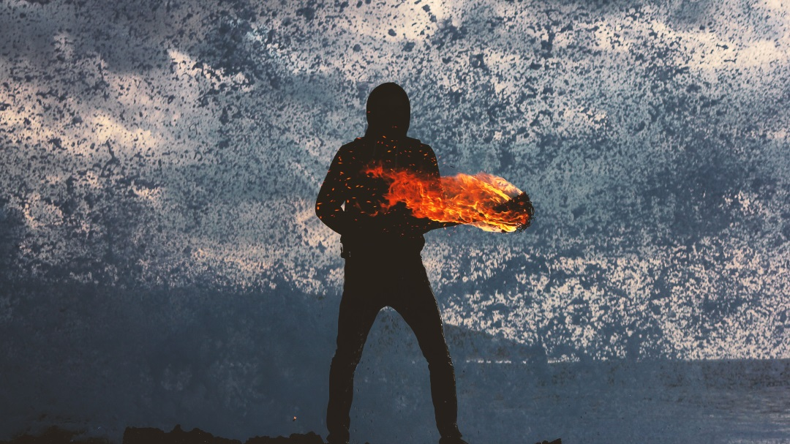
The Call and Power To Endure

Slide 3
Acts 1:6-9
So when they had come together, they asked him, “Lord, will you at this time restore the kingdom to Israel?”
⁷ He said to them, “It is not for you to know times or seasons that the Father has fixed by his own authority. ………

Slide 4
^{8 ……..} But you will receive power when the Holy Spirit has come upon you, and you will be my witnesses in Jerusalem and in all Judea and Samaria, and to the end of the earth.” ⁹ And when he had said these things, as they were looking on, he was lifted up, and a cloud took him out of their sight.

Slide 5
Mark 13:34-37
It is like a man going on a journey, when he leaves home and puts his servants in charge,
each with his work, and commands the doorkeeper to stay awake. …….

Slide 6
……. Therefore stay awake for you do not know when the master of the house will come, in the evening, or at midnight, or when the rooster crows, or in the morning ³⁶ lest he come suddenly and find you asleep. ³⁷ And what I say to you I say to all: Stay awake.”

Slide 7
Luke 12:45-47
But if that servant says to himself, ‘My master is delayed in coming,’ and begins to beat the male and female servants, and to eat and drink and get drunk,⁴⁶ the master of that servant will come on a day when he does not expect him and at an hour he does not know, and will cut him in pieces and put him with the unfaithful.

Slide 8
Luke 19:26-27
‘I tell you that to everyone who has, more will be given, but from the one who has not, even what he has will be taken away. ²⁷ But as for these enemies of mine, who did not want me to reign over them, bring them here and slaughter them before me.’”

Slide 9
Matthew 25:41-43 He will say to those on his left, ‘Depart from me, you cursed, into the eternal fire prepared for the devil and his angels. ⁴² For I was hungry and you gave me no food, I was thirsty and you gave me no drink, ⁴³ I was a stranger and you did not welcome me, naked and you did not clothe me, sick and in prison and you did not visit me. ………..

Slide 10
^{…….. 44} Then they also will answer, saying, ‘Lord, when did we see you hungry or thirsty or a stranger or naked or sick or in prison, and did not minister to you?’ ⁴⁵ Then he will answer them, saying, ‘Truly, I say to you, as you did not do it to one of the least of these, you did not do it to me.’ ⁴⁶ And these will go away into eternal punishment, but the righteous into eternal life.”

Slide 11
Revelation 2:4-5
But I have this against you, that you have abandoned the love you had at first. ⁵ Remember therefore from where you have fallen; repent, and do the works you did at first. If not, I will come to you and remove your lampstand from its place, unless you repent.

Slide 12
Revelation 2:10
Do not fear what you are about to suffer. Behold, the devil is about to throw some of you into prison, that you may be tested, and for ten days
you will have tribulation. Be faithful
unto death, and I will give you the crown of life.

Slide 13
Revelation 2:16
Therefore repent. If not, I will come to you soon and war against them with the sword of my mouth.

Slide 14
Revelation 2:24-26 But to the rest of you in Thyatira, who do not hold this teaching, who have not learned what some call the deep things of Satan, to you I say, I do not lay on you any other burden. ²⁵ Only hold fast what you have until I come. The one who conquers and who keeps my works until the end, to him I will give authority over the nations

Slide 15
Revelation 3:1-3
“‘I know your works. You have the reputation of being alive, but you are dead. ² Wake up, and strengthen what remains and is about to die, for I have not found your works complete in the sight of my God. ³ Remember, then, what you received and heard. Keep it, and repent. If you will not wake up, I will come like a thief, and you will not know at what hour I will come against you.

Slide 16
Revelation 3:8
I know your works. Behold, I have set before you an open door, which no one is able to shut. I know that you have but little power, and yet you have kept my word and have not denied my name.

Slide 17
Revelation 3:15
‘I know your works: you are neither cold nor hot. Would that you were either cold or hot! ¹⁶ So, because you are lukewarm, and neither hot nor cold, I will spit you out of my mouth.

Slide 18
Revelation 3:22
He who has an ear, let him hear what the Spirit says to the churches.’”

Slide 19
John 12:26
If anyone serves me, he must follow me; and where I am, there will my servant be also. If anyone serves me, the Father will honor him.

Slide 20
Matthew 10:21-22
Brother will deliver brother over to death, and the father his child, and children will rise against parents and have them put to death, and you will be hated by all for my name's sake.
But the one who endures to the end will be saved.

Slide 21
Matthew 24:12-14
And because lawlessness will be increased, the love of many will grow cold. But the one who endures to the end will be saved. And this gospel of the kingdom will be proclaimed throughout the whole world as a testimony to all nations, and then the end will come

Slide 22
2 Timothy 4:3-5
For the time is coming when people will not endure sound teaching, but having itching ears they will accumulate for themselves teachers to suit their own passions, and will turn away from listening to the truth and wander off into myths. As for you, always be sober-minded, endure suffering, do the work of an evangelist, fulfill your ministry.

Slide 23
Acts 1:8
But you will receive power when the Holy Spirit has come upon you, and you will be my witnesses in Jerusalem and in all Judea and Samaria, and to the end of the earth

Slide 24
The Call and Power To Endure

