Slide 2
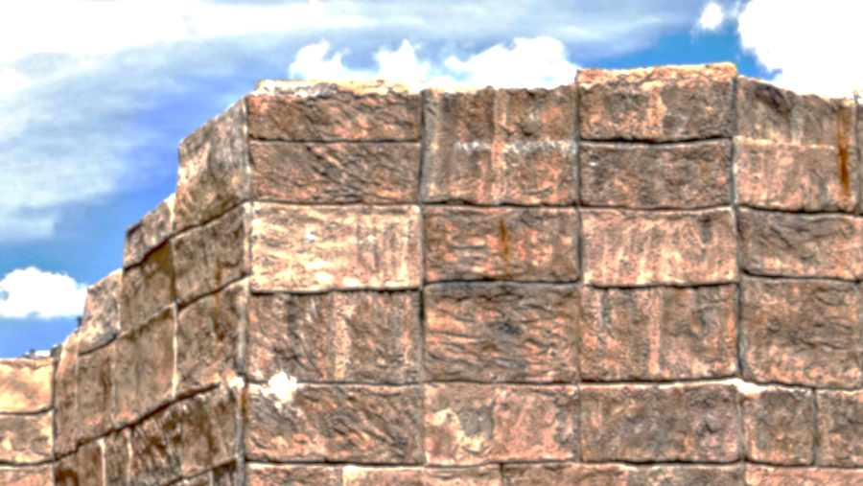
Jesus the Foundation of Faith

Slide 3
Matthew 16:13-16
Now when Jesus came into the district of Caesarea Philippi, he asked his disciples, “Who do people say that the Son of Man is?” ¹⁴ And they said, “Some say John the Baptist, others say Elijah, and others Jeremiah or one of the prophets.” …….

Slide 4
^{……15} He said to them, “But who do you say that I am?” ¹⁶ Simon Peter replied, “You are the Christ, the Son of the living God.”

Slide 5
1 Timothy 2:5
For there is one God, and there is one mediator between God and men, the man Christ Jesus

Slide 6
John 1:1-5
In the beginning was the Word, and
the Word was with God, and the Word was God. ² He was in the beginning with God. ³ All things were made through him, and without him was not anything made that was made. ……

Slide 7
^{…….. 4} In him was life, and the life was the light of men. ⁵ The light shines in the darkness, and the darkness has not overcome it.

Slide 8
Hebrews 13:8
Jesus Christ is the same yesterday and today and forever.

Slide 9
1 Peter 1:25
but the word of the Lord remains forever. And this word is the good news that was preached to you.

Slide 10
Matthew 24:35
Heaven and earth will pass away, but my words will not pass away.

Slide 11
Isaiah 55:10-11
“For as the rain and the snow come down from heaven and do not return there but water the earth, making it bring forth and sprout, giving seed to the sower and bread to the eater, ………

Slide 12
^{…… 11} so shall my word be that goes out from my mouth; it shall not return to me empty, but it shall accomplish that which I purpose, and shall succeed in the thing for which I sent it.

Slide 13
Luke 19:9-10
And Jesus said to him, “Today salvation has come to this house, since he also is a son of Abraham.
¹⁰ For the Son of Man came to seek and to save the lost.”

Slide 14
Acts 4:12
And there is salvation in no one else, for there is no other name under heaven given among men by which we must be saved.”

Slide 15
Luke 6:47- 48
Everyone who comes to me and hears my words and does them, I will show you what he is like: ⁴⁸ he is like a man building a house, who dug deep and laid the foundation on the rock. And when a flood arose, the stream broke against that house and could not shake it, because it had been well built. ……..

Slide 16
^{……. 49} But the one who hears and does not do them is like a man who built a house on the ground without a foundation. When the stream broke against it, immediately it fell, and the ruin of that house was great..”

Slide 17
Psalm 18:2
The Lord is my rock and my
fortress and my deliverer, my God, my rock, in whom I take refuge, my shield, and the horn of my salvation, my stronghold.

Slide 18
Psalm 62:1-2
Truly my soul finds rest in God; my salvation comes from him.
² Truly he is my rock and my salvation; he is my fortress;
I will never be shaken.

Slide 19
Mark 8:34
Then he called the crowd to him along with his disciples and said:
“Whoever wants to be my disciple must deny themselves and take up their cross and follow me.

Slide 20
James 2:14
What good is it, my brothers,
if someone says he has faith
but does not have works?
Can that faith save him?

Slide 21
James 2:17-19
So also faith by itself, if it does not have works, is dead.¹⁸ But someone will say, “You have faith and I have works.” Show me your faith apart from your works, and I will show you my faith by my works. ¹⁹ You believe that God is one; you do well. Even the demons believe—and shudder!

Slide 22
Matthew 7:21
“Not everyone who says to me, ‘Lord, Lord,’ will enter the kingdom of heaven, but the one who does the will of my Father who is in heaven.

Slide 23
John 14:21-23
Whoever has my commandments and keeps them, he it is who loves me. And he who loves me will be loved by my Father, and I will love him and manifest myself to him.” …….

Slide 24
^{…….. 22} Judas (not Iscariot) said to him, “Lord, how is it that you will manifest yourself to us, and not to the world?”
²³ Jesus answered him, “If anyone loves me, he will keep my word, and my Father will love him, and we will come to him and make our home with him.

Slide 25
Jesus the Foundation of Faith

