Slide 2
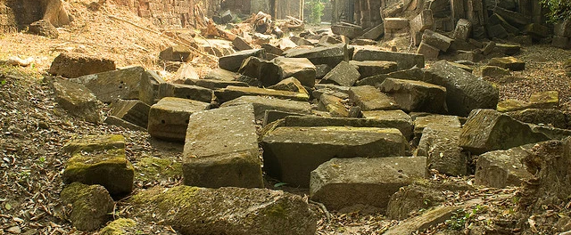
Focused on God’s Calling

Slide 3
Nehemiah 1:3
And they said to me, “The remnant there in the province who had survived the exile is in great trouble and shame. The wall of Jerusalem is broken down, and its gates are destroyed by fire.”

Slide 4
Nehemiah 1:8-11
Remember the word that you commanded your servant Moses, saying, ‘If you are unfaithful, I will scatter you among the peoples, ⁹ but if you return to me and keep my commandments and do them, though your outcasts are in the uttermost parts of heaven, from there I will gather them and bring them to the place that I have chosen, to make my name dwell there……..’

Slide 5
^{……. 10} They are your servants and your people, whom you have redeemed by your great power and by your strong hand. ¹¹ O Lord, let your ear be attentive to the prayer of your servant, and to the prayer of your servants who delight to fear your name, and give success to your servant today, and grant him mercy in the sight of this man.” Now I was cupbearer to the king.

Slide 6
Nehemiah 2:2-5
And the king said to me, “Why is your face sad, seeing you are not sick? This is nothing but sadness of the heart.” Then I was very much afraid. ³ I said to the king,
“Let the king live forever! Why should not my face be sad, when the city, the place of my fathers' graves, lies in ruins, and its gates have been destroyed by fire?” ………

Slide 7
^{4 ……….} Then the king said to me, “What are you requesting?” So I prayed to the God of heaven. ⁵ And I said to the king, “If it pleases the king, and if your servant has found favor in your sight, that you send me to Judah, to the city of my fathers' graves, that I may rebuild it.”

Slide 8
Nehemiah 2:10
But when Sanballat the Horonite and Tobiah the Ammonite servant heard this, it displeased them greatly that someone had come to seek the welfare of the people of Israel.

Slide 9
Nehemiah 2:17-18
Then I said to them, “You see the trouble we are in, how Jerusalem lies in ruins with its gates burned. Come, let us build the wall of Jerusalem, that we may no longer
suffer derision.”……….

Slide 10
^{……. 18} And I told them of the hand of my God that had been upon me for good, and also of the words that the king had spoken to me. And they said, “Let us rise up and build.” So they strengthened their hands for the good work.

Slide 11
Nehemiah 4:6
So we built the wall. And all the wall was joined together to half its height, for the people had a mind to work.

Slide 12
Nehemiah 4:7-9
But when Sanballat and Tobiah and the Arabs and the Ammonites and the Ashdodites heard that the repairing of the walls of Jerusalem was going forward and that the breaches were beginning to be closed, they were very angry. ………..

Slide 13
^{8 …….} And they all plotted together to come and fight against Jerusalem and to cause confusion in it.⁹ And we prayed to our God and set a guard as a protection against them day and night.

Slide 14
Nehemiah 4:11
And our enemies said,
“They will not know or see till we come among them and kill them and stop the work.”

Slide 15
Nehemiah 4:12-13
At that time the Jews who lived near them came from all directions and said to us ten times, “You must return to us.” ¹³ So in the lowest parts of the space behind the wall, in open places, I stationed the people by their clans, with their swords, their spears, and their bows.

Slide 16
Nehemiah 4:14
And I looked and arose and said to the nobles and to the officials and to the rest of the people, “Do not be afraid of them. Remember the Lord, who is great and awesome, and fight for your brothers, your sons, your daughters, your wives, and your homes.”

Slide 17
Nehemiah 4:15-20
When our enemies heard that it was known to us and that God had frustrated their plan, we all returned to the wall, each to his work. ¹⁶ From that day on, half of my servants worked on construction, and half held the spears, shields, bows, and coats of mail. …….

Slide 18
……. And the leaders stood behind the whole house of Judah, ¹⁷ who were building on the wall. Those who carried burdens were loaded in such a way that each labored on the work with one hand and held his weapon with the other.

Slide 19
^{………. 18} And each of the builders had his sword strapped at his side while he built. The man who sounded the trumpet was beside me. ¹⁹ And I said to the nobles and to the officials and to the rest of the people, …….

Slide 20
…….., “The work is great and widely spread, and we are separated on the wall, far from one another. ²⁰ In the place where you hear the sound of the trumpet, rally to us there. Our God will fight for us.”

Slide 21
Nehemiah 6:15 -16
So the wall was finished on the twenty-fifth day of the month Elul, in fifty-two days.
¹⁶ And when all our enemies heard of it, all the nations around us were afraid and fell greatly in their own esteem, for they perceived that this work had been accomplished with the help of our God.

Slide 22
Matthew 16:18
And I tell you, you are Peter, and on this rock I will build my church, and the gates of hell shall not prevail against it.

Slide 23
Focused on God’s Calling

