Slide 2
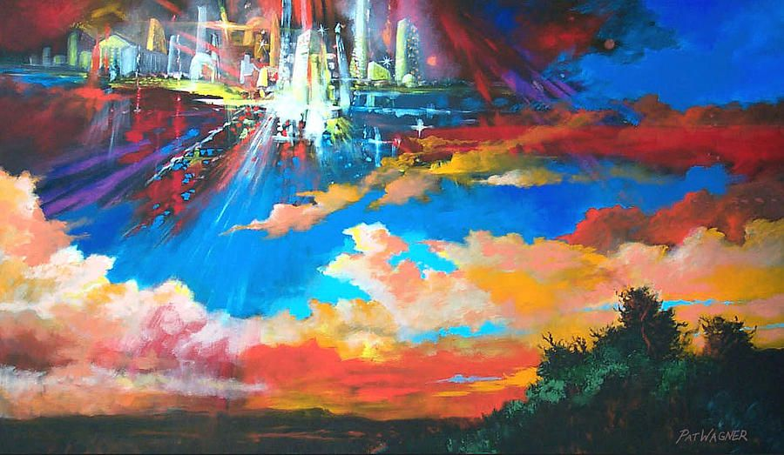
It Is The Father's Good Pleasure To Give
You The Kingdom

Slide 3
John 6:44
No one can come to me unless the Father who sent me draws him. And I will raise him up on the last day.

Slide 4
Peter 1:13-16 Therefore, preparing your minds for action, and being sober-minded, set your hope fully on the grace that will be brought to you at the revelation of Jesus Christ.¹⁴ As obedient children, do not be conformed to the passions of your former ignorance, ¹⁵ but as he who called you is holy, you also be holy in all your conduct, ¹⁶ since it is written, “You shall be holy, for I am holy.”

Slide 5
John 2:4-6
Whoever says “I know him” but does not keep his commandments is a liar, and the truth is not in him, ⁵ but whoever keeps his word, in him truly the love of God is perfected. By this we may know that we are in him: ⁶ whoever says he abides in him ought to walk in the same way in which he walked.

Slide 6
Mark 13:13, Matthew 10:22
And you will be hated by all for my name's sake. But the one who endures to the end will be saved.
Matthew 24:13 But the one who endures to the end will be saved.

Slide 7
John 2:5
His mother said to the servants, “Do whatever he tells you.”

Slide 8
John 10:27 My sheep hear my voice, and I know them, and they follow me.
John 15:14 You are my friends if you do what I command you.

Slide 9
1Timothy 2:12
if we endure, we will also reign with him; if we deny him, he also will deny us;

Slide 10
2 Timothy 4:3
For the time is coming when people will not endure sound teaching, but having itching ears they will accumulate for themselves teachers to suit their own passions.

Slide 11
Luke 10:9-11 Heal the sick in it and say to them, ‘The kingdom of God has come near to you.’¹⁰ But whenever you enter a town and they do not receive you, go into its streets and say, ¹¹ ‘Even the dust of your town that clings to our feet we wipe off against you. Nevertheless know this, that the kingdom of God has come near.’

Slide 12
Matthew 7:21
“Not everyone who says to me, ‘Lord, Lord,’ will enter the kingdom of heaven, but the one who does the will of my Father who is in heaven”.

Slide 13
2 Peter 1:10-11
Therefore, brothers, be all the more diligent to confirm your calling and election, for if you practice these qualities you will never fall. ¹¹ For in this way there will be richly provided for you an entrance into the eternal kingdom of our Lord and Savior Jesus Christ.

Slide 14
Matthew 13:40-43
Just as the weeds are gathered and burned with fire, so will it be at the end of the age. ⁴¹ The Son of Man will send his angels, and they will gather out of his kingdom all causes of sin and all law-breakers, …..

Slide 15
^{….. 42} and throw them into the fiery furnace. In that place there will be weeping and gnashing of teeth. ⁴³ Then the righteous will shine like the sun in the kingdom of their Father. He who has ears, let him hear.

Slide 16
Matthew 25:21
His master said to him, ‘Well done, good and faithful servant. You have been faithful over a little; I will set you over much. Enter into the joy of your master.’

Slide 17
James 1:12
Blessed is the man who remains steadfast under trial, for when he has stood the test he will receive the crown of life, which God has promised to those who love him.

Slide 18
Luke 12:32
“Fear not, little flock, for it is your Father's good pleasure to give you the kingdom.

Slide 19
1 Corinthians 2:9
But, as it is written, “What no eye has seen, nor ear heard, nor the heart of man imagined, what God has prepared for those who love him”

Slide 20
Isaiah 65:17
“For behold, I create new heavens and a new earth, and the former things shall not be remembered or come into mind.

Slide 21
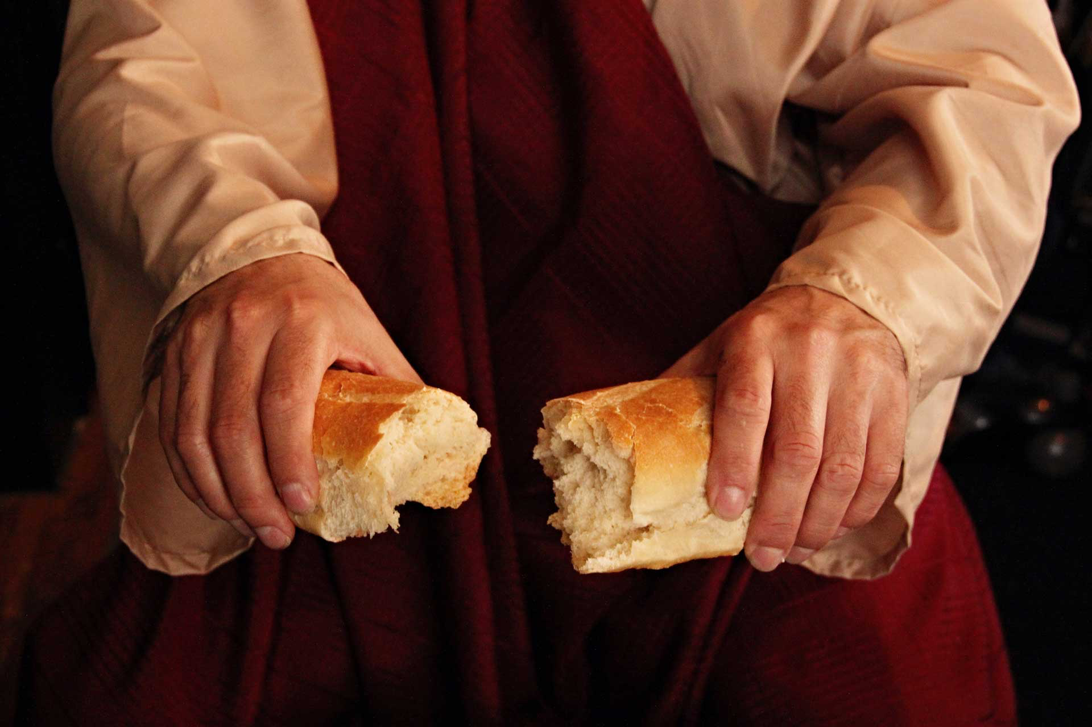
Remembering
The Great Exchange

Slide 22
Isaiah 53:10-11
Yet it was the will of the Lord to crush him; he has put him to grief; when his soul makes an offering for guilt, he shall see his offspring; he shall prolong his days; the will of the Lord shall prosper in his hand. ¹¹ Out of the anguish of his soul he shall see and be satisfied; by his knowledge shall the righteous one, my servant, make many to be accounted righteous, and he shall bear their iniquities.

Slide 23
It Is The Father's Good Pleasure To Give
You The Kingdom

