Slide 2
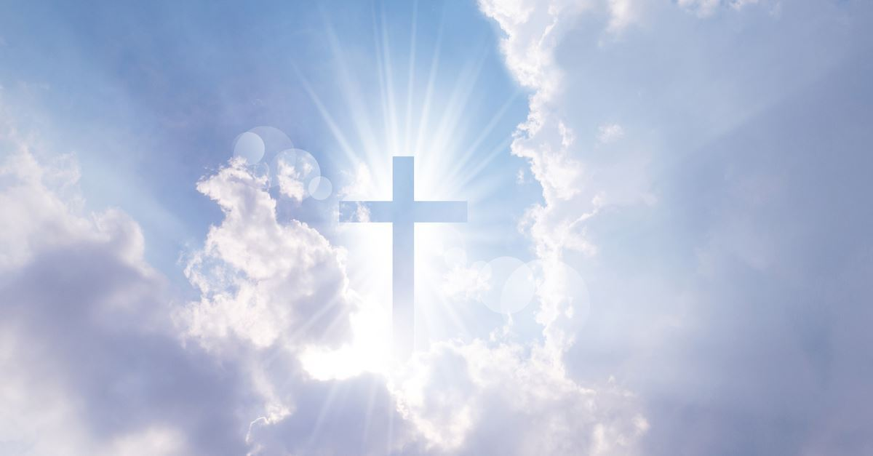
The Three Stages In
Coming To God
1 Peter 1:3
Blessed be the God and Father of our Lord Jesus Christ! According to his great mercy,
he has caused us to be born again to a living hope
through the resurrection of Jesus Christ from the dead.

Slide 3
Hebrews 11:6
And without faith it is impossible to please him, for whoever would draw near to God must believe that he exists and that he rewards those who seek him.

Slide 4
1 Peter 2:3-4
if indeed you have tasted that the Lord is good ⁴ As you come to him, a living stone rejected by men but in the sight of God chosen and precious,

Slide 5
John 6:44
No one can come to me unless the Father who sent me draws him. And I will raise him up on the last day.

Slide 6
Luke 15:11-19 “There was a man who had two sons. ¹² And the younger of them said to his father, ‘Father, give me the share of property that is coming to me.’ And he divided his property between them. ¹³ Not many days later, the younger son gathered all he had and took a journey into a far country, and there he squandered his property in reckless living. ¹⁴ And when he had ……….

Slide 7
^{…….. 14} And when he had spent everything, a severe famine arose in that country, and he began to be in need.¹⁵ So he went and hired himself out to one of the citizens of that country, who sent him into his fields to feed pigs. ¹⁶ And he was longing to be fed with the pods that the pigs ate, and no one gave him anything….

Slide 8
^{……17} “But when he came to himself, he said, ‘How many of my father's hired servants have more than enough bread, but I perish here with hunger! ¹⁸ I will arise and go to my father, and I will say to him, “Father, I have sinned against heaven and before you. ¹⁹ I am no longer worthy to be called your son. Treat me as one of your hired servants.”’

Slide 9
Ephesians 4:17-24 Now this I say and testify in the Lord, that you must no longer walk as the Gentiles do, in the futility of their minds.
¹⁸ They are darkened in their understanding, alienated from the life of God because of the ignorance that is in them, due to their hardened hearts. ¹⁹ They have become callous and have given themselves up to sensuality, greedy to practice every kind of impurity.

Slide 10
Ephesians 4:30
And do not grieve the Holy Spirit of God, by whom you were sealed for the day of redemption

Slide 11
Matthew 16:24
Then Jesus told his disciples,
“If anyone would come after me, let him deny himself and take up his cross and follow me.”

Slide 12
John 6:38-40 For I have come down from heaven, not to do my own will but the will of him who sent me. ³⁹ And this is the will of him who sent me, that I should lose nothing of all that he has given me, but raise it up on the last day. ⁴⁰ For this is the will of my Father, that everyone who looks on the Son and believes in him should have eternal life, and I will raise him up on the last day.”

Slide 13
Isaiah 25:8
He will swallow up death forever; and the Lord God will wipe away tears from all faces, and the reproach of his people he will take away from all the earth, for the Lord has spoken

Slide 14
Matthew 25:31-34
“When the Son of Man comes in his glory, and all the angels with him, then he will sit on his glorious throne. ³² Before him will be gathered all the nations, and he will separate people one from another as a shepherd separates the sheep from the goats …..

Slide 15
^{……. 33} And he will place the sheep on his right, but the goats on the left. ³⁴ Then the King will say to those on his right, ‘Come, you who are blessed by my Father, inherit the kingdom prepared for you from the foundation of the world.

Slide 16
Matthew 25:41-43
“Then he will say to those on his left, ‘Depart from me, you cursed, into the eternal fire prepared for the devil and his angels. ⁴² For I was hungry and you gave me no food, I was thirsty and you gave me no drink, ⁴³ I was a stranger and you did not welcome me, naked and you did not clothe me, sick and in prison and you did not visit me.’

Slide 17
Matthew 13:43
Then the righteous will shine like the sun in the kingdom of their Father. He who has ears, let him hear.

Slide 18
Isaiah 60:19
The sun shall be no more your light by day, nor for brightness shall the moon give you light; but the Lord will be your everlasting light, and your God will be your glory

Slide 19
The Three Stages In
Coming To God
1 Peter 1:3
Blessed be the God and Father of our Lord Jesus Christ! According to his great mercy,
he has caused us to be born again to a living hope
through the resurrection of Jesus Christ from the dead.

