Slide 2
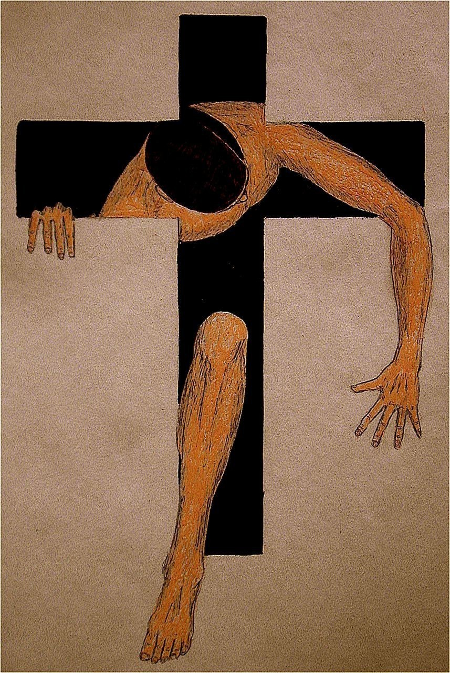
N
A
R
R
O
W
G
A
T
E
NARROW
GATE
N
A
R
R
O
W
P
A
T
H
1 Peter 1:3
Blessed be the God and Father of our Lord Jesus Christ! According to his great mercy,
he has caused us to be born again to a living hope
through the resurrection of Jesus Christ from the dead.
NARROW PATH

Slide 3
Matthew 7:13-15
“Enter by the narrow gate. For the gate is wide and the way is easy that leads to destruction, and those who enter by it are many. ¹⁴ For the gate is narrow and the way is hard that leads to life, and those who find it are few. ¹⁵ “Beware of false prophets, who come to you in sheep's clothing but inwardly are ravenous wolves.

Slide 4
Matthew 16:24-25
Then Jesus told his disciples, “If anyone would come after me, let him deny himself and take up his cross and follow me. ²⁵ For whoever would save his life will lose it, but whoever loses his life for my sake will find it.

Slide 5
Matthew 10:38
And whoever does not take his cross and follow me is not worthy of me.
Matthew 16:24
Then Jesus told his disciples, “If anyone would come after me, let him deny himself and take up his cross and follow me.

Slide 6
Matthew 22:14
“For many are called,
but few are chosen.”

Slide 7
John 15:18-20 “If the world hates you, know that it has hated me before it hated you. ¹⁹ If you were of the world, the world would love you as its own; but because you are not of the world, but I chose you out of the world, therefore the world hates you. ²⁰ Remember the word that I said to you: ‘A servant is not greater than his master.’ If they persecuted me, they will also persecute you.

Slide 8
Matthew 5:10-12
“Blessed are those who are persecuted for righteousness' sake, for theirs is the kingdom of heaven.¹¹ “Blessed are you when others revile you and persecute you and utter all kinds of evil against you falsely on my account. ¹² Rejoice and be glad, for your reward is great in heaven, for so they persecuted the prophets who were before you.

Slide 9
2 Timothy 3:12-16
Indeed, all who desire to live a godly life in Christ Jesus will be persecuted, ¹³ while evil people and impostors will go on from bad to worse, deceiving and being deceived.
¹⁴ But as for you, continue in what you have learned and have firmly believed, knowing from whom you learned it …….

Slide 10
^{……. 15} and how from childhood you have been acquainted with the sacred writings, which are able to make you wise for salvation through faith in Christ Jesus. ¹⁶ All Scripture is breathed out by God and profitable for teaching, for reproof, for correction, and for training in righteousness

Slide 11
Acts 14:21-22
When they had preached the gospel to that city and had made many disciples, they returned to Lystra and to Iconium and to Antioch,²² strengthening the souls of the disciples, encouraging them to continue in the faith, and saying that through many tribulations we must enter the kingdom of God.

Slide 12
John 14:6
Jesus said to him, “I am the way, and the truth, and the life. No one comes to the Father except through me.

Slide 13
Psalm 119:105
Your word is a lamp to my feet and a light to my path.

Slide 14
2 Peter 1:19
And we have the prophetic word more fully confirmed, to which you will do well to pay attention as to a lamp shining in a dark place, until the day dawns and the morning star rises in your hearts

Slide 15
John 3:19
And this is the judgment: the light has come into the world, and people loved the darkness rather than the light because their works were evil.

Slide 16
Romans 13:12
The night is far gone; the day is at hand. So then let us cast off the works of darkness and put on the armor of light.

Slide 17
Proverbs 6:23
For the commandment is a lamp and the teaching a light, and the reproofs of discipline are the way of life

Slide 18
Luke 13:23-25
And someone said to him, “Lord, will those who are saved be few?” And he said to them, ²⁴ “Strive to enter through the narrow door. For many, I tell you, will seek to enter and will not be able. ²⁵ When once the master of the house has risen and shut the door, and you begin to stand outside and to knock at the door, saying, ‘Lord, open to us,’ then he will answer you, ‘I do not know where you come from.’

Slide 19
Isaiah 35:8
And a highway shall be there, and it shall be called the Way of Holiness; the unclean shall not pass over it. It shall belong to those who walk on the way; even if they are fools, they shall not go astray.

Slide 20
Proverbs 16:17
The highway of the upright turns aside from evil; whoever guards his way preserves his life.

Slide 21
Proverbs 4:26-27
Ponder the path of your feet; then all your ways will be sure. ²⁷ Do not swerve to the right or to the left; turn your foot away from evil.

Slide 22
Proverbs 14:12
There is a way that seems right to a man, but its end is the way to death.

Slide 23
1 John 2:6 whoever says he abides in him ought to walk in the same way in which he walked.
1 Peter 2:21 For to this you have been called, because Christ also suffered for you, leaving you an example, so that you might follow in his steps.

Slide 24
1 Corinthians 2:14
The natural person does not accept the things of the Spirit of God, for they are folly to him, and he is not able to understand them because they are spiritually discerned.

Slide 25
Philippians 3:12-14
Not that I have already obtained this or am already perfect, but I press on to make it my own, because Christ Jesus has made me his own. ¹³ Brothers, I do not consider that I have made it my own. But one thing I do: forgetting what lies behind and straining forward to what lies ahead, ¹⁴ I press on toward the goal for the prize of the upward call of God in Christ Jesus.

Slide 26
Luke 6:46
Why do you call me ‘Lord, Lord,’ and not do what I tell you?

Slide 27
John 14:23-24
Jesus answered him, “If anyone loves me, he will keep my word, and my Father will love him, and we will come to him and make our home with him. ²⁴ Whoever does not love me does not keep my words. And the word that you hear is not mine but the Father's who sent me.

Slide 28
Matthew 7:13-14
“Enter by the narrow gate. For the gate is wide and the way is easy that leads to destruction, and those who enter by it are many. ¹⁴ For the gate is narrow and the way is hard that leads to life, and those who find it are few”.

Slide 29
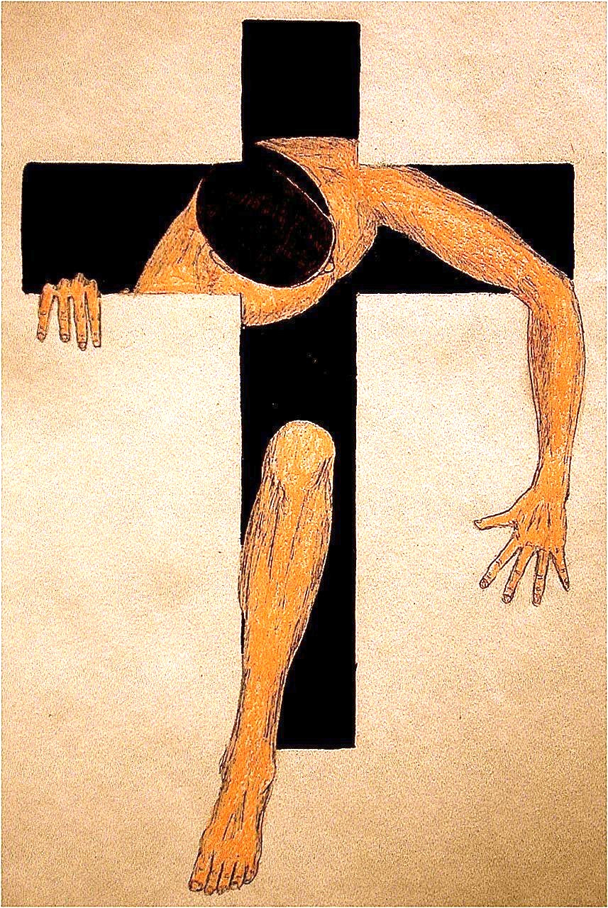
N
A
R
R
O
W
G
A
T
E
NARROW
GATE
N
A
R
R
O
W
P
A
T
H
1 Peter 1:3
Blessed be the God and Father of our Lord Jesus Christ! According to his great mercy,
he has caused us to be born again to a living hope
through the resurrection of Jesus Christ from the dead.
NARROW PATH

