Slide 2
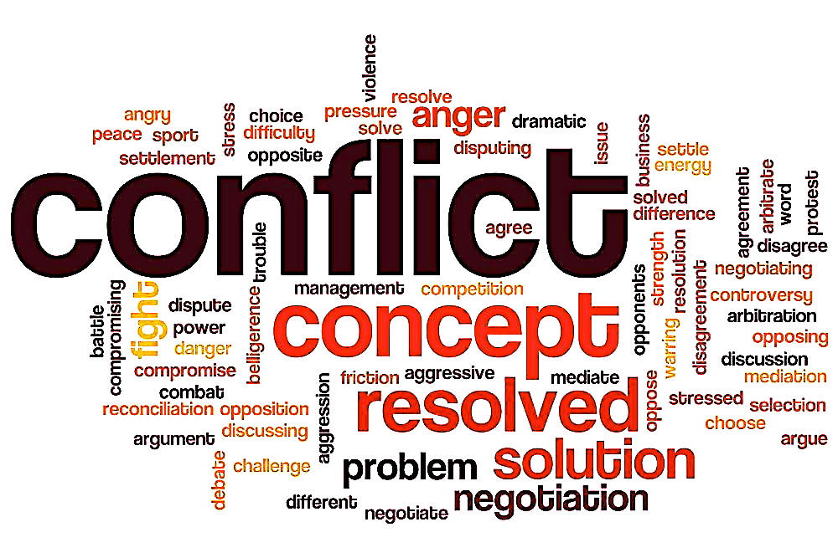
Reconciliation In The Conflict
Reconciliation
Reconciliation In The Conflict

Slide 3
Romans 14:10-12
Why do you pass judgment on your brother? Or you, why do you despise your brother? For we will all stand before the judgment seat of God; ¹¹ for it is written, “As I live, says the Lord, every knee shall bow to me, and every tongue shall confess to God.” ¹² So then each of us will give an account of himself to God.

Slide 4
Acts 15:37-40
Now Barnabas wanted to take with them John called Mark. ³⁸ But Paul thought best not to take with them one who had withdrawn from them in Pamphylia and had not gone with them to the work. ³⁹ And there arose a sharp disagreement, so that they separated from each other. Barnabas took Mark with him and sailed away to Cyprus, ⁴⁰ but Paul chose Silas and departed, having been commended by the brothers to the grace of the Lord.

Slide 5
Colossians 4:10
Aristarchus my fellow prisoner greets you, with Mark the cousin of Barnabas about whom you received instructions: if he comes to you, welcome him.

Slide 6
2 Timothy 4:11
Only Luke is with me. Get Mark and bring him with you, for he is useful to me for ministry.

Slide 7
2 Corinthians 5:17-19
Therefore, if anyone is in Christ, he is a new creation. The old has passed away; behold, the new has come. ¹⁸ All this is from God, who through Christ reconciled us to himself and gave us the ministry of reconciliation; ¹⁹ that is, in Christ God was reconciling the world to himself, ……..

Slide 8
….. not counting their trespasses against them, and entrusting to us the message of reconciliation. ²⁰ Therefore, we are ambassadors for Christ, God making his appeal through us. We implore you on behalf of Christ, be reconciled to God.

Slide 9
Romans 5:10-11
For if while we were enemies we were reconciled to God by the death of his Son, much more, now that we are reconciled, shall we be saved by his life. ¹¹ More than that, we also rejoice in God through our Lord Jesus Christ, through whom we have now received reconciliation.

Slide 10
Colossians 1:21-22
And you, who once were alienated and hostile in mind, doing evil deeds, ²² he has now reconciled in his body of flesh by his death, in order to present you holy and blameless and above reproach before him.

Slide 11
Luke 17:3-4
Pay attention to yourselves! If your brother sins, rebuke him, and if he repents, forgive him, ⁴ and if he sins against you seven times in the day, and turns to you seven times, saying, ‘I repent,’ you must forgive him.”

Slide 12
Ephesians 4:31-32
Let all bitterness and wrath and anger and clamor and slander be put away from you, along with all malice. Be kind to one another, tenderhearted, forgiving one another, as God in Christ forgave you.

Slide 13
Colossians 3:12-13
Put on then, as God's chosen ones, holy and beloved, compassionate hearts, kindness, humility, meekness, and patience, ¹³ bearing with one another and, if one has a complaint against another, forgiving each other; as the Lord has forgiven you, so you also must forgive.

Slide 14
Matthew 5:22-24
But I say to you that everyone who is angry with his brother will be liable to judgment; whoever insults his brother will be liable to the council; and whoever says, ‘You fool!’ will be liable to the hell of fire. ………

Slide 15
^{…… 23} So if you are offering your gift at the altar and there remember that your brother has something against you, ²⁴ leave your gift there before the altar and go. First be reconciled to your brother, and then come and offer your gift.

Slide 16
James 1:19-20
Know this, my beloved brothers: let every person be quick to hear, slow to speak, slow to anger; ²⁰ for the anger of man does not produce the righteousness of God.

Slide 17
Romans 12:17-21
Repay no one evil for evil, but give thought to do what is honorable in the sight of all.¹⁸ If possible, so far as it depends on you, live peaceably with all. ¹⁹ Beloved, never avenge yourselves, but leave it to the wrath of God, for it is written, “Vengeance is mine, I will repay, says the Lord.”……..

Slide 18
^{………. 20} To the contrary, “if your enemy is hungry, feed him; if he is thirsty, give him something to drink; for by so doing you will heap burning coals on his head.” ²¹ Do not be overcome by evil, but overcome evil with good.

Slide 19
1 Corinthians 13:1-4 If I speak in the tongues of men and of angels, but have not love, I am a noisy gong or a clanging cymbal. ² And if I have prophetic powers, and understand all mysteries and all knowledge, and if I have all faith, so as to remove mountains, but have not love, I am nothing. ³ If I give away all I have, and if I deliver up my body to be burned, but have not love, I gain nothing ……..

Slide 20
^{………. 4} Love is patient and kind; love does not envy or boast; it is not arrogant ⁵ or rude. It does not insist on its own way; it is not irritable or resentful; ⁶ it does not rejoice at wrongdoing, but rejoices with the truth. ⁷ Love bears all things, believes all things, hopes all things, endures all things.

Slide 21
Hebrews 12:14-15
Strive for peace with everyone, and for the holiness without which no one will see the Lord. ¹⁵ See to it that no one fails to obtain the grace of God; that no “root of bitterness” springs up and causes trouble, and by it many become defiled

Slide 22
Ephesians 4:1-3
I therefore, a prisoner for the Lord, urge you to walk in a manner worthy of the calling to which you have been called, ² with all humility and gentleness, with patience, bearing with one another in love, ³ eager to maintain the unity of the Spirit in the bond of peace.

Slide 23
1 Thessalonians 2:2
But though we had already suffered and been shamefully treated at Philippi, as you know, we had boldness in our God to declare to you the gospel of God in the midst of much conflict.

Slide 24
1 Peter 4:12
Beloved, do not be surprised at the fiery trial when it comes upon you to test you, as though something strange were happening to you

Slide 25
Romans 15:13
May the God of hope fill you with all joy and peace in believing, so that by the power of the Holy Spirit you may abound in hope.

Slide 26
Reconciliation In The Conflict
Reconciliation
Reconciliation In The Conflict

