Slide 2
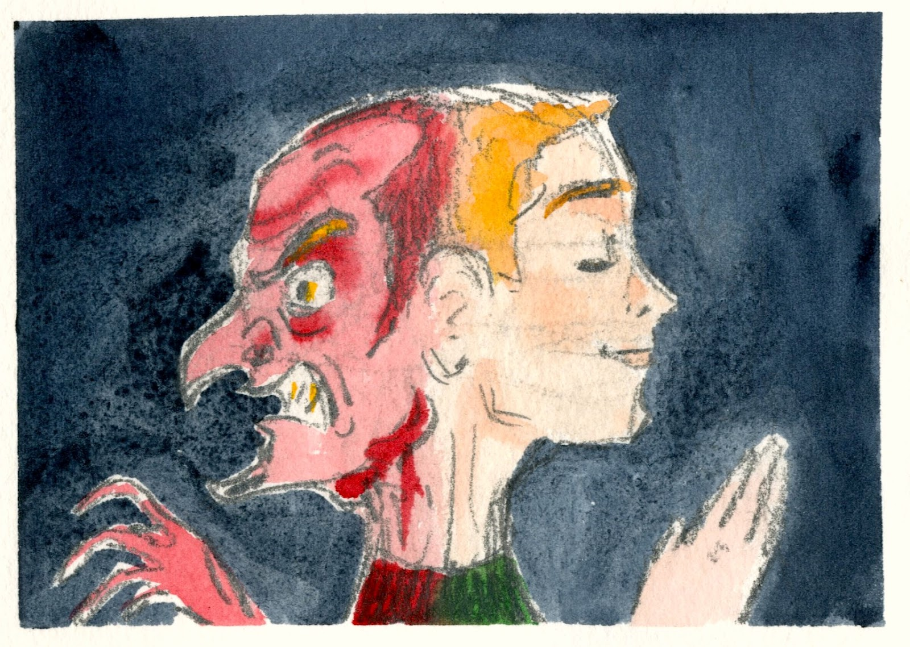
A SOMETIMES FORGOTTEN BUT VERY IMPORTANT TEACHING
WOE
WOE
WOE
WOE
WOE
WOE
WOE

Slide 3
Matthew 5:3 “Blessed are the poor in spirit, for theirs is the kingdom of heaven. Matthew 5:4 “Blessed are those who mourn, for they shall be comforted. Matthew 5:5 “Blessed are the meek, for they shall inherit the earth. Matthew 5:6 “Blessed are those who hunger and thirst for righteousness, for they shall be satisfied.

Slide 4
Matthew 5:7 “Blessed are the merciful, for they shall receive mercy.
Matthew 5:8 “Blessed are the pure in heart, for they shall see God.
Matthew 5:9 “Blessed are the peacemakers, for they shall be called sons of God.

Slide 5
Matthew 5:10-12 “Blessed are those who are persecuted for righteousness' sake, for theirs is the kingdom of heaven.¹¹“Blessed are you when others revile you and persecute you and utter all kinds of evil against you falsely on my account. ¹² Rejoice and be glad, for your reward is great in heaven, for so they persecuted the prophets who were before you.

Slide 6
WOE !
Matthew 23:13
“But woe to you, scribes and Pharisees, hypocrites! For you shut the kingdom of heaven in people's faces. For you neither enter yourselves nor allow those who would enter to go in.

Slide 7
Matthew 18:6-7
But whoever causes one of these little ones who believe in me to sin, it would be better for him to have a great millstone fastened around his neck and to be drowned in the depth of the sea.⁷ “Woe to the world for temptations to sin! For it is necessary that temptations come, but woe to the one by whom the temptation comes!

Slide 8
James 4:17
So whoever knows the right thing to do and fails to do it, for him it is sin.

Slide 9
WOE !
Matthew 23:14
Woe to you, scribes and Pharisees, hypocrites! For you devour widows’ houses, and for a pretense make long prayers. Therefore you will receive greater condemnation.

Slide 10
James 1:27
Religion that is pure and undefiled before God the Father is this: to visit orphans and widows in their affliction, and to keep oneself unstained from the world.

Slide 11
WOE !
Matthew 23:15
Woe to you, scribes and Pharisees, hypocrites! For you travel across sea and land to make a single proselyte, and when he becomes a proselyte, you make him twice as much a child of hell as yourselves.

Slide 12
WOE !
Matthew 23:16-22
Woe to you, blind guides, who say, ‘If anyone swears by the temple, it is nothing, but if anyone swears by the gold of the temple, he is bound by his oath.’ ¹⁷ You blind fools! For which is greater, the gold or the temple that has made the gold sacred? ………..

Slide 13
^{……….18} And you say, ‘If anyone swears by the altar, it is nothing, but if anyone swears by the gift that is on the altar, he is bound by his oath.’ ¹⁹ You blind men! For which is greater, the gift or the altar that makes the gift sacred? ²⁰ So whoever swears by the altar swears by it and by everything on it. ²¹ And whoever swears by the temple swears by it and by him who dwells in it. ²² And whoever swears by heaven swears by the throne of God and by him who sits upon it.

Slide 14
Matthew 5:37
Let what you say be simply ‘Yes’ or ‘No’; anything more than this comes from evil.

Slide 15
WOE !
Matthew 23:23-24
“Woe to you, scribes and Pharisees, hypocrites! For you tithe mint and dill and cumin, and have neglected the weightier matters of the law: justice and mercy and faithfulness………..

Slide 16
……These you ought to have done, without neglecting the others. ²⁴ You blind guides, straining out a gnat and swallowing a camel!

Slide 17
Matthew 9:13
But go and learn what this means: ‘I desire mercy, not sacrifice.’ For I have not come to call the righteous, but sinners.”

Slide 18
WOE !
Matthew 23:25-26
“Woe to you, scribes and Pharisees, hypocrites! For you clean the outside of the cup and the plate, but inside they are full of greed and self-indulgence. ²⁶ You blind Pharisee! First clean the inside of the cup and the plate, that the outside also may be clean.

Slide 19
Psalm 24:3-4
Who may ascend the mountain of the Lord? Who may stand in his holy place? ⁴ The one who has clean hands and a pure heart, who does not trust in an idol or swear by a false god.

Slide 20
WOE !
Matthew 23:27-28
“Woe to you, scribes and Pharisees, hypocrites! For you are like whitewashed tombs, which outwardly appear beautiful, but within are full of dead people's bones and all uncleanness. ²⁸ So you also outwardly appear righteous to others, but within you are full of hypocrisy and lawlessness.

Slide 21
WOE !
Matthew 23:29-33
“Woe to you, scribes and Pharisees, hypocrites! For you build the tombs of the prophets and decorate the monuments of the righteous, ³⁰ saying, ‘If we had lived in the days of our fathers, we would not have taken part with them in shedding the blood of the prophets.’ ………..

Slide 22
…….. ³¹ Thus you witness against yourselves that you are sons of those who murdered the prophets. ³² Fill up, then, the measure of your fathers. ³³ You serpents, you brood of vipers, how are you to escape being sentenced to hell?

Slide 23
A SOMETIMES FORGOTTEN BUT VERY IMPORTANT TEACHING
WOE
WOE
WOE
WOE
WOE
WOE
WOE

