Slide 2
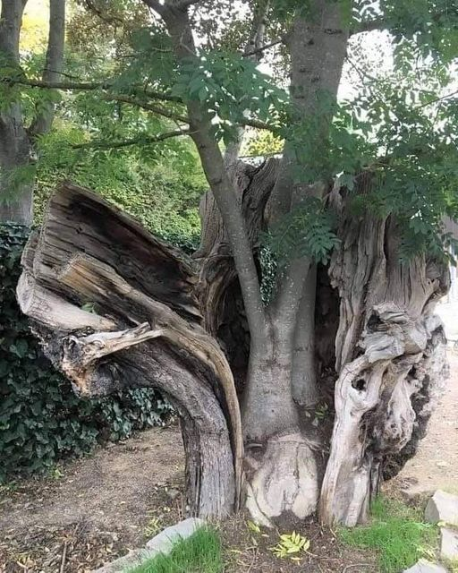
THE
POWER
OF
NEW
LIFE
THE
POWER
OF
NEW
LIFE
The old
Therefore, if anyone is in Christ, he is a new creation.
The old has passed away; behold, the new has come. 2 Corinthians 5:17

Slide 3
Romans 6:5-11
For if we have been united with him in a death like his, we shall certainly be united with him in a resurrection like his. ⁶ We know that our old self was crucified with him in order that the body of sin might be brought to nothing, so that we would no longer be enslaved to sin. ⁷ For one who has died has been set free from sin ……..

Slide 4
^{……. 8} Now if we have died with Christ, we believe that we will also live with him. ⁹ We know that Christ, being raised from the dead, will never die again; death no longer has dominion over him. ¹⁰ For the death he died he died to sin, once for all, but the life he lives he lives to God. ¹¹ So you also must consider yourselves dead to sin and alive to God in Christ Jesus.

Slide 5
Ephesians 1:19-23
and what is the immeasurable greatness of his power toward us who believe, according to the working of his great might ²⁰ that he worked in Christ when he raised him from the dead and seated him at his right hand in the heavenly places, ……

Slide 6
^{……. 21} far above all rule and authority and power and dominion, and above every name that is named, not only in this age but also in the one to come. ²² And he put all things under his feet and gave him as head over all things to the church, ²³ which is his body, the fullness of him who fills all in all.

Slide 7
God Changes us from the inside out.
Ezekiel 36:26-27
And I will give you a new heart, and a new spirit I will put within you. And I will remove the heart of stone from your flesh and give you a heart of flesh. ²⁷ And I will put my Spirit within you, and cause you to walk in my statutes and be careful to obey my rules.

Slide 8
The Holy Spirit of the Living God lives in you!!!!
Romans 8:11
If the Spirit of him who raised Jesus from the dead dwells in you, he who raised Christ Jesus from the dead will also give life to your mortal bodies through his Spirit who dwells in you.

Slide 9
We are granted right relationship with the almighty God
2 Corinthians 5:21
For our sake he made him to be sin who knew no sin, so that in him we might become the righteousness of God.

Slide 10
We have freedom NOT condemnation
Romans 8:1-2
There is therefore now no condemnation for those who are in Christ Jesus.
² For the law of the Spirit of life has set you free in Christ Jesus from the law of sin and death.

Slide 11
We are raised up and united with Jesus
Ephesians 2:6
and raised us up with him and seated us with him in the heavenly places in Christ Jesus

Slide 12
Colossians 3:1-4
If then you have been raised with Christ, seek the things that are above, where Christ is, seated at the right hand of God. ² Set your minds on things that are above, not on things that are on earth. ³ For you have died, and your life is hidden with Christ in God. ⁴ When Christ who is your life appears, then you also will appear with him in glory.

Slide 13
God honors His followers
John 12:26
If anyone serves me, he must follow me; and where I am, there will my servant be also. If anyone serves me, the Father will honor him.

Slide 14
We have received a spirit of adoptions as sons and heirs with Christ.
Romans 8:15-16
For you did not receive the spirit of slavery to fall back into fear, but you have received the Spirit of adoption as sons, by whom we cry, “Abba! Father!” ¹⁶ The Spirit himself bears witness with our spirit that we are children of God.

Slide 15
The sufferings of this present time cannot compare
Romans 8:18
For I consider that the sufferings
of this present time are not worth comparing with the glory
that is to be revealed to us.

Slide 16
Our bodies will be soon be completely redeemed
Romans 8:23
And not only the creation, but we ourselves, who have the firstfruits of the Spirit, groan inwardly as we wait eagerly for adoption as sons, the redemption of our bodies.

Slide 17
Philippians 3:20-21
But our citizenship is in heaven, and from it we await a Savior, the Lord Jesus Christ, ²¹ who will transform our lowly body to be like his glorious body, by the power that enables him even to subject all things to himself.

Slide 18
THE
POWER
OF
NEW
LIFE
THE
POWER
OF
NEW
LIFE
The old
Therefore, if anyone is in Christ, he is a new creation.
The old has passed away; behold, the new has come. 2 Corinthians 5:17

