Slide 2
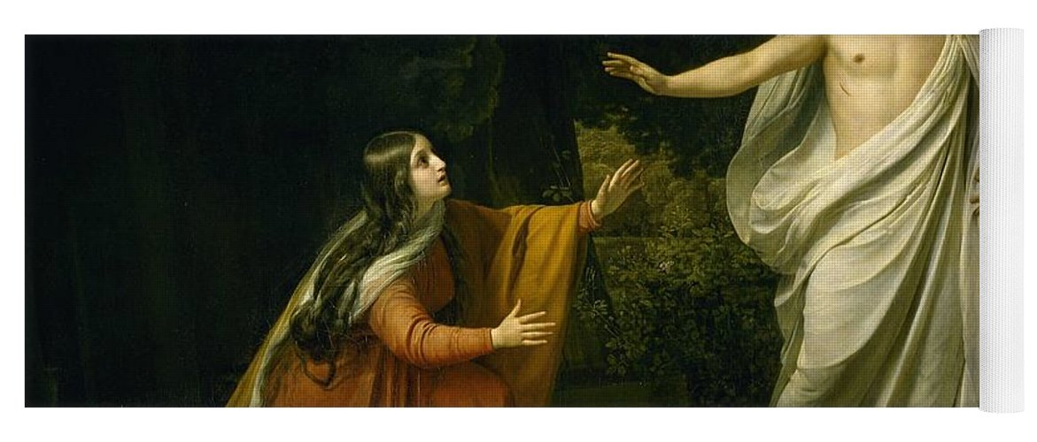
Resurrection,
The Restoration Plan
Believing Is Life

Slide 3
John 20:11-12
But Mary stood weeping outside the tomb, and as she wept she stooped to look into the tomb. ¹² And she saw two angels in white, sitting where the body of Jesus had lain, one at the head and one at the feet.

Slide 4
Exodus 25:17-20
“You shall make a mercy seat of pure gold. Two cubits and a half shall be its length, and a cubit and a half its breadth. ¹⁸ And you shall make two cherubim of gold; of hammered work shall you make them, on the two ends of the mercy seat.¹⁹ Make one cherub on the one end, and one cherub on the other end. ………

Slide 5
……. Of one piece with the mercy seat shall you make the cherubim on its two ends. ²⁰ The cherubim shall spread out their wings above, overshadowing the mercy seat with their wings, their faces one to another; toward the mercy seat shall the faces of the cherubim be.

Slide 6
Matthew 26:26-28
Now as they were eating, Jesus took bread, and after blessing it broke it and gave it to the disciples, and said, “Take, eat; this is my body.” ²⁷ And he took a cup, and when he had given thanks he gave it to them, saying, “Drink of it, all of you, ²⁸ for this is my blood of the covenant, which is poured out for many for the forgiveness of sins.

Slide 7
Genesis 2:15-17
The Lord God took the man and put him in the garden of Eden to work it and keep it. ¹⁶ And the Lord God commanded the man, saying, “You may surely eat of every tree of the garden, ¹⁷ but of the tree of the knowledge of good and evil you shall not eat, for in the day that you eat of it you shall surely die.”

Slide 8
Genesis 3:8
And they heard the sound of the Lord God walking in the garden in the cool of the day, and the man and his wife hid themselves from the presence of the Lord God among the trees of the garden.

Slide 9
John 19:41-42
Now in the place where he was crucified there was a garden, and in the garden a new tomb in which no one had yet been laid. ⁴² So because of the Jewish day of Preparation, since the tomb was close at hand, they laid Jesus there.

Slide 10
Genesis 2:15
The Lord God took the man and put him in the garden of Eden to work it and keep it. But they rebelled against God after Eve was deceived.

Slide 11
1Corinthians 15:22 For as in Adam all die, so also in Christ shall all be made alive.

Slide 12
Genesis 3:24
He drove out the man, and at the east of the garden of Eden he placed the cherubim and a flaming sword that turned every way to guard the way to the tree of life.

Slide 13
Matthew 28:5-7
But the angel said to the women, “Do not be afraid, for I know that you seek Jesus who was crucified. ⁶ He is not here, for he has risen, as he said. Come, see the place where he lay. ⁷ Then go quickly and tell his disciples that he has risen from the dead, and behold, he is going before you to Galilee; there you will see him. See, I have told you.”

Slide 14
Genesis 3:22-24
Then the Lord God said, “Behold, the man has become like one of us in knowing good and evil. Now, lest he reach out his hand and take also of the tree of life and eat, and live forever” ………

Slide 15
^{…… 23} therefore the Lord God sent him out from the garden of Eden to work the ground from which he was taken. ²⁴ He drove out the man, and at the east of the garden of Eden he placed the cherubim and a flaming sword that turned every way to guard the way to the tree of life.

Slide 16
John 19:30
So when Jesus had received the sour wine, He said, “It is finished!” And bowing His head, He gave up His spirit.

Slide 17
2Corintians 5:17
“Therefore, if anyone is in Christ, he is a new creation. The old has passed away; behold, the new has come.”

Slide 18
1Peter 1:3-9 Blessed be the God and Father of our Lord Jesus Christ! According to his great mercy, he has caused us to be born again to a living hope through the resurrection of Jesus Christ from the dead, ⁴ to an inheritance that is imperishable, undefiled, and unfading, kept in heaven for you, ⁵ who by God's power are being guarded through faith for a salvation ready to be revealed in the last time.

Slide 19
Resurrection,
The Restoration Plan
Believing Is Life

