Slide 2
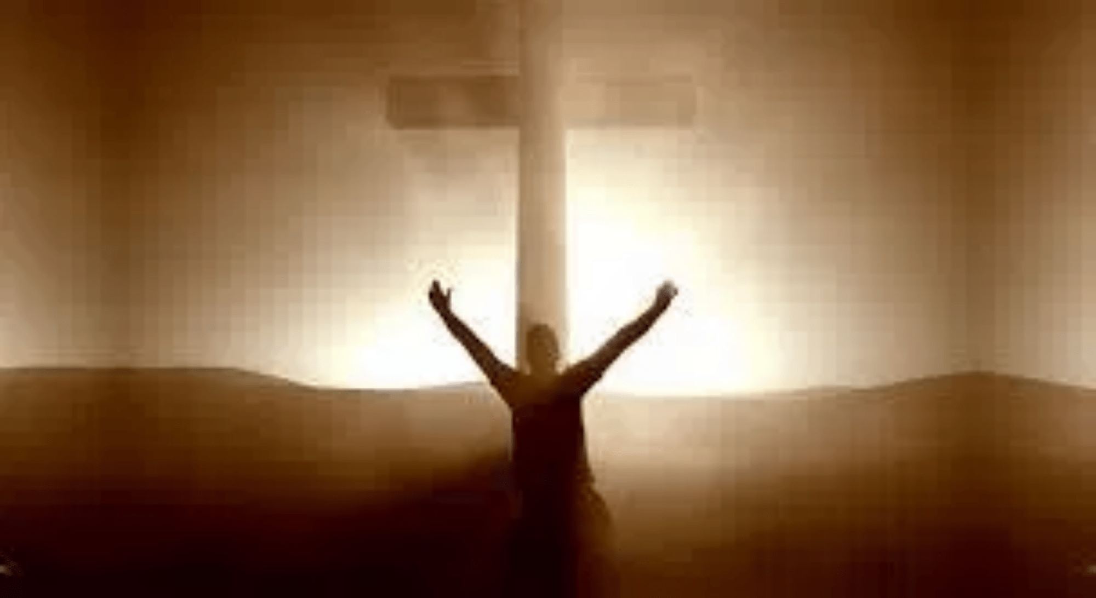
To Live For Christ

Slide 3
Philippians 1:19-26
for I know that through your prayers and the help of the Spirit of Jesus Christ this will turn out for my deliverance, ²⁰ as it is my eager expectation and hope that I will not be at all ashamed, but that with full courage now as always Christ will be honored in my body, whether by life or by death. ²¹ For to me to live is Christ, and to die is gain. …………

Slide 4
^{…… 22} If I am to live in the flesh, that means fruitful labor for me. Yet which I shall choose I cannot tell. ²³ I am hard pressed between the two. My desire is to depart and be with Christ, for that is far better. ²⁴ But to remain in the flesh is more necessary on your account. ………….

Slide 5
^{…… 25} Convinced of this, I know that I will remain and continue with you all, for your progress and joy in the faith, ²⁶ so that in me you may have ample cause to glory in Christ Jesus, because of my coming to you again.

Slide 6
John 10:10
The thief comes only to steal and kill and destroy. I came that they may have life and have it abundantly.

Slide 7
Galatians 2:20
I have been crucified with Christ. It is no longer I who live, but Christ who lives in me. And the life I now live in the flesh I live by faith in the Son of God, who loved me and gave himself for me

Slide 8
To Live for Christ, We Must Trust and Submit to God’s Plan
Philippians 1:19
for I know that through your prayers and the help of the Spirit of Jesus Christ this will turn out for my deliverance

Slide 9
Philippians 2:12-13
Therefore, my beloved, as you have always obeyed, so now, not only as in my presence but much more in my absence, work out your own salvation with fear and trembling, ¹³ for it is God who works in you, both to will and to work for his good pleasure.

Slide 10
Romans 8:28
And we know that for those who love God all things work together for good, for those who are called according to his purpose.

Slide 11
John 6:38
For I have come down from heaven, not to do my own will but the will of him who sent me.

Slide 12
To Live for Christ, We Must Depend on the Body of Christ.
Philippians 1:19
I know that through your prayers and the help of the Spirit of Jesus Christ this will turn out for my deliverance.

Slide 13
To Live for Christ, We Must Exalt Christ in Everything We Do.
Philippians 1:20
as it is my eager expectation and hope that I will not be at all ashamed, but that with full courage now as always Christ will be honored in my body, whether by life or by death.

Slide 14
1Corinthians 10:31
So, whether you eat or drink, or whatever you do, do all to the glory of God. That should be our goal as well that even inn the ordinary and routine things of life should be done in a way to glorify our Savior.

Slide 15
To Live for Christ, We Must Properly View Eternity
Philippians 1:21-23
For to me to live is Christ, and to die is gain. ²² If I am to live in the flesh, that means fruitful labor for me. Yet which I shall choose I cannot tell. ²³ I am hard pressed between the two. My desire is to depart and be with Christ, for that is far better.

Slide 16
Matthew 6:19-21
“Do not lay up for yourselves treasures on earth, where moth and rust destroy and where thieves break in and steal, ²⁰ but lay up for yourselves treasures in heaven, where neither moth nor rust destroys and where thieves do not break in and steal. ²¹ For where your treasure is, there your heart will be also.

Slide 17
1Corinthians 15:32
What do I gain if, humanly speaking, I fought with beasts at Ephesus? If the dead are not raised, “Let us eat and drink, for tomorrow we die.”

Slide 18
2Corinthians 5:1-2
For we know that if the tent that is our earthly home is destroyed, we have a building from God, a house not made with hands, eternal in the heavens.
² For in this tent we groan, longing to put on our heavenly dwelling.

Slide 19
To Live for Christ, We Must Focus on Discipleship
Philippians 1:25-26
Convinced of this, I know that I will remain and continue with you all, for your progress and joy in the faith, ²⁶ so that in me you may have ample cause to glory in Christ Jesus, because of my coming to you again.

Slide 20
2Timothy 2:1-3
You then, my child, be strengthened by the grace that is in Christ Jesus, ² and what you have heard from me in the presence of many witnesses entrust to faithful men, who will be able to teach others also. ³ Share in suffering as a good soldier of Christ Jesus.

Slide 21
To Live For Christ

