Slide 2
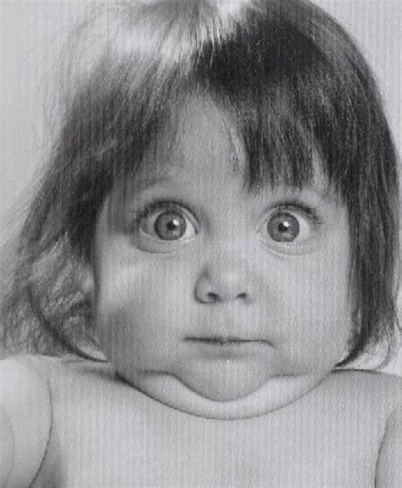
They Who Have Ears Let Them Hear!
Jesus Said What?

Slide 3
Matthew 24:3-14
As Jesus was sitting on the Mount of Olives, the disciples came to him privately. “Tell us,” they said, “when will this happen, and what will be the sign of your coming and of the end of the age?”

Slide 4
Matthew 24:8
All these are but
the beginning of
the birth pains.

Slide 5
Matthew 24:9-14 “Then they will deliver you up to tribulation and put you to death, and you will be hated by all nations for my name's sake. ¹⁰ And then many will fall away and betray one another and hate one another.¹¹ And many false prophets will arise and lead many astray. …………..

Slide 6
^{………… 12} And because lawlessness will be increased, the love of many will grow cold.¹³ But the one who endures to the end will be saved. ¹⁴ And this gospel of the kingdom will be proclaimed throughout the whole world as a testimony to all nations, and then the end will come.

Slide 7
Matthew 24:29-31
“Immediately after the tribulation of those days the sun will be darkened, and the moon will not give its light, and the stars will fall from heaven, and the powers of the heavens will be shaken. …………

Slide 8
……….³⁰ Then will appear in heaven the sign of the Son of Man, and then all the tribes of the earth will mourn, and they will see the Son of Man coming on the clouds of heaven with power and great glory. ³¹ And he will send out his angels with a loud trumpet call, and they will gather his elect from the four winds, from one end of heaven to the other.

Slide 9
Matthew 24:42-44 Therefore, stay awake, for you do not know on what day your Lord is coming. ⁴³ But know this, that if the master of the house had known in what part of the night the thief was coming, he would have stayed awake and would not have let his house be broken into. ⁴⁴ Therefore you also must be ready, for the Son of Man is coming at an hour you do not expect.

Slide 10
Matthew 24:45-51
“Who then is the faithful and wise servant, whom his master has set over his household, to give them their food at the proper time? ⁴⁶ Blessed is that servant whom his master will find so doing when he comes. ⁴⁷ Truly, I say to you, he will set him over all his possessions. ……………..

Slide 11
^{………..48} But if that wicked servant says to himself, ‘My master is delayed,’⁴⁹ and begins to beat his fellow servants and eats and drinks with drunkards, ⁵⁰ the master of that servant will come on a day when he does not expect him and at an hour he does not know ⁵¹ and will cut him in pieces and put him with the hypocrites. In that place there will be weeping and gnashing of teeth.

Slide 12
Matthew 25:1-13
Then the kingdom of heaven will be like ten virgins who took their lamps and went to meet the bridegroom. ² Five of them were foolish, and five were wise. ³ For when the foolish took their lamps, they took no oil with them, ⁴ but the wise took flasks of oil with their lamps. …………….

Slide 13
^{…………5} As the bridegroom was delayed, they all became drowsy and slept. ⁶ But at midnight there was a cry, ‘Here is the bridegroom! Come out to meet him.’ ⁷ Then all those virgins rose and trimmed their lamps. ⁸ And the foolish said to the wise, ‘Give us some of your oil, for our lamps are going out.’ ………….

Slide 14
^{………… 9} But the wise answered, saying, ‘Since there will not be enough for us and for you, go rather to the dealers and buy for yourselves.’ ¹⁰ And while they were going to buy, the bridegroom came, and those who were ready went in with him to the marriage feast, and the door was shut.

Slide 15
^{………. 11} Afterward the other virgins came also, saying, ‘Lord, lord, open to us.’ ¹² But he answered, ‘Truly, I say to you, I do not know you.’ ¹³ Watch therefore, for you know neither the day nor the hour.

Slide 16
Matthew 25:14-30
“For it will be like a man going on a journey, who called his servants and entrusted to them his property. ¹⁵ To one he gave five talents, to another two, to another one, to each according to his ability. Then he went away. ¹⁶ He who had received the five talents went at once and traded with them, and he made five talents more. ………..

Slide 17
^{…….17} So also he who had the two talents made two talents more. ¹⁸ But he who had received the one talent went and dug in the ground and hid his master's money. ¹⁹ Now after a long time the master of those servants came and settled accounts with them. ……….

Slide 18
^{……….20} And he who had received the five talents came forward, bringing five talents more, saying, ‘Master, you delivered to me five talents; here, I have made five talents more.’ ²¹ His master said to him, ‘Well done, good and faithful servant. You have been faithful over a little; I will set you over much. Enter into the joy of your master. …….

Slide 19
^{………22} And he also who had the two talents came forward, saying, ‘Master, you delivered to me two talents; here, I have made two talents more.’ ²³ His master said to him, ‘Well done, good and faithful servant. You have been faithful over a little; I will set you over much. Enter into the joy of your master.’ ………

Slide 20
^{……… 24} He also who had received the one talent came forward, saying, ‘Master, I knew you to be a hard man, reaping where you did not sow, and gathering where you scattered no seed, ²⁵ so I was afraid, and I went and hid your talent in the ground. Here, you have what is yours.’ ²⁶ But his master answered him, ‘You wicked and slothful servant! You knew that I reap where I have not sown and gather where I scattered no seed? ………..

Slide 21
^{……….27} Then you ought to have invested my money with the bankers, and at my coming I should have received what was my own with interest. ²⁸ So take the talent from him and give it to him who has the ten talents. ²⁹ For to everyone who has will more be given, and he will have an abundance. But from the one who has not, even what he has will be taken away. ³⁰ And cast the worthless servant into the outer darkness. In that place there will be weeping and gnashing of teeth.’

Slide 22
Matthew 25:31-46
“When the Son of Man comes in his glory, and all the angels with him, then he will sit on his glorious throne. ³² Before him will be gathered all the nations, and he will separate people one from another as a shepherd separates the sheep from the goats …….

Slide 23
^{………. 33} And he will place the sheep on his right, but the goats on the left. ³⁴ Then the King will say to those on his right, ‘Come, you who are blessed by my Father, inherit the kingdom prepared for you from the foundation of the world. ……….

Slide 24
^{……..35} For I was hungry and you gave me food, I was thirsty and you gave me drink, I was a stranger and you welcomed me, ³⁶ I was naked and you clothed me, I was sick and you visited me, I was in prison and you came to me.’ ³⁷ Then the righteous will answer him, saying, ‘Lord, when did we see you hungry and feed you, or thirsty and give you drink? …….

Slide 25
^{……. 38} And when did we see you a stranger and welcome you, or naked and clothe you? ³⁹ And when did we see you sick or in prison and visit you?’ ⁴⁰ And the King will answer them, ‘Truly, I say to you, as you did it to one of the least of these my brothers, you did it to me.’…….

Slide 26
^{…….. 41} “Then he will say to those on his left, ‘Depart from me, you cursed, into the eternal fire prepared for the devil and his angels. ⁴² For I was hungry and you gave me no food, I was thirsty and you gave me no drink, ⁴³ I was a stranger and you did not welcome me, naked and you did not clothe me, sick and in prison and you did not visit me.’ ……..

Slide 27
^{……….44} Then they also will answer, saying, ‘Lord, when did we see you hungry or thirsty or a stranger or naked or sick or in prison, and did not minister to you?’ ⁴⁵ Then he will answer them, saying, ‘Truly, I say to you, as you did not do it to one of the least of these, you did not do it to me.’ ⁴⁶ And these will go away into eternal punishment, but the righteous into eternal life.”

Slide 28
COMMUNION
A TIME TO REMEMBER WHAT HE HAS DONE AND WHAT HE HAS SAID!

Slide 29
They Who Have Ears Let Them Hear!
Jesus Said What?

