Slide 2
Believing Is Life

Slide 3
John 1:11-13
He came to his own, and his own people did not receive him. ¹² But to all who did receive him, who believed in his name, he gave the right to become children of God,¹³ who were born, not of blood nor of the will of the flesh nor of the will of man, but of God.

Slide 4
John 6:35
Jesus said to them, “I am the bread of life; whoever comes to me shall not hunger, and whoever believes in me shall never thirst.

Slide 5
John 6:58
This is the bread that came down from heaven, not like the bread the fathers ate, and died. Whoever feeds on this bread will live forever.”

Slide 6
John 3:14-16
And as Moses lifted up the serpent in the wilderness, so must the Son of Man be lifted up, ¹⁵that whoever believes in him may have eternal life. ¹⁶ “For God so loved the world, that he gave his only Son, that whoever believes in him should not perish but have eternal life.

Slide 7
John 6:40
For this is the will of my Father, that everyone who looks on the Son and believes in him should have eternal life, and I will raise him up on the last day.”

Slide 8
John 3:36
Whoever believes in the Son has eternal life; whoever does not obey the Son shall not see life, but the wrath of God remains on him.

Slide 9
Matthew 7:21-23
“Not everyone who says to me, ‘Lord, Lord,’ will enter the kingdom of heaven, but the one who does the will of my Father who is in heaven. ²² On that day many will say to me, ‘Lord, Lord, did we not prophesy in your name, and cast out demons in your name, and do many mighty works in your name?’ ²³ And then will I declare to them, ‘I never knew you; depart from me, you workers of lawlessness.’

Slide 10
John 5:24
Truly, truly, I say to you, whoever hears my word and believes him who sent me has eternal life. He does not come into judgment, but has passed from death to life.

Slide 11
James 2:19
You believe that God is one; you do well. Even the demons believe and shudder!

Slide 12
John 11:25
Jesus said to her, “I am the resurrection and the life. Whoever believes in me, though he die, yet shall he live.

Slide 13
John 6:47
Truly, truly, I say to you, whoever believes has eternal life.

Slide 14
John 20:31
Now Jesus did many other signs in the presence of the disciples, which are not written in this book; but these are written so that you may believe that Jesus is the Christ, the Son of God, and that by believing you may have life in his name.

Slide 15
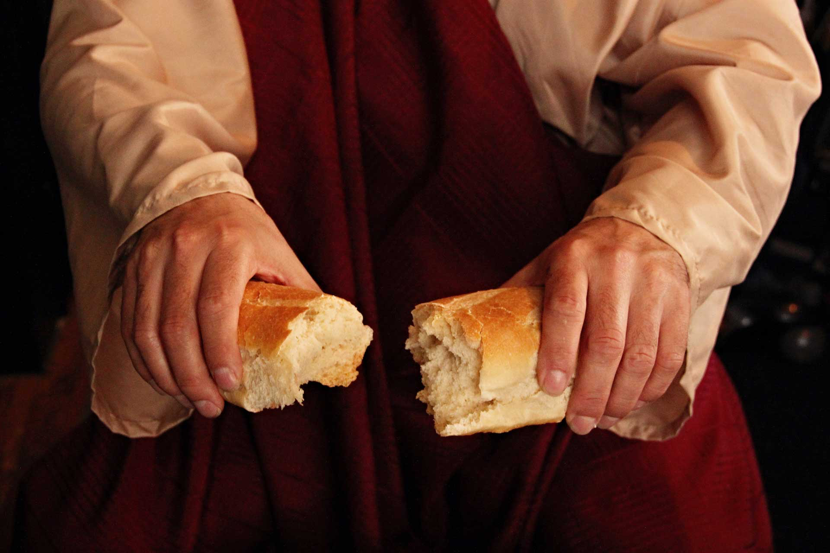
Celebrating and BELIEVING
The Sacrifice

Slide 16
John 6:40
For this is the will of my Father, that everyone who looks on the Son and believes in him should have eternal life, and I will raise him up on the last day.”

Slide 17
Matthew 5:6
“Blessed are those who hunger and thirst for righteousness, for they
shall be satisfied.

Slide 18
Ephesians 2:8
For by grace you have been saved through faith. And this is not your own doing; it is the gift of God

Slide 19
Believing Is Life

