Slide 2
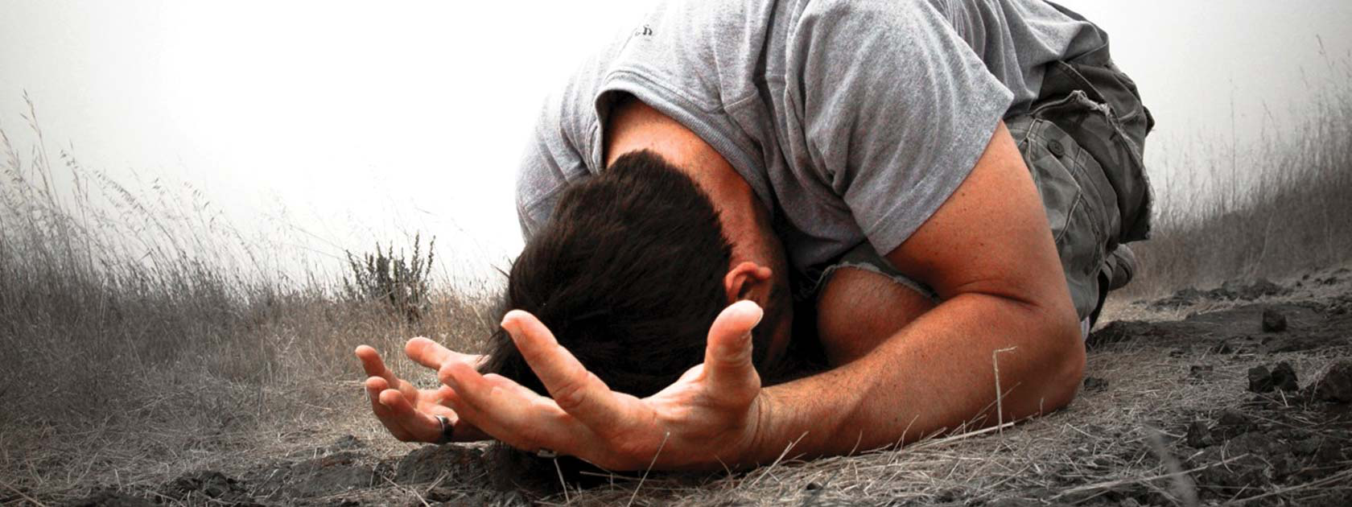
THE WORLD NEEDS
FAITH FILLED SURRENDERD HEARTS

Slide 3
Hebrews 13:14
For here we have no lasting city, but we seek the city that is to come.

Slide 4
1 John 2:16-17
For all that is in the world, the desires of the flesh and the desires of the eyes and pride of life—is not from the Father but is from the world. ¹⁷ And the world is passing away along with its desires, but whoever does the will of God abides forever.

Slide 5
Matthew 6:19-21
“Do not lay up for yourselves treasures on earth, where moth and rust destroy and where thieves break in and steal, ²⁰ but lay up for yourselves treasures in heaven, where neither moth nor rust destroys and where thieves do not break in and steal. ²¹ For where your treasure is, there your heart will be also.

Slide 6
Romans 12:2
Do not be conformed to this world, but be transformed by the renewal of your mind, that by testing you may discern what is the will of God, what is good and acceptable and perfect.

Slide 7
Philippians 3:20
But our citizenship is in heaven, and from it we await a Savior, the Lord Jesus Christ

Slide 8
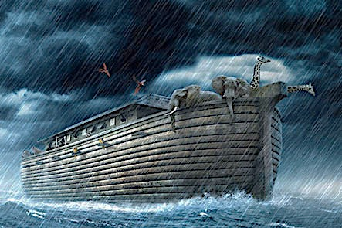
For as were the days of Noah, so will be the coming of the Son of Man. ³⁸ For as in those days before the flood they were eating and drinking, marrying and giving in marriage, until the day when Noah entered the ark (Matthew 24:37-38)

Slide 9
James 1:21
Therefore put away all filthiness and rampant wickedness and receive with meekness the implanted word, which is able to save your souls.

Slide 10
1 John 1:9
"If we confess our sins, He is faithful and righteous to forgive us our sins and to cleanse us from all unrighteousness"

Slide 11
Luke 5:32
I have not come to call the righteous,
but sinners to repentance.

Slide 12
John 8:11
She said, “No one, Lord.” And Jesus said, “Neither do I condemn you; go, and from now on sin no more.”

Slide 13
Hebrews 10:26-27
For if we go on sinning deliberately after receiving the knowledge of the truth, there no longer remains a sacrifice for sins, ²⁷ but a fearful expectation of judgment, and a fury of fire that will consume the adversaries.

Slide 14
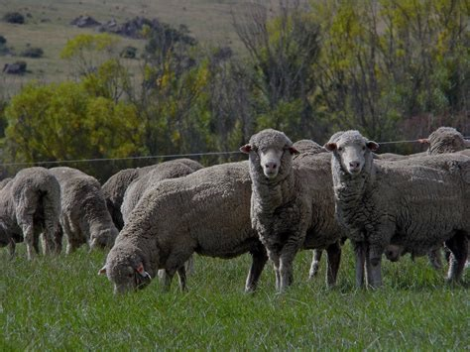
Matthew 9:35-38
And Jesus went throughout all the cities and villages, teaching in their synagogues and proclaiming the gospel of the kingdom and healing every disease and every affliction. ³⁶ When he saw the crowds, he had compassion for them, because they were harassed and helpless, like sheep without a shepherd. ………….

Slide 15
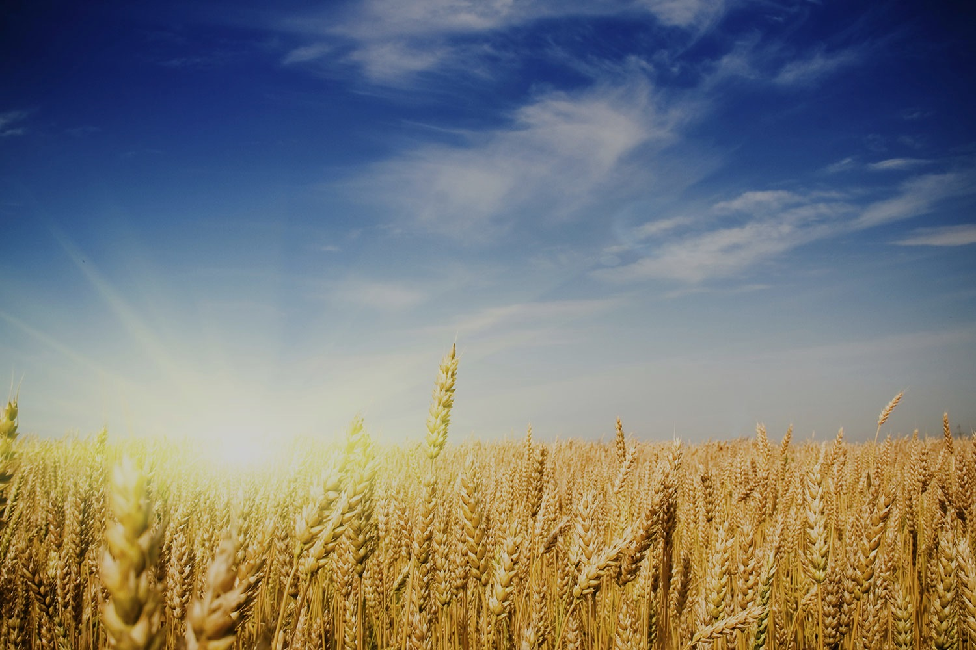
………………. ³⁷ Then he said to his disciples, “The harvest is plentiful, but the laborers are few; ³⁸ therefore pray earnestly to the Lord of the harvest to send out laborers into his harvest.”

Slide 16
Luke 14:25-28
Now great crowds accompanied him, and he turned and said to them, ²⁶ “If anyone comes to me and does not hate his own father and mother and wife and children and brothers and sisters, yes, and even his own life, he cannot be my disciple. ……….

Slide 17
^{………… 27} Whoever does not bear his own cross and come after me cannot be my disciple. ²⁸ For which of you, desiring to build a tower, does not first sit down and count the cost, whether he has enough to complete it?

Slide 18
Hebrews 10:35-39
Therefore do not throw away your confidence, which has a great reward.
³⁶ For you have need of endurance, so that when you have done the will of God you may receive what is promised.
³⁷ For, “Yet a little while, and the coming one will come and will not delay; ………

Slide 19
^{…… 38} but my righteous one shall live by faith, and if he shrinks back, my soul has no pleasure in him.” ³⁹ But we are not of those who shrink back and are destroyed, but of those who have faith and preserve their souls.

Slide 20
Romans 8:7
For the mind that is set on the flesh is hostile to God, for it does not submit to God's law; indeed, it cannot.

Slide 21
2 John 7
For many deceivers have gone out into the world, those who do not confess the coming of Jesus Christ in the flesh. Such a one is the deceiver and the antichrist.

Slide 22
2 Corinthians 4:4
In their case the god of this world has blinded the minds of the unbelievers, to keep them from seeing the light of the gospel of the glory of Christ, who is the image of God. By God’s mercy, our minds have been opened for the very purpose of freely choosing the Sovereign God and willingly submitting ourselves to Him and His will for our lives.

Slide 23
Matthew 5:14-16
“You are the light of the world. A city set on a hill cannot be hidden. ¹⁵ Nor do people light a lamp and put it under a basket, but on a stand, and it gives light to all in the house. ¹⁶ In the same way, let your light shine before others, so that they may see your good works and give glory to your Father who is in heaven.

Slide 24
1 Peter 2:9
But you are a chosen race, a royal priesthood, a holy nation, a people for his own possession, that you may proclaim the excellencies of him who called you out of darkness into his marvelous light.

Slide 25
Philippians 2:14-15
Do all things without grumbling or disputing, ¹⁵ that you may be blameless and innocent, children of God without blemish in the midst of a crooked and twisted generation, among whom you shine as lights in the world

Slide 26
Acts 13:47
For so the Lord has commanded us, saying, “I have made you a light for the Gentiles, that you may bring salvation to the ends of the earth.”

Slide 27
1 Timothy 2:3-4
This is good, and it is pleasing in the sight of God our Savior,⁴ who desires all people to be saved and to come to the knowledge of the truth.

Slide 28
THE WORLD NEEDS
FAITH FILLED SURRENDERD HEARTS

