Slide 2
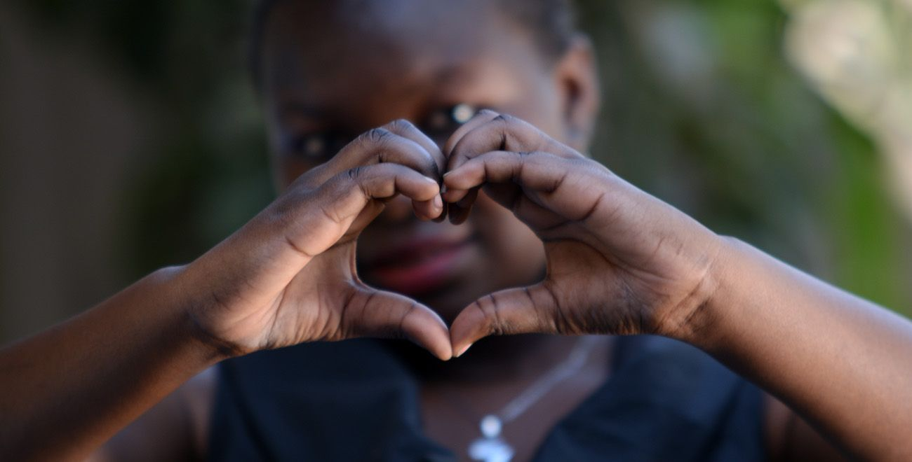
What Kind Of Love
The Father Has Given To Us
1 Peter 1:3
Blessed be the God and Father of our Lord Jesus Christ! According to his great mercy,
he has caused us to be born again to a living hope
through the resurrection of Jesus Christ from the dead.

Slide 3
1 John 3:1-3
See what kind of love the Father has given to us, that we should be called children of God; and so we are. The reason why the world does not know us is that it did not know him.² Beloved, we are God's children now, and what we will be has not yet appeared; but we know that when he appears we shall be like him, because we shall see him as he is.³ And everyone who thus hopes in him purifies himself as he is pure.

Slide 4
Romans 5:8
But God shows his love for us in that while we were still sinners, Christ died for us.

Slide 5
John 1:12
But to all who did receive him, who believed in his name, he gave the right to become children of God,

Slide 6
John 14:18
“I will not leave
you as orphans;
I will come to you”

Slide 7
2 Corinthians 6:16-18
What agreement has the temple of God with idols? For we are the temple of the living God; as God said, “I will make my dwelling among them and walk among them, and I will be their God, and they shall be my people. ……..

Slide 8
^{..……17} Therefore go out from their midst, and be separate from them, says the Lord, and touch no unclean thing; then I will welcome you,¹⁸ and I will be a father to you, and you shall be sons and daughters to me, says the Lord Almighty.”

Slide 9
1 John 3:2
Beloved, we are God's children now, and what we will be has not yet appeared; but we know that when he appears we shall be like him, because we shall see him as he is.

Slide 10
1 Corinthians 2:9
But, as it is written, “What no eye has seen, nor ear heard, nor the heart of man imagined, what God has prepared for those who love him”

Slide 11
2 Corinthians 3:18
And we all, with unveiled face, beholding the glory of the Lord, are being transformed into the same image from one degree of glory to another. For this comes from the Lord who is the Spirit

Slide 12
Philippians 3:20-21
But our citizenship is in heaven, and from it we await a Savior, the Lord Jesus Christ, ²¹ who will transform our lowly body to be like his glorious body, by the power that enables him even to subject all things to himself

Slide 13
Revelation 1:13-16
and in the midst of the lampstands one like a son of man, clothed with a long robe and with a golden sash around his chest. ¹⁴ The hairs of his head were white, like white wool, like snow. His eyes were like a flame of fire, ……..

Slide 14
^{……. 15} his feet were like burnished bronze, refined in a furnace, and his voice was like the roar of many waters. ¹⁶ In his right hand he held seven stars, from his mouth came a sharp two-edged sword, and his face was like the sun shining in full strength.

Slide 15
1 John 3:3
And everyone who thus hopes in him purifies himself as he is pure.

Slide 16
Matthew 5:8
Blessed are the pure in heart, for they will see God.

Slide 17
Philippians 1:6
And I am sure of this, that he who began a good work in you will bring it to completion at the day of Jesus Christ.

Slide 18
1 Peter 1:3-9
Blessed be the God and Father of our Lord Jesus Christ! According to his great mercy, he has caused us to be born again to a living hope through the resurrection of Jesus Christ from the dead, ⁴ to an inheritance that is imperishable, undefiled, and unfading, kept in heaven for you, ⁵ who by God's power are being guarded through faith for a salvation ready to be revealed in the last time……..

Slide 19
^{……… 6} In this you rejoice, though now for a little while, if necessary, you have been grieved by various trials, ⁷ so that the tested genuineness of your faith—more precious than gold that perishes though it is tested by fire—may be found to result in praise and glory and honor at the revelation of Jesus Christ ……….

Slide 20
^{………… 8} Though you have not seen him, you love him. Though you do not now see him, you believe in him and rejoice with joy that is inexpressible and filled with glory, ⁹ obtaining the outcome of your faith, the salvation of your souls.

Slide 21
Mark 9:35
And he sat down and called the twelve. And he said to them, “If anyone would be first, he must be last of all and servant of all.”

Slide 22
Matthew 20:28
“Even as the Son of Man came not to be served but to serve, and to give his life as a ransom for many.”

Slide 23
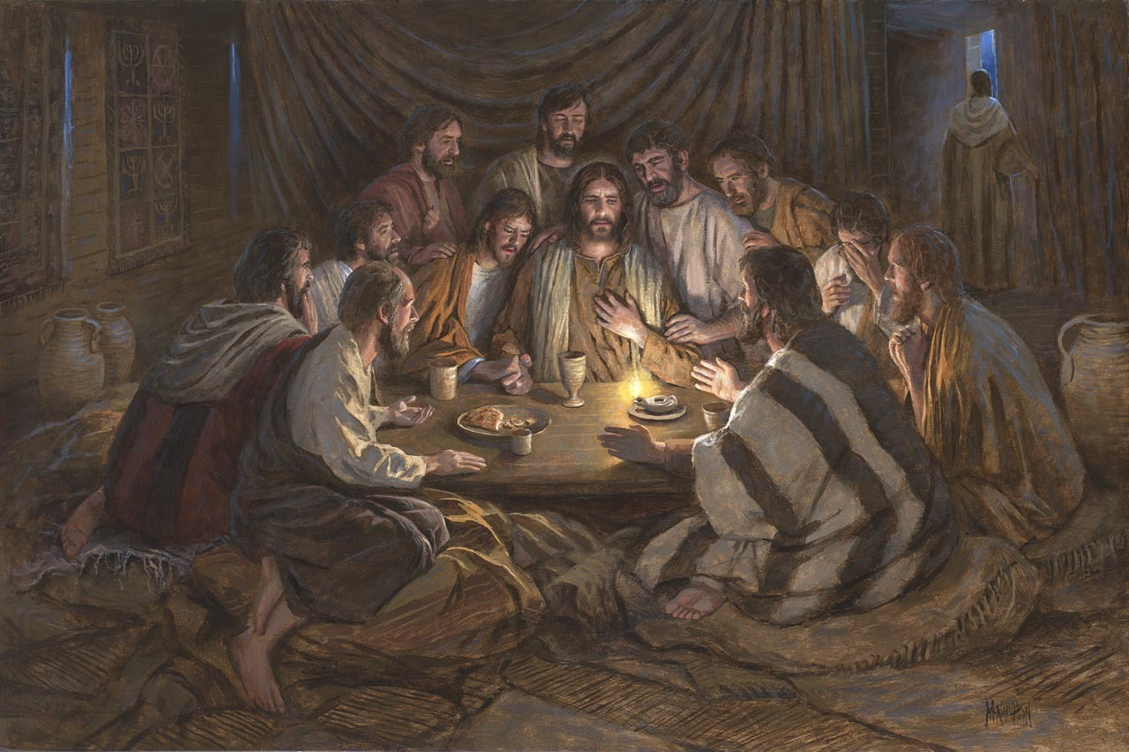
COMMUNION
1 Corinthians 11:23-26 For I received from the Lord what I also delivered to you, that the Lord Jesus on the night when he was betrayed took bread, ²⁴ and when he had given thanks, he broke it, and said, “This is my body, which is for you. Do this in remembrance of me.” ²⁵ In the same way also he took the cup, after supper, saying, “This cup is the new covenant in my blood. Do this, as often as you drink it, in remembrance of me.” ²⁶ For as often as you eat this bread and drink the cup, you proclaim the Lord's death until he comes.

Slide 24
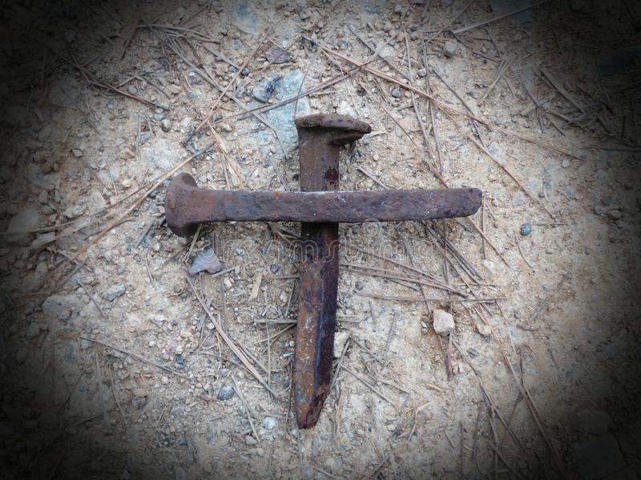
What Kind Of Love
The Father Has Given To Us
1 Peter 1:3
Blessed be the God and Father of our Lord Jesus Christ! According to his great mercy,
he has caused us to be born again to a living hope
through the resurrection of Jesus Christ from the dead.

Slide 25
Active Participation
In The Return Of Jesus
1 Peter 1:3
Blessed be the God and Father of our Lord Jesus Christ! According to his great mercy,
he has caused us to be born again to a living hope
through the resurrection of Jesus Christ from the dead.

