Slide 3
2 Timothy 3:14-15
But as for you, continue in what you have learned and have firmly believed, knowing from whom you learned it ¹⁵ and how from childhood you have been acquainted with the sacred writings, which are able to make you wise for salvation through faith in Christ Jesus.

Slide 4
2 Timothy 3:16-17
All Scripture is breathed out by God and profitable for teaching, for reproof, for correction, and for training in righteousness, ¹⁷ that the man of God may be complete, equipped for every good work.

Slide 5
Hebrews 4:12
For the word of God is living and active, sharper than any two-edged sword, piercing to the division of soul and of spirit, of joints and of marrow, and discerning the thoughts and intentions of the heart

Slide 6
James 1:22
But be doers of the word, and not hearers only, deceiving yourselves.

Slide 7
John 1:1, 14
In the beginning was the Word, and the Word was with God, and the Word was God……. ¹⁴ And the Word became flesh and dwelt among us, and we have seen his glory, glory as of the only Son from the Father, full of grace and truth

Slide 8
Psalm 119:114
You are my hiding place and my shield; I hope in your word.

Slide 9
Proverbs 30:5
Every word of God proves true; he is a shield to those who take refuge in him.

Slide 10
John 14:23
Jesus answered him, “If anyone loves me, he will keep my word, and my Father will love him, and we will come to him and make our home with him.

Slide 11
Isaiah 55:10-11 “For as the rain and the snow come down from heaven and do not return there but water the earth, making it bring forth and sprout, giving seed to the sower and bread to the eater,¹¹ so shall my word be that goes out from my mouth; it shall not return to me empty, but it shall accomplish that which I purpose, and shall succeed in the thing for which I sent it.

Slide 12
Ephesians 6:17
the sword of the Spirit, which is the word of God

Slide 13
https://youtu.be/bX1hUAArazc
Free Burma Rangers in Mosul:
'No Greater Love’
clip

Slide 14
God’s Word has power to convict us of sin.
Acts 2:37
Now when they heard this they were cut to the heart, and said to Peter and the rest of the apostles, “Brothers, what shall we do?”

Slide 15
God’s Word has power to impart spiritual life.
1 Peter 1:23
since you have been born again, not of perishable seed but of imperishable, through the living and abiding word of God;

Slide 16
God’s Word has power to produce faith.
Romans 10:17
So faith comes from hearing, and hearing through the word of Christ

Slide 17
God’s Word has power to build us up in spiritual maturity.
Acts 20:32
And now I commend you to God and to the word of his grace, which is able to build you up and to give you the inheritance among all those who are sanctified

Slide 18
God’s Word has power to cleanse our lives.
Ephesians 5:26
that he might sanctify her, having cleansed her by the washing of water with the word

Slide 19
God’s word has power to give
revelation and make us wise.
Psalm 119:105,130
Your word is a lamp to my feet and a light to my path.
¹³⁰ The unfolding of your words gives light; it imparts understanding to the simple.

Slide 20
God’s Word has power to reveal to us the promise of eternal life.
1 John 5:13
I write these things to you who believe in the name of the Son of God, that you may know that you have eternal life.

Slide 21
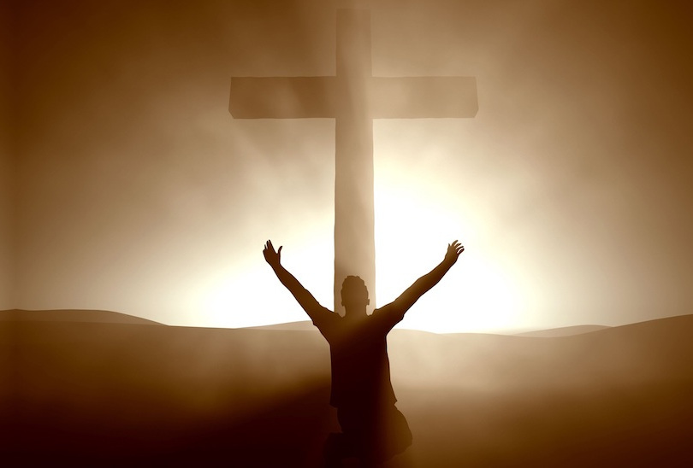
“This is my body, which is for you. Do this in remembrance of me.” 25 In the same way also he took the cup, after supper, saying, “This cup is the new covenant in my blood. Do this, as often as you drink it, in remembrance of me.”

Slide 22
1 Peter 2:24-25
He himself bore our sins in his body on the tree, that we might die to sin and live to righteousness. By his wounds you have been healed. ²⁵ For you were straying like sheep, but have now returned to the Shepherd and Overseer of your souls.

Slide 23
Isaiah 53:12
Therefore I will divide him a portion with the many, and he shall divide the spoil with the strong, because he poured out his soul to death and was numbered with the transgressors; yet he bore the sin of many, and makes intercession for the transgressors.

Slide 24
Galatians 2:20
I have been crucified with Christ. It is no longer I who live, but Christ who lives in me. And the life I now live in the flesh I live by faith in the Son of God, who loved me and gave himself for me.

