Slide 2
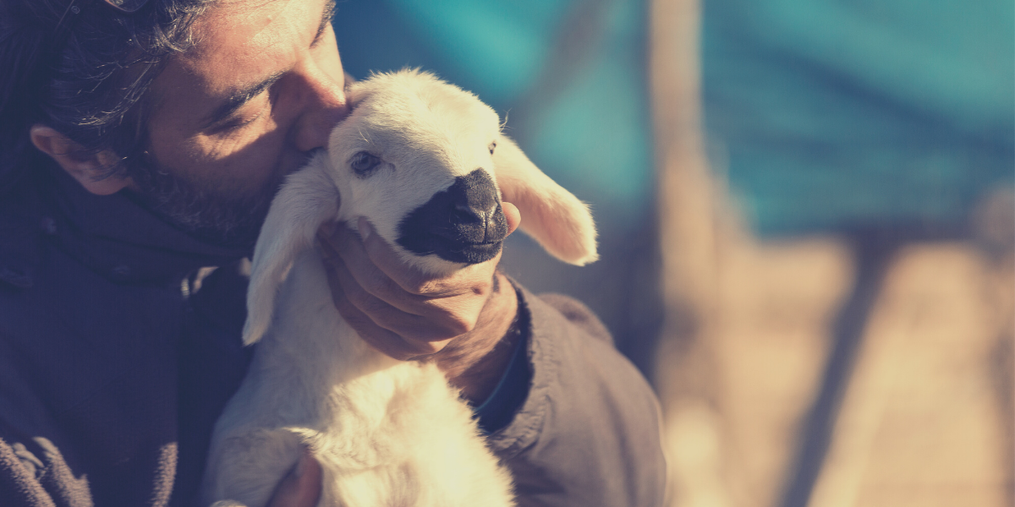
The Contentment Of My Good Shepherd
1 Peter 1:3
Blessed be the God and Father of our Lord Jesus Christ! According to his great mercy,
he has caused us to be born again to a living hope
through the resurrection of Jesus Christ from the dead.

Slide 3
Psalm 23
The Lord is my shepherd; I shall not want.² He makes me lie down in green pastures. He leads me beside still waters.³ He restores my soul. He leads me in paths of righteousness for his name's sake. ⁴ Even though I walk through the valley of the shadow of death, I will fear no evil, ………..

Slide 4
……for you are with me; your rod and your staff, they comfort me. ⁵ You prepare a table before me in the presence of my enemies; you anoint my head with oil; my cup overflows. ⁶ Surely goodness and mercy shall follow me all the days of my life, and I shall dwell in the house of the Lord forever.

Slide 5
Psalm 23:1-3
The Lord is my shepherd; I shall not want.² He makes me lie down in green pastures. He leads me beside still waters.³ He restores my soul. He leads me in paths of righteousness for his name's sake.

Slide 6
Philippians 4:19
And my God will supply every need of yours according to his riches in glory in Christ Jesus.

Slide 7
Psalm 23:4
Even though I walk through the valley of the shadow of death, I will fear no evil, for you are with me; your rod and your staff, they comfort me.

Slide 8
Isaiah 43:2
When you pass through the waters, I will be with you; and through the rivers, they shall not overwhelm you; when you walk through fire you shall not be burned, and the flame shall not consume you.

Slide 9
Psalm 46:1
God is our refuge and strength, a very present help in trouble.

Slide 10
Psalm 118:6-7
The Lord is on my side; I will not fear. What can man do to me? ⁷ The Lord is on my side as my helper; I shall look in triumph on those who hate me.

Slide 11
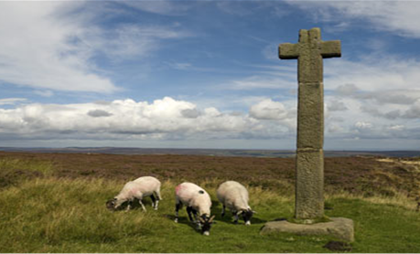
Communion - Remembering
The Good Shepherd Laying Down His Life

Slide 12
John 10:11
I am the good shepherd. The good shepherd lays down his life for the sheep.
1 Peter 1:3
Blessed be the God and Father of our Lord Jesus Christ! According to his great mercy,
he has caused us to be born again to a living hope
through the resurrection of Jesus Christ from the dead.

Slide 13
Psalm 23:5
You prepare a table before me in the presence of my enemies; you anoint my head with oil; my cup overflows.

Slide 14
Luke 1:78-79
because of the tender mercy of our God, whereby the sunrise shall visit us from on high ⁷⁹ to give light to those who sit in darkness and in the shadow of death, to guide our feet into the way of peace.”

Slide 15
Psalm 23:6
Surely goodness and mercy
shall follow me all the days of my life, and I shall dwell in the house of the Lord forever

Slide 16
The Contentment Of My Good Shepherd
1 Peter 1:3
Blessed be the God and Father of our Lord Jesus Christ! According to his great mercy,
he has caused us to be born again to a living hope
through the resurrection of Jesus Christ from the dead.

