Slide 2
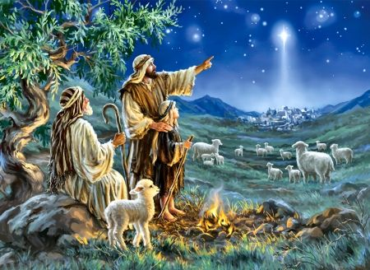
“CHRISTMAS”
1 Peter 1:3
Blessed be the God and Father of our Lord Jesus Christ! According to his great mercy,
he has caused us to be born again to a living hope
through the resurrection of Jesus Christ from the dead.
A Reminder to Keep Watch

Slide 3
Isaiah 7:14
“The Lord Himself will give you a sign: Behold, the virgin will conceive and will bear a son, and she will call his name Immanuel.”

Slide 4
Matthew 1:18
Now the birth of Jesus Christ took place in this way. When his mother Mary had been betrothed to Joseph, before they came together she was found to be with child from the Holy Spirit

Slide 5
Matthew 2:4-6 and assembling all the chief priests and scribes of the people, he inquired of them where the Christ was to be born. ⁵ They told him, “In Bethlehem of Judea, for so it is written by the prophet: ⁶ “‘And you, O Bethlehem, in the land of Judah, are by no means least among the rulers of Judah; for from you shall come a ruler who will shepherd my people Israel.’”

Slide 6
Mark 13:37
And what I say to you I say to all: Watch.”

Slide 7
Matthew 24:42-44
Watch therefore, for you do not know what hour your Lord is coming. ⁴³ But know this, that if the master of the house had known what hour the thief would come, he would have watched and not allowed his house to be broken into. ⁴⁴ Therefore you also be ready, for the Son of Man is coming at an hour you do not expect.

Slide 8
Matthew 25:13
Watch therefore, for you know neither the day nor the hour in which the Son of Man is coming.

Slide 9
Mark 13:34-37
It is like a man going to a far country, who left his house and gave authority to his servants, and to each his work, and commanded the doorkeeper to watch. ³⁵ Watch therefore, for you do not know when the master of the house is coming, in the evening, at midnight, at the crowing of the rooster, or in the morning ³⁶ lest, coming suddenly, he find you sleeping. ³⁷ And what I say to you, I say to all: Watch!”

Slide 10
Luke 12:37-40
Blessed are those servants whom the master, when he comes, will find watching. Assuredly, I say to you that he will gird himself and have them sit down to eat, and will come and serve them. ³⁸ And if he should come in the second watch, or come in the third watch, and find them so, blessed are those servants……..

Slide 11
^{……..39} But know this, that if the master of the house had known what hour the thief would come, he would have watched and not allowed his house to be broken into. ⁴⁰ Therefore you also be ready, for the Son of Man is coming at an hour you do not expect.”

Slide 12
1 Peter 2:21
For to this you have been called, because Christ also suffered for you, leaving you an example, so that you might follow in his steps.

Slide 13
Mark 14:34-39 (Matthew 26:38-44)
And he said to them, “My soul is very sorrowful, even to death. Remain here and watch.” ³⁵ And going a little farther, he fell on the ground and prayed that, if it were possible, the hour might pass from him. ³⁶ And he said, “Abba, Father, all things are possible for you. Remove this cup from me. Yet not what I will, but what you will……………..

Slide 14
^{……… 37} And he came and found them sleeping, and he said to Peter, “Simon, are you asleep? Could you not watch one hour? ³⁸ Watch and pray that you may not enter into temptation. The spirit indeed is willing, but the flesh is weak.”³⁹ And again he went away and prayed, saying the same words.

Slide 15
Matthew 26:56
But all this has taken place that the Scriptures of the prophets might be fulfilled.” Then all the disciples left him and fled.

Slide 16
Mark 14:50-52
And they all left him and fled. ⁵¹ And a young man followed him, with nothing but a linen cloth about his body. And they seized him, ⁵² but he left the linen cloth and ran away naked.

Slide 17
Hebrews 4:15
For we do not have a high priest who is unable to sympathize with our weaknesses, but one who in every respect has been tempted as we are, yet without sin.

Slide 18
Luke 22:41-44
And he withdrew from them about a stone's throw, and knelt down and prayed, ⁴² saying, “Father, if you are willing, remove this cup from me. Nevertheless, not my will, but yours, be done.” …………….

Slide 19
^{………….. 43} And there appeared to him an angel from heaven, strengthening him. ⁴⁴ And being in agony he prayed more earnestly; and his sweat became like great drops of blood falling down to the ground.

Slide 20
Ephesians 5:27
so that he might present the church to himself in splendor, without spot or wrinkle or any such thing, that she might be holy and without blemish.

Slide 21
2 Peter 3:14
Therefore, beloved, since you are waiting for these, be diligent to be found by him without spot or blemish, and at peace.

Slide 22
James 5:2
Your riches have rotted and your garments are moth-eaten

Slide 23
Revelation 16:15
“Behold, I am coming like a thief! Blessed is the one who stays awake, keeping his garments on, that he may not go about naked and be seen exposed!”

Slide 24
Revelation 3:3
Remember, then, what you received and heard. Keep it, and repent. If you will not wake up, I will come like a thief, and you will not know at what hour I will come against you.

Slide 25
Luke 21:36
But stay awake at all times, praying that you may have strength to escape all these things that are going to take place, and to stand before the Son of Man.”

Slide 26
Luke 2:8-14
And in the same region there were shepherds out in the field, keeping watch over their flock by night. ⁹ And an angel of the Lord appeared to them, and the glory of the Lord shone around them, and they were filled with great fear. ……………

Slide 27
^{………10} And the angel said to them, “Fear not, for behold, I bring you good news of great joy that will be for all the people. ¹¹ For unto you is born this day in the city of David a Savior, who is Christ the Lord. ¹² And this will be a sign for you: you will find a baby wrapped in swaddling cloths and lying in a manger.” ……………

Slide 28
^{……….. 13} And suddenly there was with the angel a multitude of the heavenly host praising God and saying,¹⁴ “Glory to God in the highest, and on earth peace among those with whom he is pleased!”

Slide 29
“CHRISTMAS”
1 Peter 1:3
Blessed be the God and Father of our Lord Jesus Christ! According to his great mercy,
he has caused us to be born again to a living hope
through the resurrection of Jesus Christ from the dead.
A Reminder to Keep Watch

Slide 30
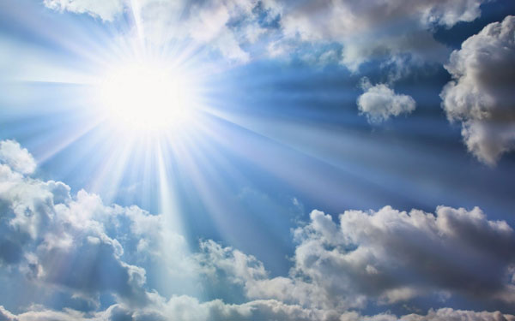
Active Participation
In The Return Of Jesus
1 Peter 1:3
Blessed be the God and Father of our Lord Jesus Christ! According to his great mercy,
he has caused us to be born again to a living hope
through the resurrection of Jesus Christ from the dead.

