Slide 2
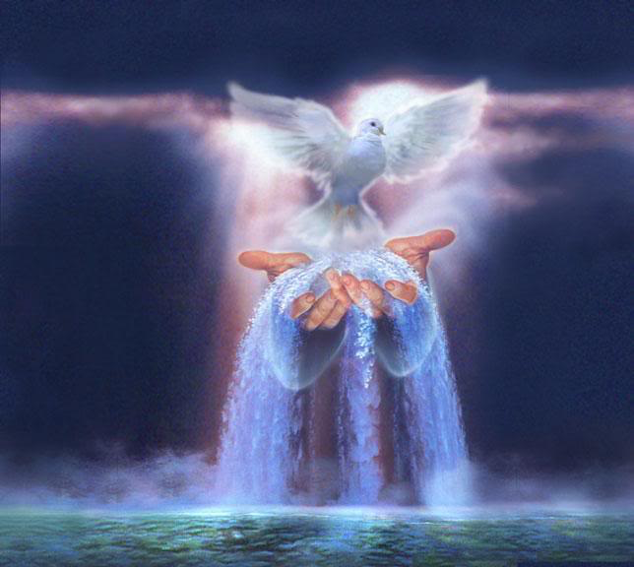
STAY CONNECTED TO THE HOLY SPIRITS FLOW

Slide 3
Ezekiel 37:14
And I will put my Spirit within you, and you shall live, and I will place you in your own land. Then you shall know that I am the Lord; I have spoken, and I will do it, declares the Lord.”

Slide 4
Joel 2:28-29
“And it shall come to pass afterward, that I will pour out my Spirit on all flesh; your sons and your daughters shall prophesy, your old men shall dream dreams, and your young men shall see visions. ²⁹ Even on the male and female servants in those days I will pour out my Spirit.

Slide 5
Ezekiel 36:25-26
I will sprinkle clean water on you, and you shall be clean from all your uncleannesses, and from all your idols I will cleanse you. ²⁶ And I will give you a new heart, and a new spirit I will put within you. And I will remove the heart of stone from your flesh and give you a heart of flesh.

Slide 6
Luke 3:16
John answered them all, saying, “I baptize you with water, but he who is mightier than I is coming, the strap of whose sandals I am not worthy to untie. He will baptize you with the Holy Spirit and fire.
Matthew 3:11 - Mark 1:8 - John 1:33

Slide 7
Acts 1:5
for John baptized with water, but you will be baptized with the Holy Spirit not many days from now.

Slide 8
John 7:37-39
On the last day of the feast, the great day, Jesus stood up and cried out, “If anyone thirsts, let him come to me and drink. ³⁸ Whoever believes in me, as the Scripture has said, ‘Out of his heart will flow rivers of living water.’” ³⁹ Now this he said about the Spirit, whom those who believed in him were to receive, for as yet the Spirit had not been given, because Jesus was not yet glorified.

Slide 9
Acts 1:8
But you will receive power when the Holy Spirit has come upon you, and you will be my witnesses in Jerusalem and in all Judea and Samaria, and to the end of the earth.”

Slide 10
Acts 2:37-39
Now when they heard this they were cut to the heart, and said to Peter and the rest of the apostles, “Brothers, what shall we do?” ³⁸ And Peter said to them, “Repent and be baptized every one of you in the name of Jesus Christ for the forgiveness of your sins, and you will receive the gift of the Holy Spirit. ³⁹ For the promise is for you and for your children and for all who are far off, everyone whom the Lord our God calls to himself.”

Slide 11
Romans 8:9
You, however, are not in the flesh but in the Spirit, if in fact the Spirit of God dwells in you. Anyone who does not have the Spirit of Christ does not belong to him.

Slide 12
Luke 11:9-13
And I tell you, ask, and it will be given to you; seek, and you will find; knock, and it will be opened to you. ¹⁰ For everyone who asks receives, and the one who seeks finds, and to the one who knocks it will be opened. ……….

Slide 13
^{………… 11} What father among you, if his son asks for a fish, will instead of a fish give him a serpent; ¹² or if he asks for an egg, will give him a scorpion? ¹³ If you then, who are evil, know how to give good gifts to your children, how much more will the heavenly Father give the Holy Spirit to those who ask him!”

Slide 14
John 14:17
even the Spirit of truth, whom the world cannot receive, because it neither sees him nor knows him. You know him, for he dwells with you and will be in you.

Slide 15
1 Corinthians 6:19
Or do you not know that your body is a temple of the Holy Spirit within you, whom you have from God? You are not your own.

Slide 16
1 Corinthians 12:13
For in one Spirit we were all baptized into one body—Jews or Greeks, slaves or free—and all were made to drink of one Spirit.

Slide 17
Acts 13:2
While they were worshiping the Lord and fasting, the Holy Spirit said, “Set apart for me Barnabas and Saul for the work to which I have called them.”

Slide 18
Acts 8:35-39
Then Philip opened his mouth, and beginning with this Scripture he told him the good news about Jesus. ³⁶ And as they were going along the road they came to some water, and the eunuch said, “See, here is water! What prevents me from being baptized?” ……………

Slide 19
^{……… 38} And he commanded the chariot to stop, and they both went down into the water, Philip and the eunuch, and he baptized him.³⁹ And when they came up out of the water, the Spirit of the Lord carried Philip away, and the eunuch saw him no more, and went on his way rejoicing.

Slide 20
Romans 8:26-27
Likewise the Spirit helps us in our weakness. For we do not know what to pray for as we ought, but the Spirit himself intercedes for us with groanings too deep for words. ²⁷ And he who searches hearts knows what is the mind of the Spirit, because the Spirit intercedes for the saints according to the will of God.

Slide 21
Ephesians 5:15-21
Look carefully then how you walk, not as unwise but as wise,¹⁶ making the best use of the time, because the days are evil.¹⁷ Therefore do not be foolish, but understand what the will of the Lord is. ¹⁸ And do not get drunk with wine, for that is debauchery, but be filled with the Spirit, ……..

Slide 22
^{…… 19} addressing one another in psalms and hymns and spiritual songs, singing and making melody to the Lord with your heart, ²⁰ giving thanks always and for everything to God the Father in the name of our Lord Jesus Christ, ²¹ submitting to one another out of reverence for Christ.

Slide 23
Luke 11:13
If you then, who are evil, know how to give good gifts to your children, how much more will the heavenly Father give the Holy Spirit to those who ask him!”

Slide 24
STAY CONNECTED TO THE HOLY SPIRITS FLOW

