Slide 2
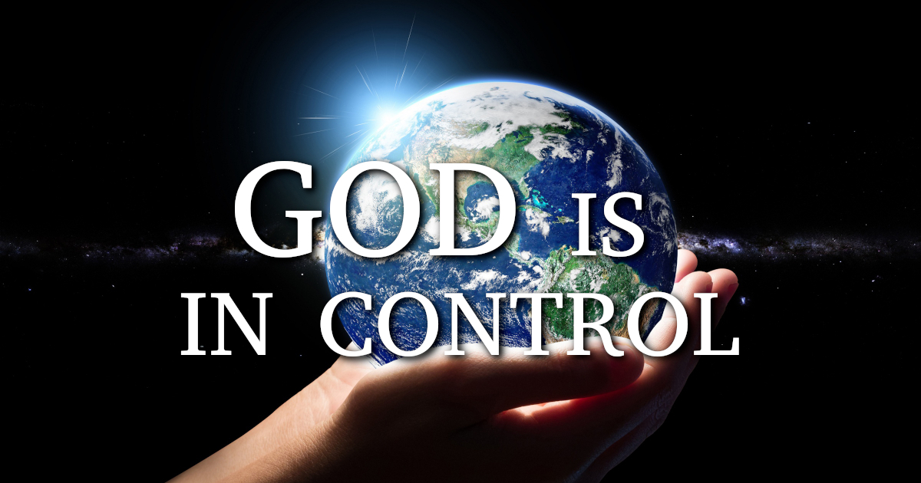
“I have set before you an open door”
Jesus

Slide 3
Isaiah 45:7-8
I form light and create darkness; I make well-being and create calamity; I am the Lord, who does all these things. ⁸ “Shower, O heavens, from above, and let the clouds rain down righteousness; let the earth open, that salvation and righteousness may bear fruit; let the earth cause them both to sprout; I the Lord have created it.

Slide 4
Matthew 10:29-31
And not one of them will fall to the ground apart from your Father.
³⁰ But even the hairs of your head are all numbered. ³¹ Fear not, therefore; you are of more value than many sparrows.

Slide 5
Romans 8:28
And we know that in all things God works for the good of those who love him, who have been called according to his purpose.

Slide 6
Prayer for the President (Pre & post election)
His advisors
the Election

Slide 7
Philippians 3:20-21
But our citizenship is in heaven, and from it we await a Savior, the Lord Jesus Christ,²¹ who will transform our lowly body to be like his glorious body, by the power that enables him even to subject all things to himself.

Slide 8
1 Peter 2:11-12
Beloved, I urge you as sojourners and exiles to abstain from the passions of the flesh, which wage war against your soul. ¹² Keep your conduct among the Gentiles honorable, so that when they speak against you as evildoers, they may see your good deeds and glorify God on the day of visitation.

Slide 9
Isaiah 46:8-11 Remember this and stand firm, recall it to mind, you transgressors, ⁹ remember the former things of old; for I am God, and there is no other; I am God, and there is none like me, ¹⁰ declaring the end from the beginning and from ancient times things not yet done, saying, ‘My counsel shall stand, and I will accomplish all my purpose,’ ¹¹ calling a bird of prey from the east, the man of my counsel from a far country. I have spoken, and I will bring it to pass; I have purposed, and I will do it.

Slide 10
2 Corinthians 5:18-20
All this is from God, who reconciled us to himself through Christ and gave us the ministry of reconciliation: ¹⁹ that God was reconciling the world to himself in Christ, not counting people’s sins against them. And he has committed to us the message of reconciliation. ²⁰ We are therefore Christ’s ambassadors, as though God were making his appeal through us. We implore you on Christ’s behalf: Be reconciled to God.

Slide 11
Prayer for the Church
The mission
The Lost and dyeing

Slide 12
Romans 12:1-2
I appeal to you therefore, brothers, by the mercies of God, to present your bodies as a living sacrifice, holy and acceptable to God, which is your spiritual worship. ² Do not be conformed to this world, but be transformed by the renewal of your mind, that by testing you may discern what is the will of God, what is good and acceptable and perfect.

Slide 13
John 17:20-24
I do not ask for these only, but also for those who will believe in me through their word,²¹ that they may all be one, just as you, Father, are in me, and I in you, that they also may be in us, so that the world may believe that you have sent me. ²² The glory that you have given me I have given to them, that they may be one even as we are one, ………..

Slide 14
^{………23} I in them and you in me, that they may become perfectly one, so that the world may know that you sent me and loved them even as you loved me. ²⁴ Father, I desire that they also, whom you have given me, may be with me where I am, to see my glory that you have given me because you loved me before the foundation of the world.

Slide 15
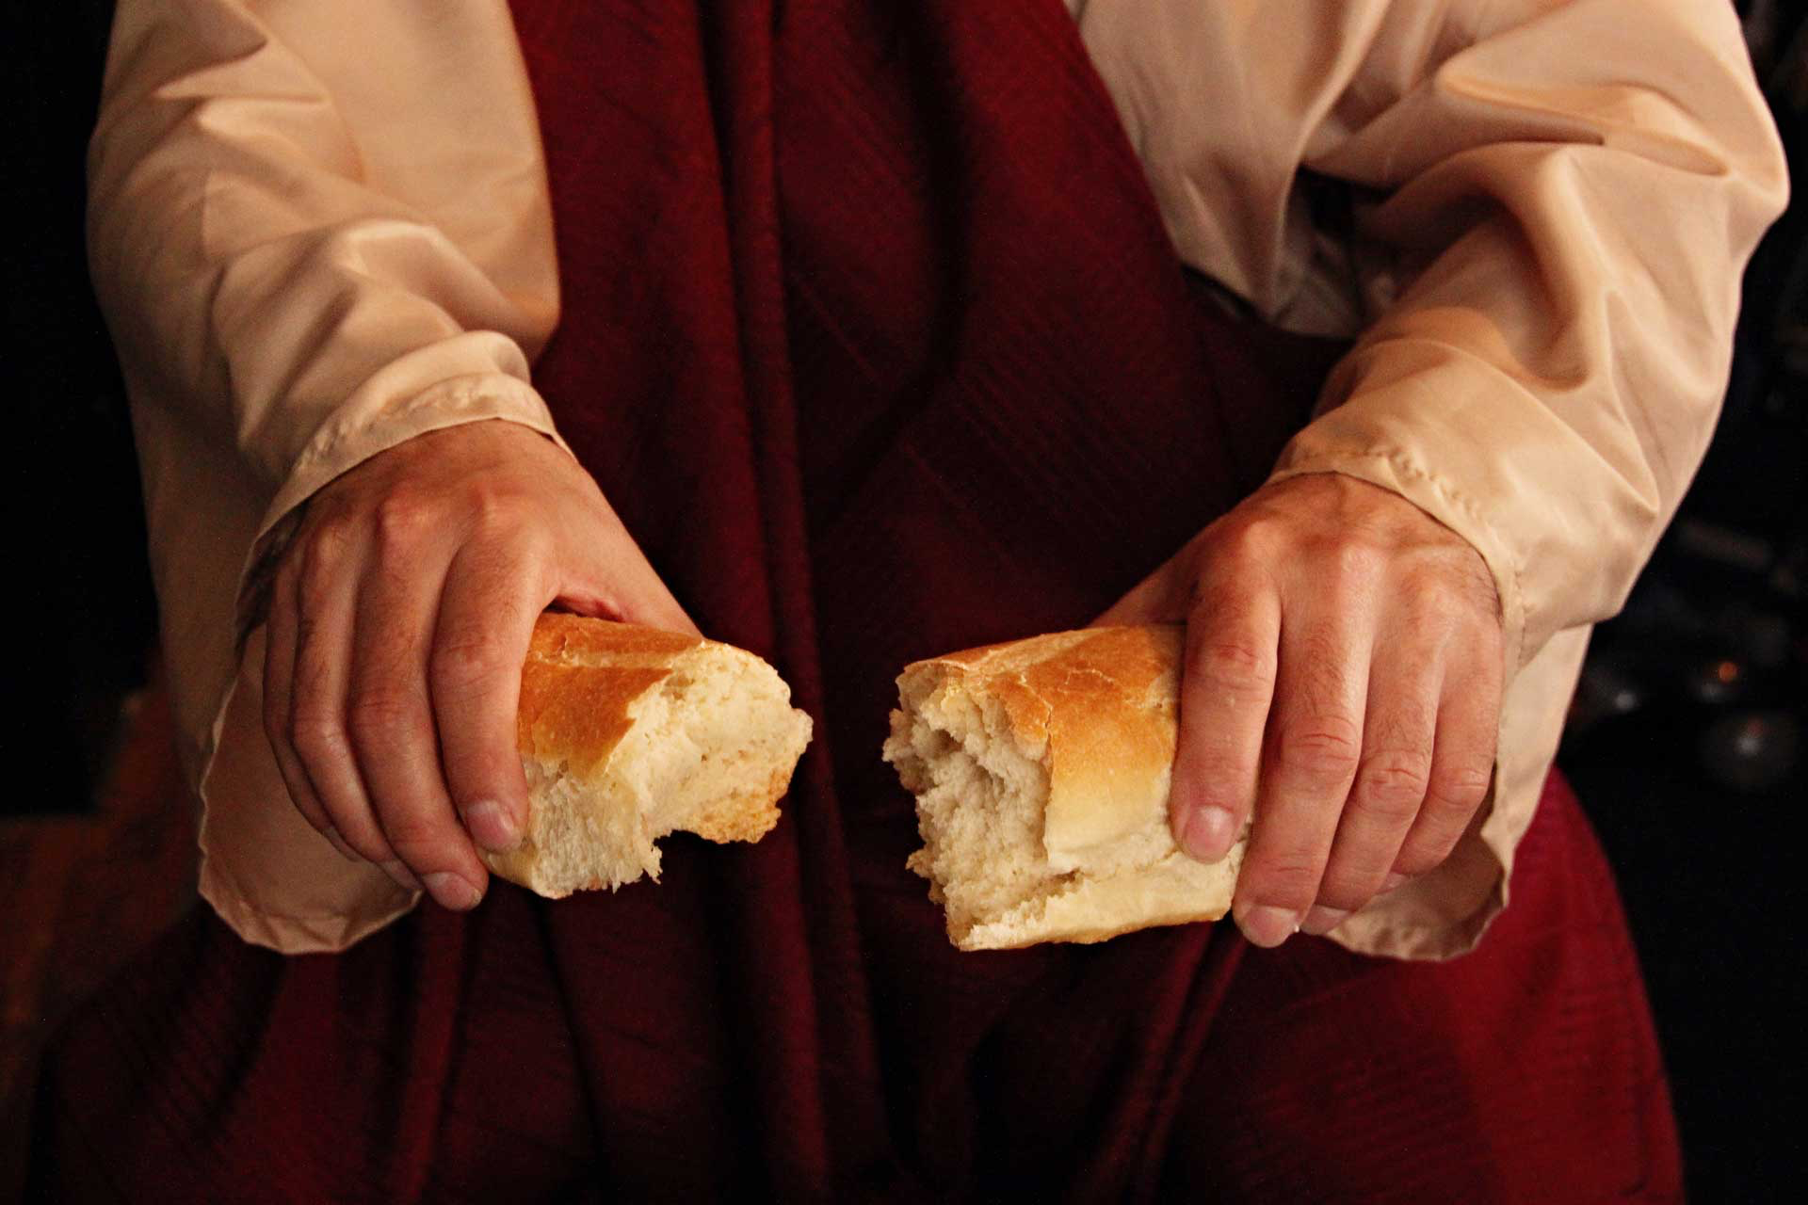
Remembering
The Living Sacrifice of
Jesus the Lord of All

Slide 16
“I have set before you an open door”
Jesus

