Slide 2
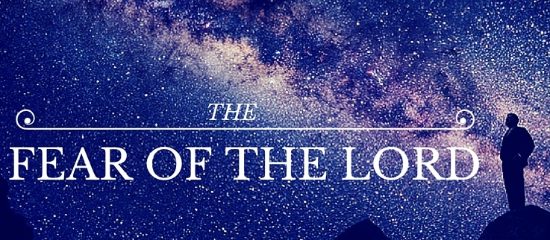
THE WAY OF WISDOM
1 Peter 1:3
Blessed be the God and Father of our Lord Jesus Christ! According to his great mercy,
he has caused us to be born again to a living hope
through the resurrection of Jesus Christ from the dead.

Slide 3
Matthew 7:23
And then will I declare to them, ‘I never knew you; depart from me,
you workers of lawlessness!

Slide 4
Matthew 7:21-22
“Not everyone who says to me, ‘Lord, Lord,’ will enter the kingdom of heaven, but the one who does the will of my Father who is in heaven. ²² On that day many will say to me, ‘Lord, Lord, did we not prophesy in your name, and cast out demons in your name, and do many mighty works in your name?’

Slide 5
John 3:3
Jesus answered him, “Truly, truly, I say to you, unless one is born again he cannot see the kingdom of God.”

Slide 6
Romans 5:8
But God shows his love for us in that while we were still sinners, Christ died for us.

Slide 7
Nehemiah 1:5
And I said, “O Lord God of heaven, the great and awesome God who keeps covenant and steadfast love with those who love him and keep his commandments,

Slide 8
John 3:16
“For God so loved the world, that he gave his only Son, that whoever believes in him should not perish but have eternal life.”

Slide 9
Psalm 147:5
Great is our Lord, and abundant in power; his understanding is beyond measure.
Genesis 1:1
In the beginning, God created the heavens and the earth.

Slide 10
Isaiah 40:28 Have you not known? Have you not heard? The Lord is the everlasting God, the Creator of the ends of the earth. He does not faint or grow weary; his understanding is unsearchable.
Psalm 47:2 For the Lord, the Most High, is to be feared, a great king over all the earth.

Slide 11
Hebrews 1:3
He is the radiance of the glory of God and the exact imprint of his nature, and he upholds the universe by the word of his power. After making purification for sins, he sat down at the right hand of the Majesty on high,

Slide 12
Hebrews 12:28-29
Therefore, since we are receiving a kingdom that cannot be shaken, let us be thankful, and so worship God acceptably with reverence and awe, ²⁹ for our “God is a consuming fire.”

Slide 13
Proverbs 28:14
Blessed is the one who fears the Lord always, but whoever hardens his heart will fall into calamity.

Slide 14
Isaiah 66:2
All these things my hand has made, and so all these things came to be, declares the Lord. But this is the one to whom I will look: he who is humble and contrite in spirit and trembles at my word.

Slide 15
Philippians 2:12⁻13
Therefore, my beloved, as you have always obeyed, so now, not only as in my presence but much more in my absence, work out your own salvation with fear and trembling,¹³ for it is God who works in you, both to will and to work for his good pleasure.

Slide 16
John 15:5
“I am the vine; you are the branches. If you remain in me and I in you, you will bear much fruit; apart from me you can do nothing.

Slide 17
1 Corinthians 12:6
There are different kinds of working, but in all of them and in everyone it is the same God at work.

Slide 18
Proverbs 8:13
The fear of the Lord is hatred of evil. Pride and arrogance and the way of evil and
perverted speech I hate.

Slide 19
Psalm 16:11
You make known to me the path of life; in your presence there is fullness of joy; at your right hand are pleasures forevermore

Slide 20
Genesis 22:3
So Abraham rose early in the morning, saddled his donkey, and took two of his young men with him, and his son Isaac. And he cut the wood for the burnt offering and arose and went to the place of which God had told him.

Slide 21
Acts 10:1-2
At Caesarea there was a man named Cornelius, a centurion of what was known as the Italian Cohort, ² a devout man who feared God with all his household, gave alms generously to the people, and prayed continually to God.

Slide 22
Acts 10:22
And they said, “Cornelius, a centurion, an upright and God-fearing man, who is well spoken of by the whole Jewish nation, was directed by a holy angel to send for you to come to his house and to hear what you have to say.”

Slide 23
Psalm 51:1-4
Have mercy on me, O God, according to your steadfast love; according to your abundant mercy blot out my transgressions. ² Wash me thoroughly from my iniquity, and cleanse me from my sin! ³ For I know my transgressions, and my sin is ever before me.⁴ Against you, you only, have I sinned and done what is evil in your sight, so that you may be justified in your words and blameless in your judgment.

Slide 24
Psalm 51:10 12
Create in me a clean heart, O God, and renew a right spirit within me.¹¹ Cast me not away from your presence, and take not your Holy Spirit from me. ¹² Restore to me the joy of your salvation, and uphold me with a willing spirit.

Slide 25
Communion
REMEMBERING
THE JOY OF OUR

Slide 26
THE WAY OF WISDOM
1 Peter 1:3
Blessed be the God and Father of our Lord Jesus Christ! According to his great mercy,
he has caused us to be born again to a living hope
through the resurrection of Jesus Christ from the dead.

