Slide 2
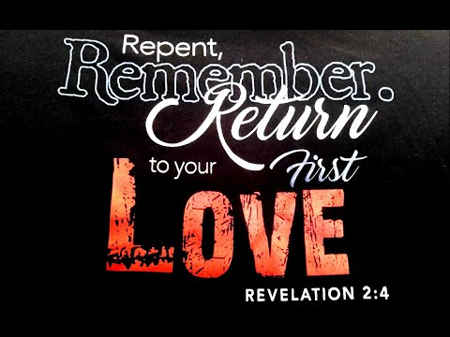

Slide 3
Revelation 2:2-3
“I know your works, your toil and your patient endurance, and how you cannot bear with those who are evil, but have tested those who call themselves apostles and are not, and found them to be false. ³ I know you are enduring patiently and bearing up for my name's sake, and you have not grown weary.

Slide 4
Luke 10:38-42 Now as they went on their way, Jesus entered a village. And a woman named Martha welcomed him into her house. ³⁹ And she had a sister called Mary, who sat at the Lord's feet and listened to his teaching. ⁴⁰ But Martha was distracted with much serving. And she went up to him and said, “Lord, do you not care that my sister has left me to serve alone? Tell her then to help me.” ………

Slide 5
^{.…….. 41} But the Lord answered her, “Martha, Martha, you are anxious and troubled about many things, ⁴² but one thing is necessary. Mary has chosen the good portion, which will not be taken away from her.”

Slide 6
1 Samuel 15:22
But Samuel replied:
“Does the Lord delight in burnt offerings and sacrifices as much as in obeying the Lord? To obey is better than sacrifice, and to heed is better than the fat of rams.

Slide 7
Mark 12:33
To love him with all your heart, with all your understanding and with all your strength, and to love your neighbor as yourself is more important than all burnt offerings and sacrifices.”

Slide 8
Revelation 2:4
But I have this against you, that you have abandoned the love you had at first.

Slide 9
Jeremiah 2:2
Go and proclaim in the hearing of Jerusalem, Thus says the Lord,
I remember the devotion of your youth, your love as a bride, how you followed me in the wilderness, in a land not sown.

Slide 10
1 John 4:19
We love because he first loved us.

Slide 11
Ephesians 1:15-16
For this reason, because I have heard of your faith in the Lord Jesus and your love toward all the saints, ¹⁶ I do not cease to give thanks for you, remembering you in my prayers

Slide 12
Ephesians 2:1-3
And you were dead in the trespasses and sins ² in which you once walked, following the course of this world, following the prince of the power of the air, the spirit that is now at work in the sons of disobedience— ³ among whom we all once lived in the passions of our flesh, carrying out the desires of the body and the mind, and were by nature children of wrath, like the rest of mankind.

Slide 13
Ephesians 2:4-5
But God, being rich in mercy, because of the great love with which he loved us, ⁵ even when we were dead in our trespasses, made us alive together with Christ—by grace you have been saved.

Slide 14
Mark 12:30-31 And you shall love the Lord your God with all your heart and with all your soul and with all your mind and with all your strength.’
³¹ The second is this: ‘You shall love your neighbor as yourself.’ There is no other commandment greater than these.”

Slide 15
Luke 15:22
But the father said to his servants, ‘Bring quickly the best robe, and put it on him, and put a ring on his hand, and shoes on his feet.

Slide 16
Revelation 2:5
Remember therefore from where you have fallen; repent, and do the works you did at first. If not, I will come to you and remove your lampstand from its place, unless you repent.

Slide 17
James 4:8
Draw near to God, and he will draw near to you. Cleanse your hands, you sinners, and purify your hearts, you double-minded.

Slide 18
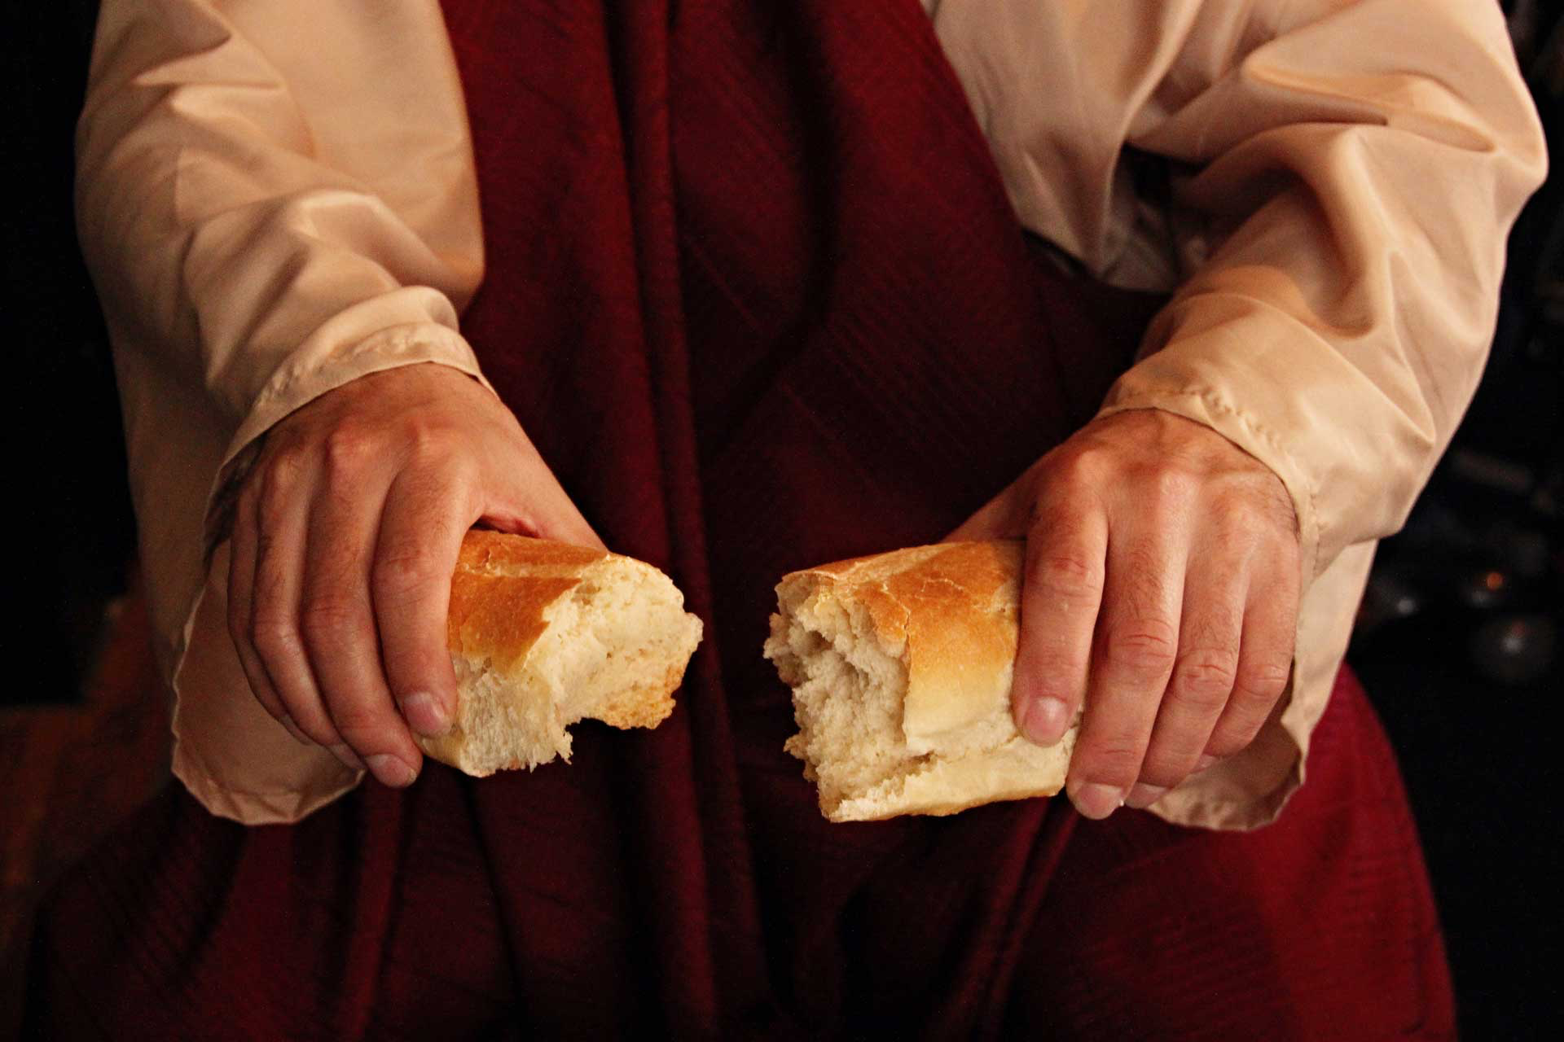
Remembering
His
LOVE

