Slide 3
Psalm 51:10-17
Create in me a clean heart, O God, and renew a right spirit within me. ¹¹Cast me not away from your presence, and take not your Holy Spirit from me. ¹²Restore to me the joy of your salvation, and uphold me with a willing spirit. ¹³Then I will teach transgressors your ways, and sinners will return to you………….

Slide 4
^{………..14} Deliver me from blood guiltiness, O God, O God of my salvation, and my tongue will sing aloud of your righteousness. ¹⁵O Lord, open my lips, and my mouth will declare your praise. ¹⁶For you will not delight in sacrifice, or I would give it; you will not be pleased with a burnt offering. ¹⁷The sacrifices of God are a broken spirit; a broken and contrite heart, O God, you will not despise.

Slide 5
Ephesians 6:13-20
Therefore take up the whole armor of God, that you may be able to withstand in the evil day, and having done all, to stand firm. ¹⁴ Stand therefore, having fastened on the belt of truth, and having put on the breastplate of righteousness, ¹⁵ and, as shoes for your feet, having put on the readiness given by the gospel of peace. ¹⁶ In all circumstances take up the shield of faith, with which you can extinguish all the flaming darts of the evil one; ………………………..

Slide 6
^{………….17} and take the helmet of salvation, and the sword of the Spirit, which is the word of God, ¹⁸ praying at all times in the Spirit, with all prayer and supplication. To that end, keep alert with all perseverance, making supplication for all the saints, ¹⁹ and also for me, that words may be given to me in opening my mouth boldly to proclaim the mystery of the gospel, ²⁰ for which I am an ambassador in chains, that I may declare it boldly, as I ought to speak.

Slide 7
Hebrews 4:16 Let us then with confidence draw near to the throne of grace, that we may receive mercy and find grace to help in time of need.
Ephesians 3:12 in whom we have boldness and access with confidence through our faith in him.

Slide 8
Hebrews 13:6
We can confidently say,
“The Lord is my helper; I will not fear; what can man do to me?”

Slide 9
2Chronicles 32:7
Be strong and courageous.
Do not be afraid or dismayed before the king of Assyria and all the horde that is with him.

Slide 10
Acts 20:24
But I do not account my life of any value nor as precious to myself, if only I may finish my course and the ministry that I received from the Lord Jesus, to testify to the gospel of the grace of God.

Slide 11
Acts 4:29
And now, Lord, look upon their threats and grant to your servants to continue to speak your word with all boldness.

Slide 12
Philippians 1:27-28
Only let your manner of life be worthy of the gospel of Christ, so that whether I come and see you or am absent, I may hear of you that you are standing firm in one spirit, with one mind striving side by side for the faith of the gospel, ²⁸ and not frightened in anything by your opponents. This is a clear sign to them of their destruction, but of your salvation, and that from God.

Slide 13
Ephesians 1:7 In him we have redemption
through his blood, the forgiveness of our trespasses, according to the riches of his grace.
Isaiah 53:5 But he was pierced for our transgressions; he was crushed for our iniquities; upon him was the chastisement that brought us peace, and with his wounds we are healed.

Slide 14
1Peter 2:24
He himself bore our sins in his body on the tree, that we might die to sin and live to righteousness. By his wounds you have been healed.

Slide 15
Philippians 3:9
and be found in him, not having a righteousness of my own that comes from the law, but that which comes through faith in Christ, the righteousness from God that depends on faith

Slide 16
John 3:36
Whoever believes in the Son has eternal life; whoever does not obey the Son shall not see life, but the wrath of God remains on him.

Slide 17
Romans 8:28
We know that for those who love God all things work together for good, for those who are called according to his purpose.

Slide 18
1Peter 2:6
“Behold, I am laying in Zion a stone, a cornerstone chosen and precious, and whoever believes in him will not be put to shame.”

Slide 19
Isaiah 41:10
Fear not, for I am with you; be not dismayed, for I am your God; I will strengthen you, I will help you, I will uphold you with my righteous right hand.

Slide 20
Romans 8:35-37
Who shall separate us from the love of Christ? Shall tribulation, or distress, or persecution, or famine, or nakedness, or danger, or sword? As it is written, “For your sake we are being killed all the day long; we are regarded as sheep to be slaughtered.” No, in all these things we are more than conquerors through him who loved us.

Slide 21
Psalm 34:18
The Lord is near to the brokenhearted and saves the crushed in spirit.
Psalm 51:17
The sacrifices of God are a broken spirit; a broken and contrite heart, O God, you will not despise.

Slide 22
Isaiah 57:15
Thus says the One who is high and lifted up, who inhabits eternity, whose name is Holy: “I dwell in the high and holy place, and also with him who is of a contrite and lowly spirit, to revive the spirit of the lowly, and to revive the heart of the contrite.”

Slide 23
Isaiah 66:2
This is the one to whom I will look: he who is humble and contrite in spirit and trembles at my word.

Slide 24
Philippians 2:12-13 Work out your own salvation with fear and trembling, for it is God who works in you, both to will and to work for his good pleasure.
Psalm 2:11 Serve the Lord with fear, and rejoice with trembling.

Slide 25
1 John 2:3-5
And by this we know that we have come to know him, if we keep his commandments. ⁴ Whoever says “I know him” but does not keep his commandments is a liar, and the truth is not in him, ⁵ but whoever keeps his word, in him truly the love of God is perfected. By this we may know that we are in him:

Slide 26
Proverbs 16:5 Everyone who is arrogant in heart is an abomination to the Lord; be assured, he will not go unpunished.
Proverbs 18:2 A fool takes no pleasure in understanding, but only in expressing his opinion.
Proverbs 8:13 The fear of the Lord is hatred of evil. Pride and arrogance and the way of evil and perverted speech I hate.

Slide 27
1 John 3:16-24 By this we know love, that he laid down his life for us, and we ought to lay down our lives for the brothers.¹⁷ But if anyone has the world's goods and sees his brother in need, yet closes his heart against him, how does God's love abide in him? ¹⁸ Little children, let us not love in word or talk but in deed and in truth……………….

Slide 28
^{………….19} By this we shall know that we are of the truth and reassure our heart before him; ²⁰ for whenever our heart condemns us, God is greater than our heart, and he knows everything. ²¹ Beloved, if our heart does not condemn us, we have confidence before God; ²² and whatever we ask we receive from him, because we keep his commandments and do what pleases him………………………

Slide 29
^{…………23} And this is his commandment, that we believe in the name of his Son Jesus Christ and love one another, just as he has commanded us. ²⁴ Whoever keeps his commandments abides in God, and God in him. And by this we know that he abides in us, by the Spirit whom he has given us.

Slide 30
1 Peter 3:14-17
But even if you should suffer for righteousness' sake, you will be blessed. Have no fear of them, nor be troubled, ¹⁵ but in your hearts honor Christ the Lord as holy, always being prepared to make a defense to anyone who asks you for a reason for the hope that is in you; yet do it with gentleness and respect.

Slide 31
1Corinthians 11:24-25
“This is my body, which is for you. Do this in remembrance of me.” ²⁵ In the same way also he took the cup, after supper, saying, “This cup is the new covenant in my blood. Do this, as often as you drink it, in remembrance of me.”

Slide 32
1 John 3:16
By this we know love, that he laid down his life for us, and we ought to lay down our lives for the brothers.

Slide 33
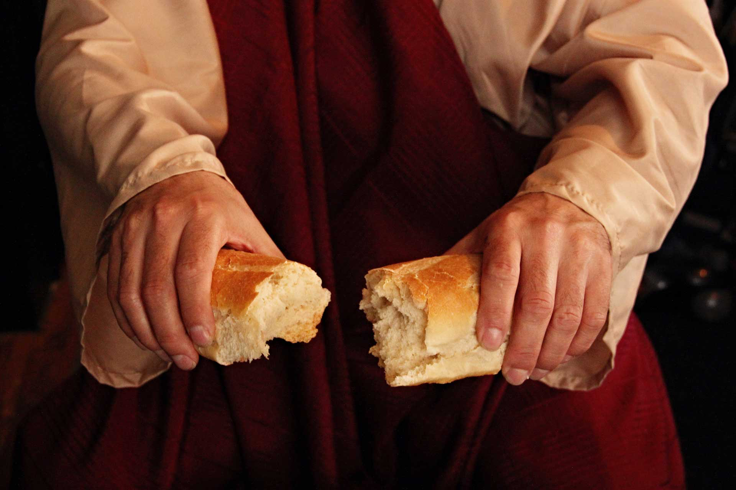
Remembering
The Act Of Laying Down Ones’ Life

