Slide 2
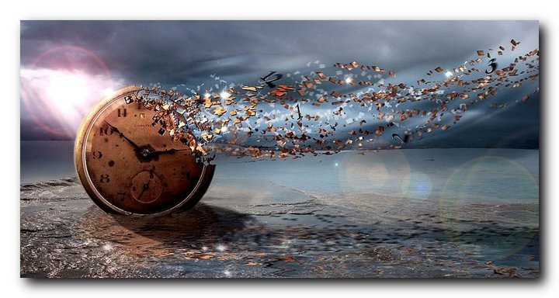
Faithfully Using Our Entrusted Time

Slide 3
Romans 14:10-12
Why do you pass judgment on your brother? Or you, why do you despise your brother? For we will all stand before the judgment seat of God; ¹¹ for it is written “As I live, says the Lord, every knee shall bow to me, and every tongue shall confess to God.” ¹² So then each of us will give an account of himself to God.

Slide 4
Romans 2:6-8
He will render to each one according to his works: ⁷ to those who by patience in well-doing seek for glory and honor and immortality, he will give eternal life; ⁸ but for those who are self-seeking and do not obey the truth, but obey unrighteousness, there will be wrath and fury.

Slide 5
Revelation 20:11-15
Then I saw a great white throne and him who was seated on it. From his presence earth and sky fled away, and no place was found for them. ¹² And I saw the dead, great and small, standing before the throne, and books were opened. Then another book was opened, which is the book of life. And the dead were judged by what was written in the books, according to what they had done……….

Slide 6
^{…………13} And the sea gave up the dead who were in it, Death and Hades gave up the dead who were in them, and they were judged, each one of them, according to what they had done. ¹⁴ Then Death and Hades were thrown into the lake of fire. This is the second death, the lake of fire. ¹⁵ And if anyone's name was not found written in the book of life, he was thrown into the lake of fire.

Slide 7
Colossians 4:5
Walk in wisdom toward outsiders, making the best use of the time.

Slide 8
Matthew 25:31-46
The Final Judgment “When the Son of Man comes in his glory, and all the angels with him, then he will sit on his glorious throne. ³² Before him will be gathered all the nations, and he will separate people one from another as a shepherd separates the sheep from the goats. ³³ And he will place the sheep on his right, but the goats on the left. …………….

Slide 9
^{……..34} Then the King will say to those on his right, ‘Come, you who are blessed by my Father, inherit the kingdom prepared for you from the foundation of the world. ³⁵ For I was hungry and you gave me food, I was thirsty and you gave me drink, I was a stranger and you welcomed me, ³⁶ I was naked and you clothed me, I was sick and you visited me, I was in prison and you came to me.’ …………

Slide 10
^{………37} Then the righteous will answer him, saying, ‘Lord, when did we see you hungry and feed you, or thirsty and give you drink? ³⁸ And when did we see you a stranger and welcome you, or naked and clothe you?³⁹ And when did we see you sick or in prison and visit you?’ ⁴⁰ And the King will answer them, ‘Truly, I say to you, as you did it to one of the least of these my brothers, you did it to me…………

Slide 11
^{………41} “Then he will say to those on his left, ‘Depart from me, you cursed, into the eternal fire prepared for the devil and his angels. ⁴² For I was hungry and you gave me no food, I was thirsty and you gave me no drink, ⁴³ I was a stranger and you did not welcome me, naked and you did not clothe me, sick and in prison and you did not visit me.’ ………

Slide 12
^{……….44} Then they also will answer, saying, ‘Lord, when did we see you hungry or thirsty or a stranger or naked or sick or in prison, and did not minister to you?’ ⁴⁵ Then he will answer them, saying, ‘Truly, I say to you, as you did not do it to one of the least of these, you did not do it to me.’ ⁴⁶ And these will go away into eternal punishment, but the righteous into eternal life.”

Slide 13
James 2:19-20
You believe that God is one; you do well. Even the demons believe—and shudder! ²⁰ Do you want to be shown, you foolish person, that faith apart from works is useless?

Slide 14
Ephesians 2:8-10
For by grace you have been saved through faith. And this is not your own doing; it is the gift of God,⁹ not a result of works, so that no one may boast. ¹⁰ For we are his workmanship, created in Christ Jesus for good works, which God prepared beforehand, that we should walk in them.

Slide 15
Ephesians 5:15-16
Look carefully then how you walk, not as unwise but as wise, ¹⁶ making the best use of the time, because the days are evil.

Slide 16
2 Corinthians 5:10
For we must all appear before the judgment seat of Christ, so that each one may receive what is due for what he has done in the body, whether good or evil.

Slide 17
Titus 2:7
Show yourself in all respects to be a model of good works, and in your teaching show integrity, dignity

Slide 19
Titus 2:14
who gave himself for us to redeem us from all lawlessness and to purify for himself a people for his own possession who are zealous for good works.

Slide 20
Revelation 22:12
Behold, I am coming soon, bringing my recompense with me, to repay each one for what he has done.

Slide 21
Faithfully Using Our Entrusted Time

