Slide 2
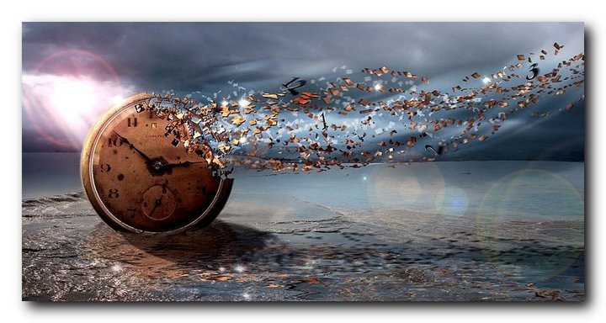
Next Week Time As We Know It Comes To An End!
Remember To Set Your Clocks Back
1 Peter 1:3
Blessed be the God and Father of our Lord Jesus Christ! According to his great mercy,
he has caused us to be born again to a living hope
through the resurrection of Jesus Christ from the dead.

Slide 3
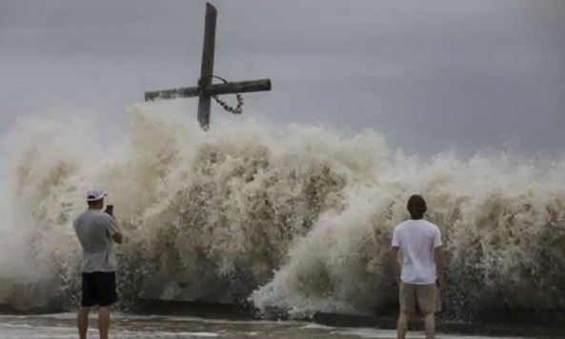
FAITHFULL ENDURANCE
1 Peter 1:3
Blessed be the God and Father of our Lord Jesus Christ! According to his great mercy,
he has caused us to be born again to a living hope
through the resurrection of Jesus Christ from the dead.

Slide 4
Acts 2:4, 14-17 And they were all filled with the Holy Spirit and began to speak in other tongues as the Spirit gave them utterance. ……¹⁴ But Peter, standing with the eleven, lifted up his voice and addressed them: “Men of Judea and all who dwell in Jerusalem, let this be known to you, and give ear to my words……

Slide 5
^{……15} For these people are not drunk, as you suppose, since it is only the third hour of the day. ¹⁶ But this is what was uttered through the prophet Joel: ¹⁷ And in the last days it shall be, God declares, that I will pour out my Spirit on all flesh, and your sons and your daughters shall prophesy, and your young men shall see visions, and your old men shall dream dreams.

Slide 6
2 Timothy 3:1-5 But understand this, that in the last days there will come times of difficulty. ² For people will be lovers of self, lovers of money, proud, arrogant, abusive, disobedient to their parents, ungrateful, unholy, ³ heartless, unappeasable, slanderous, without self-control, brutal, not loving good, ⁴ treacherous, reckless, swollen with conceit, lovers of pleasure rather than lovers of God, ⁵ having the appearance of godliness, but denying its power. Avoid such people.

Slide 7
Hebrews 3:12-14
Take care, brothers, lest there be in any of you an evil, unbelieving heart, leading you to fall away from the living God. ¹³ But exhort one another every day, as long as it is called “today,” that none of you may be hardened by the deceitfulness of sin. ¹⁴ For we have come to share in Christ, if indeed we hold our original confidence firm to the end.

Slide 8
Matthew 24:10-13
And then many will fall away and betray one another and hate one another. ¹¹ And many false prophets will arise and lead many astray. ¹² And because lawlessness will be increased, the love of many will grow cold. ¹³ But the one who endures to the end will be saved.

Slide 9
Luke 6:47-49
Everyone who comes to me and hears my words and does them, I will show you what he is like: ⁴⁸ he is like a man building a house, who dug deep and laid the foundation on the rock. And when a flood arose, the stream broke against that house and could not shake it, because it had been well built. ………..

Slide 10
^{…….. 49} But the one who hears and does not do them is like a man who built a house on the ground without a foundation. When the stream broke against it, immediately it fell, and the ruin of that house was great.”

Slide 11
Psalm 61:1-3
Hear my cry, O God, listen to my prayer; ² from the end of the earth I call to you when my heart is faint. Lead me to the rock that is higher than I, ³ for you have been my refuge, a strong tower against the enemy.

Slide 12
Deuteronomy 31:6
Be strong and courageous. Do not fear or be in dread of them, for it is the Lord your God who goes with you. He will not leave you or forsake you.”

Slide 13
Ephesians 6:13 Therefore take up the whole armor of God, that you may be able to withstand in the evil day, and having done all, to stand firm.
1 Corinthians 15:58 Therefore, my beloved brothers, be steadfast, immovable, always abounding in the work of the Lord, knowing that in the Lord your labor is not in vain.

Slide 14
Philippians 4:1
Therefore, my brothers, whom I love and long for, my joy and crown, stand firm thus in the Lord, my beloved.
1 Corinthians 16:13
Be watchful, stand firm in the faith, act like men, be strong.

Slide 15
Psalm 31:24
Be strong, and let your heart take courage, all you who wait for the Lord.

Slide 16
Galatians 5:1
For freedom Christ has set us free; stand firm therefore, and do not submit again to a yoke of slavery.

Slide 17
1 Corinthians 15:1-8 Now I would remind you, brothers, of the gospel I preached to you, which you received, in which you stand, ² and by which you are being saved, if you hold fast to the word I preached to you—unless you believed in vain.³ For I delivered to you as of first importance what I also received: that Christ died for our sins in accordance with the Scriptures, ⁴ that he was buried, that he was raised on the third day in accordance with the Scriptures, ……………

Slide 18
^{…………5} and that he appeared to Cephas, then to the twelve. ⁶ Then he appeared to more than five hundred brothers at one time, most of whom are still alive, though some have fallen asleep. ⁷ Then he appeared to James, then to all the apostles. ⁸ Last of all, as to one untimely born, he appeared also to me.

Slide 19
Hebrews 12:1-2
Therefore, since we are surrounded by so great a cloud of witnesses, let us also lay aside every weight, and sin which clings so closely, and let us run with endurance the race that is set before us, ² looking to Jesus, the founder and perfecter of our faith, who for the joy that was set before him endured the cross, despising the shame, and is seated at the right hand of the throne of God.

Slide 20
Matthew 24:12-14
And because lawlessness will be increased, the love of many will grow cold ¹³ But the one who endures to the end will be saved. ¹⁴ And this gospel of the kingdom will be proclaimed throughout the whole world as a testimony to all nations, and then the end will come.

Slide 21
Video
https://youtu.be/67tPlnNMKSc

Slide 22
1 Corinthians 9:24
Do you not know that in a race all the runners run, but only one receives the prize? So run that you may obtain it.

Slide 23
Ephesians 3:16
that according to the riches of his glory he may grant you to be strengthened with power through his Spirit in your inner being,

Slide 24
Colossians 1:11
being strengthened with all power, according to his glorious might, for all endurance and patience with joy;

Slide 25
1 Thessalonians 3:8
For now we live, if you are standing fast in the Lord.

Slide 26
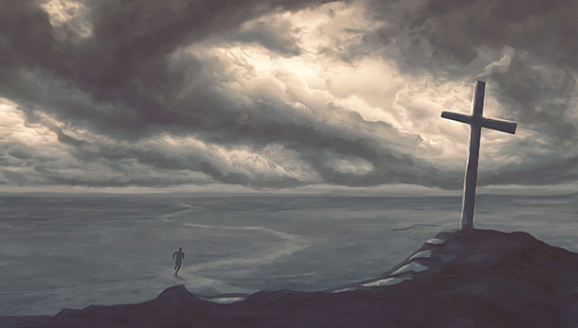
Communion
Remembering
The Ultimate Faithful Endurance

Slide 27
FAITHFULL ENDURANCE
1 Peter 1:3
Blessed be the God and Father of our Lord Jesus Christ! According to his great mercy,
he has caused us to be born again to a living hope
through the resurrection of Jesus Christ from the dead.

