Slide 2
Proper Attire,
Clothing The New You

Slide 3
Colossians 3:1-4
If then you have been raised with Christ, seek the things that are above, where Christ is, seated at the right hand of God. ² Set your minds on things that are above, not on things that are on earth. ³ For you have died, and your life is hidden with Christ in God. ⁴ When Christ who is your life appears, then you also will appear with him in glory.

Slide 4
Colossians 3:5-11
Put to death therefore what is earthly in you: sexual immorality, impurity, passion, evil desire, and covetousness, which is idolatry.⁶ On account of these the wrath of God is coming. ⁷ In these you too once walked, when you were living in them……….

Slide 5
^{……….8} But now you must put them all away: anger, wrath, malice, slander, and obscene talk from your mouth. ⁹ Do not lie to one another, seeing that you have put off the old self with its practices ¹⁰ and have put on the new self, which is being renewed in knowledge after the image of its creator. ¹¹ Here there is not Greek and Jew, circumcised and uncircumcised, barbarian, Scythian, slave, free; but Christ is all, and in all.

Slide 6
Mark 2:22
And no one puts new wine into old wineskins. If he does, the wine will burst the skins—and the wine is destroyed, and so are the skins. But new wine is for fresh wineskins.”

Slide 7
Galatians 3:27
For as many of you as were baptized into Christ have put on Christ.

Slide 8
2Corinthians 4:16
So we do not lose heart. Though our outer self is wasting away, our inner self is being renewed day by day.

Slide 9
Psalm 90:8
You have set our iniquities before you, our secret sins
in the light of your presence.

Slide 10
Colossians 3:10
and have put on the new self, which is being renewed in knowledge after the image of its creator

Slide 11
Galatians 2:20
I have been crucified with Christ. It is no longer I who live, but Christ who lives in me. And the life I now live in the flesh I live by faith in the Son of God, who loved me and gave himself for me.

Slide 12
Colossians 3:12-13
Put on then, as God's chosen ones, holy and beloved, compassionate hearts, kindness, humility, meekness, and patience, ¹³ bearing with one another and, if one has a complaint against another, forgiving each other; as the Lord has forgiven you, so you also must forgive.

Slide 13
Colossians 3:14-17
And above all these put on love, which binds everything together in perfect harmony. ¹⁵ And let the peace of Christ rule in your hearts, to which indeed you were called in one body. And be thankful. ¹⁶ Let the word of Christ dwell in you richly, teaching and admonishing one another in all wisdom, singing psalms and hymns and spiritual songs, with thankfulness in your hearts to God……..

Slide 14
^{………17} And whatever you do, in word or deed, do everything in the name of the Lord Jesus, giving thanks to God the Father through him.

Slide 15
John 14:27
Peace I leave with you; my peace I give to you. Not as the world gives do I give to you. Let not your hearts be troubled, neither let them be afraid.

Slide 16
Philippians 4:7
And the peace of God, which surpasses all understanding, will guard your hearts and your minds in Christ Jesus.

Slide 17
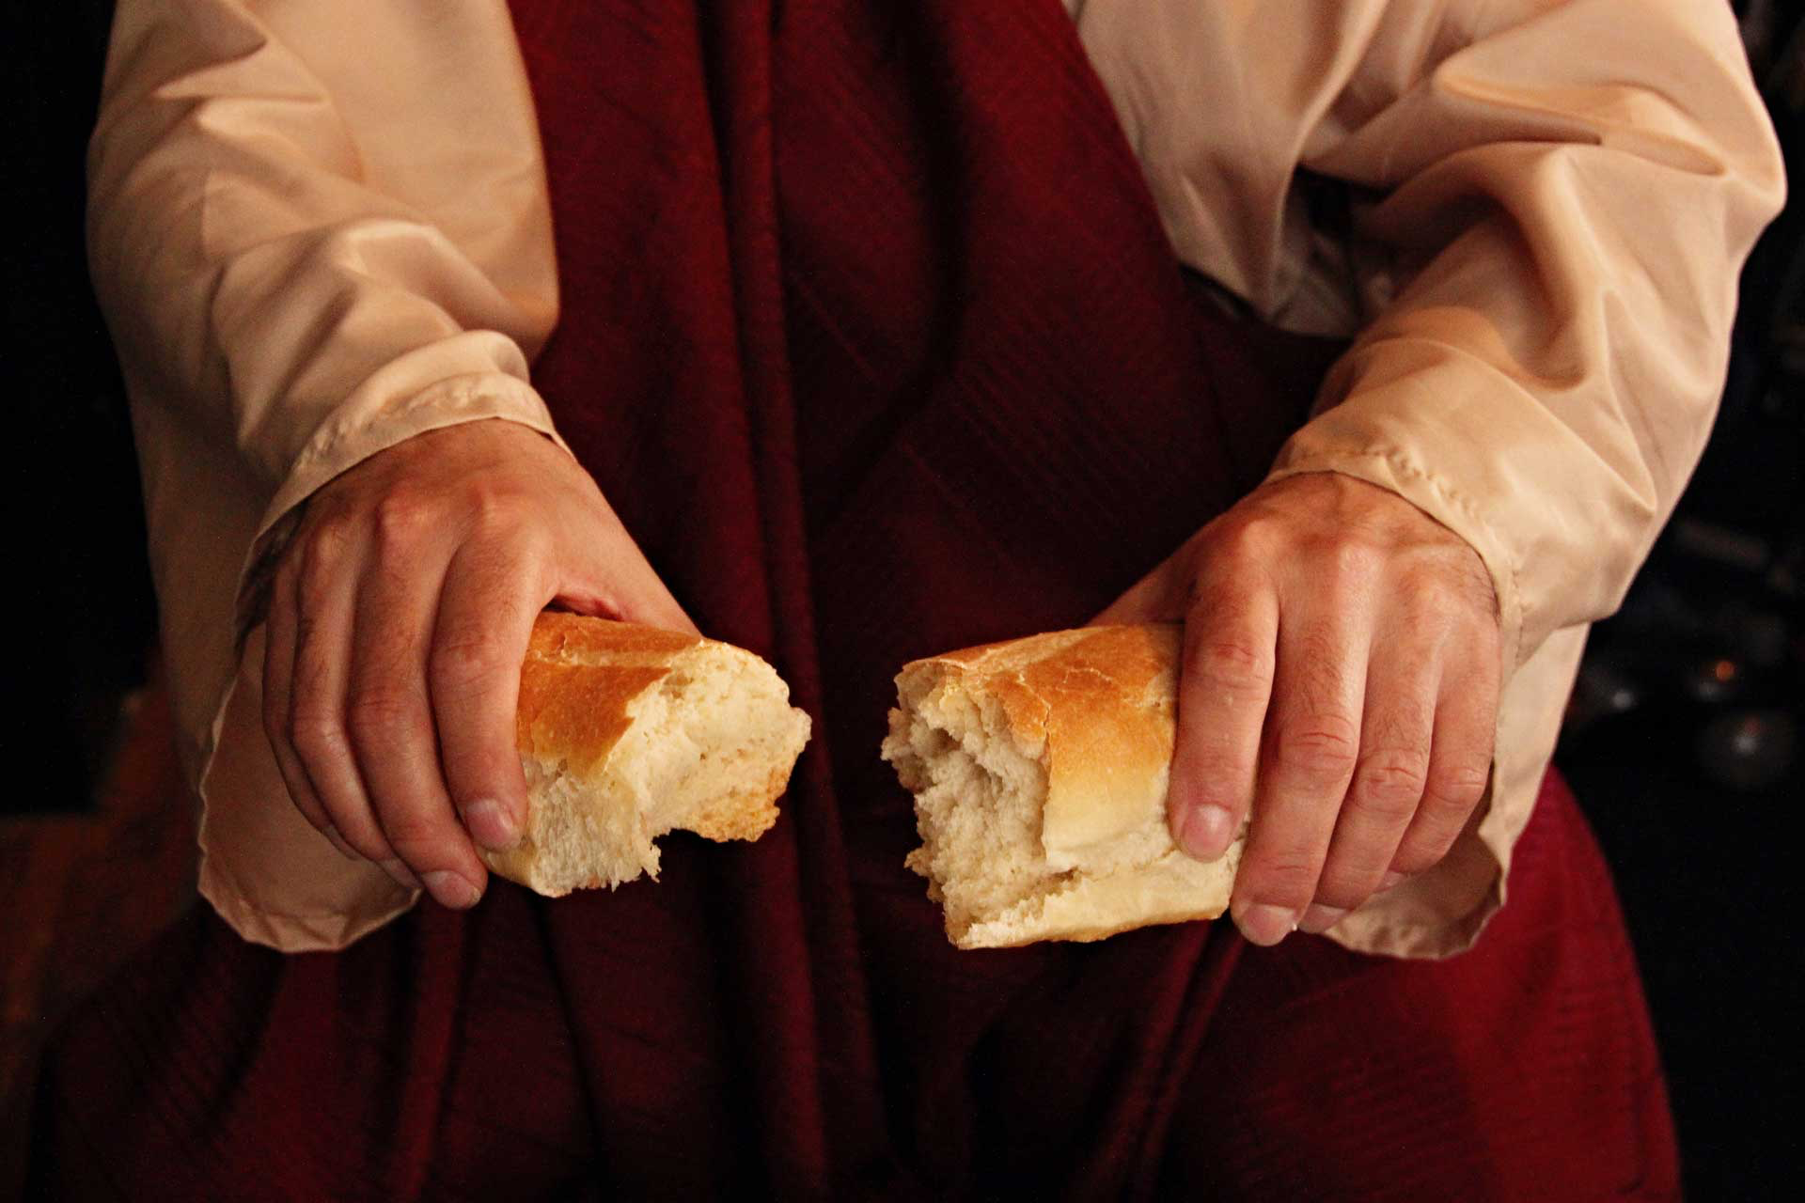
Remembering
We Have Died With Christ

Slide 18
Proper Attire,
Clothing The New You

