Slide 2
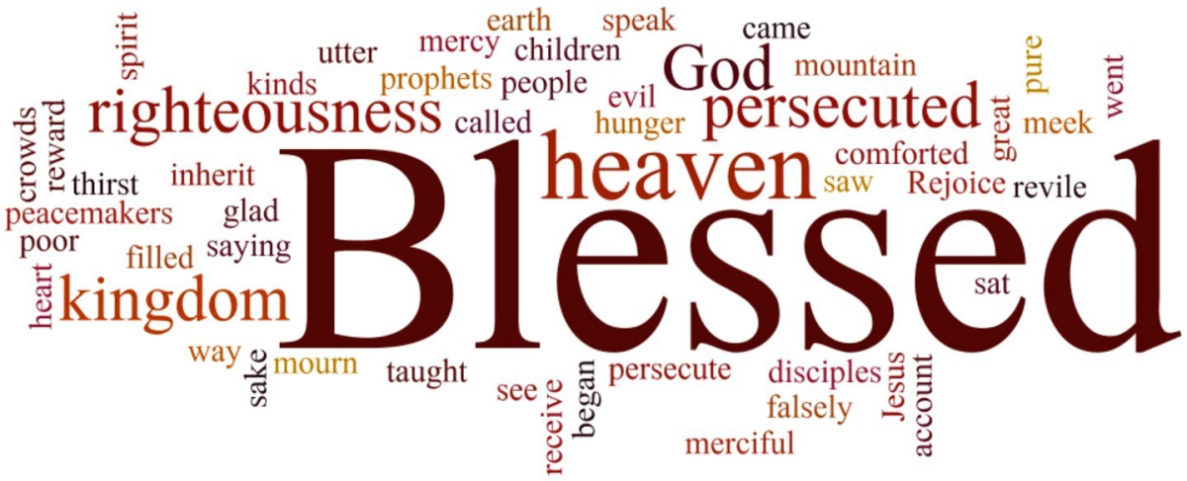
1 Peter 1:3
Blessed be the God and Father of our Lord Jesus Christ! According to his great mercy,
he has caused us to be born again to a living hope
through the resurrection of Jesus Christ from the dead.
PERSECUTION

Slide 3
Matthew 5:2-12 And he opened his mouth and taught them, saying:
³ “Blessed are the poor in spirit, for theirs is the kingdom of heaven. ⁴ “Blessed are those who mourn, for they shall be comforted. ⁵ “Blessed are the meek, for they shall inherit the earth.

Slide 4
⁶ “Blessed are those who hunger and thirst for righteousness, for they shall be satisfied.
⁷ “Blessed are the merciful, for they shall receive mercy. ⁸ “Blessed are the pure in heart, for they shall see God. ⁹ “Blessed are the peacemakers, for they shall be called sons of God.

Slide 5
¹⁰ “Blessed are those who are persecuted for righteousness' sake, for theirs is the kingdom of heaven. ¹¹ “Blessed are you when others revile you and persecute you and utter all kinds of evil against you falsely on my account ¹² Rejoice and be glad, for your reward is great in heaven, for so they persecuted the prophets who were before you.

Slide 6
2 Timothy 3:12-13
Indeed, all who desire to live a godly life in Christ Jesus will be persecuted,¹³ while evil people and impostors will go on from bad to worse, deceiving and being deceived.

Slide 7
Luke 17:7-10
“Will any one of you who has a servant plowing or keeping sheep say to him when he has come in from the field, ‘Come at once and recline at table’? ⁸ Will he not rather say to him, ‘Prepare supper for me, and dress properly, and serve me while I eat and drink, and afterward you will eat and drink’? ……….

Slide 8
^{…………..9} Does he thank the servant because he did what was commanded? ¹⁰ So you also, when you have done all that you were commanded, say, ‘We are unworthy servants; we have only done what was our duty.’”

Slide 9
John 15:5
I am the vine; you are the branches. Whoever abides in me and I in him, he it is that bears much fruit, for apart from me you can do nothing.

Slide 10
Romans 5:3-4
Not only that, but we rejoice in our sufferings, knowing that suffering produces endurance, ⁴ and endurance produces character, and character produces hope

Slide 11
1 Peter 3:14
But even if you should suffer for righteousness' sake, you will be blessed. Have no fear of them, nor be troubled,

Slide 12
Galatians 6:12
It is those who want to make a good showing in the flesh who would force you to be circumcised, and only in order that they may not be persecuted for the cross of Christ.

Slide 13
Romans 12:14
Bless those who persecute you; bless and do not curse them.

Slide 14
Romans 12:17-21
Repay no one evil for evil, but give thought to do what is honorable in the sight of all. ¹⁸ If possible, so far as it depends on you, live peaceably with all. ¹⁹ Beloved, never avenge yourselves, but leave it to the wrath of God, for it is written, “Vengeance is mine, I will repay, says the Lord.” ………….

Slide 15
^{………20} To the contrary, “if your enemy is hungry, feed him; if he is thirsty, give him something to drink; for by so doing you will heap burning coals on his head.” ²¹ Do not be overcome by evil, but overcome evil with good.

Slide 16
Hebrews 10:32-35
But recall the former days when, after you were enlightened, you endured a hard struggle with sufferings, ³³ sometimes being publicly exposed to reproach and affliction, and sometimes being partners with those so treated. …………

Slide 17
^{……….34} For you had compassion on those in prison, and you joyfully accepted the plundering of your property, since you knew that you yourselves had a better possession and an abiding one. ³⁵ Therefore do not throw away your confidence, which has a great reward.

Slide 18
Hebrews 10:39
But we are not of those who shrink back and are destroyed, but of those who have faith and preserve their souls.

Slide 19
Romans 8:15-18
For you did not receive the spirit of slavery to fall back into fear, but you have received the Spirit of adoption as sons, by whom we cry, “Abba! Father!” ¹⁶ The Spirit himself bears witness with our spirit that we are children of God, ………………

Slide 20
^{…………….17} and if children, then heirs—heirs of God and fellow heirs with Christ, provided we suffer with him in order that we may also be glorified with him. ¹⁸ For I consider that the sufferings of this present time are not worth comparing with the glory that is to be revealed to us.

Slide 21
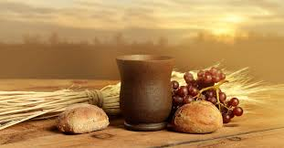
REMEMBERING
Sacrificial Love

Slide 22
1 Peter 1:3
Blessed be the God and Father of our Lord Jesus Christ! According to his great mercy,
he has caused us to be born again to a living hope
through the resurrection of Jesus Christ from the dead.
PERSECUTION

