Slide 2
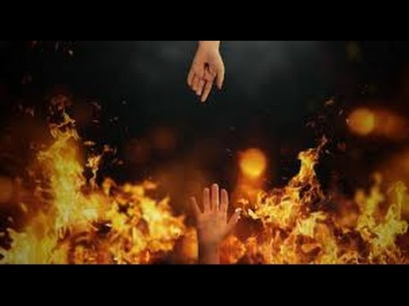
What Are We Saved From

Slide 3
1Thessalonians 5:1-11
Now concerning the times and the seasons, brothers, you have no need to have anything written to you. 2 For you yourselves are fully aware that the day of the Lord will come like a thief in the night. 3 While people are saying, “There is peace and security,” then sudden destruction will come upon them as labor pains come upon a pregnant woman, and they will not escape ……..

Slide 4
………….4 But you are not in darkness, brothers, for that day to surprise you like a thief.5 For you are all children of light, children of the day. We are not of the night or of the darkness. 6 So then let us not sleep, as others do, but let us keep awake and be sober. 7 For those who sleep, sleep at night, and those who get drunk, are drunk at night. 8 But since we belong to the day, let us be sober, having put on the breastplate of faith and love, and for a helmet the hope of salvation. ………………

Slide 5
………….9 For God has not destined us for wrath, but to obtain salvation through our Lord Jesus Christ, 10 who died for us so that whether we are awake or asleep we might live with him. 11 Therefore encourage one another and build one another up, just as you are doing.

Slide 6
1Thessalonians 5:1-2
Now concerning the times and the seasons, brothers, you have no need to have anything written to you. 2 For you yourselves are fully aware that the day of the Lord will come like a thief in the night.

Slide 7
Isaiah 26:4 Trust in the Lord forever, for the Lord God is an everlasting rock.
Proverbs 3:5-6 Trust in the Lord with all your heart, and do not lean on your own understanding. ⁶ In all your ways acknowledge him, and he will make straight your paths.

Slide 8
Isaiah 41:13 For I, the Lord your God, hold your right hand; it is I who say to you, “Fear not, I am the one who helps you.”
John 3:17 For God did not send his Son into the world to condemn the world, but in order that the world might be saved through him.

Slide 9
1Thessalonians 5:3-4
While people are saying, “There is peace and security,” then sudden destruction will come upon them as labor pains come upon a pregnant woman, and they will not escape. 4 But you are not in darkness, brothers, for that day to surprise you like a thief.

Slide 10
1Thessalonians 5:5-7
For you are all children of light, children of the day. We are not of the night or of the darkness. ⁶ So then let us not sleep, as others do, but let us keep awake and be sober. ⁷ For those who sleep, sleep at night, and those who get drunk, are drunk at night.

Slide 11
Romans 15:4
For whatever was written in former days was written for our instruction, that through endurance and through the encouragement of the Scriptures we might have hope.

Slide 12
1Corinthians 10:6 Now these things took place as examples for us, that we might not desire evil as they did.
2Timothy 3:16-17 All Scripture is breathed out by God and profitable for teaching, for reproof, for correction, and for training in righteousness, 17 that the man of God may be complete, equipped for every good work.

Slide 13
1Corinthians 10:11
Now these things happened to them as an example, but they were written down for our instruction, on whom the end of the ages has come.

Slide 14
Hebrews 9:25-26
Nor was it to offer himself repeatedly, as the high priest enters the holy places every year with blood not his own, ²⁶ for then he would have had to suffer repeatedly since the foundation of the world. But as it is, he has appeared once for all at the end of the ages to put away sin by the sacrifice of himself.

Slide 15
1Peter 1:20-21
He was foreknown before the foundation of the world but was made manifest in the last times for the sake of you ²¹ who through him are believers in God, who raised him from the dead and gave him glory, so that your faith and hope are in God.

Slide 16
John 3:19-21
And this is the judgment: the light has come into the world, and people loved the darkness rather than the light because their works were evil. ²⁰ For everyone who does wicked things hates the light and does not come to the light, lest his works should be exposed. ²¹ But whoever does what is true comes to the light, so that it may be clearly seen that his works have been carried out in God.”

Slide 17
Matthew 24:37-39
For as were the days of Noah, so will be the coming of the Son of Man. ³⁸ For as in those days before the flood they were eating and drinking, marrying and giving in marriage, until the day when Noah entered the ark, ³⁹ and they were unaware until the flood came and swept them all away, so will be the coming of the Son of Man.

Slide 18
Jeremiah 6:14
They have healed the wound of my people lightly, saying, ‘Peace, peace, when there is no peace.

Slide 19
Ezekiel 33:1-6 The word of the Lord came to me: ² “Son of man, speak to your people and say to them, If I bring the sword upon a land, and the people of the land take a man from among them, and make him their watchman, ³ and if he sees the sword coming upon the land and blows the trumpet and warns the people,…………………

Slide 20
^{………….. 4} then if anyone who hears the sound of the trumpet does not take warning, and the sword comes and takes him away, his blood shall be upon his own head. ⁵ He heard the sound of the trumpet and did not take warning; his blood shall be upon himself. But if he had taken warning, he would have saved his life………………

Slide 21
…………..⁶ But if the watchman sees the sword coming and does not blow the trumpet, so that the people are not warned, and the sword comes and takes any one of them, that person is taken away in his iniquity, but his blood I will require at the watchman's hand.

Slide 22
John 3:16
For God so loved the world, that he gave his only Son, that whoever believes in him should not perish but have eternal life.

Slide 23
John 10:28
I give them eternal life, and they will never perish, and no one will snatch them out of my hand.

Slide 24
John 12:25
Whoever loves his life loses it, and whoever hates his life in this world will keep it for eternal life.

Slide 25
Genesis 2:16-17
And the Lord God commanded the man, saying, “You may surely eat of every tree of the garden, ¹⁷ but of the tree of the knowledge of good and evil you shall not eat, for in the day that you eat of it you shall surely die.”

Slide 26
Genesis 18:25
Far be it from you to do such a thing, to put the righteous to death with the wicked, so that the righteous fare as the wicked! Far be that from you! Shall not the Judge of all the earth do what is just?”

Slide 27
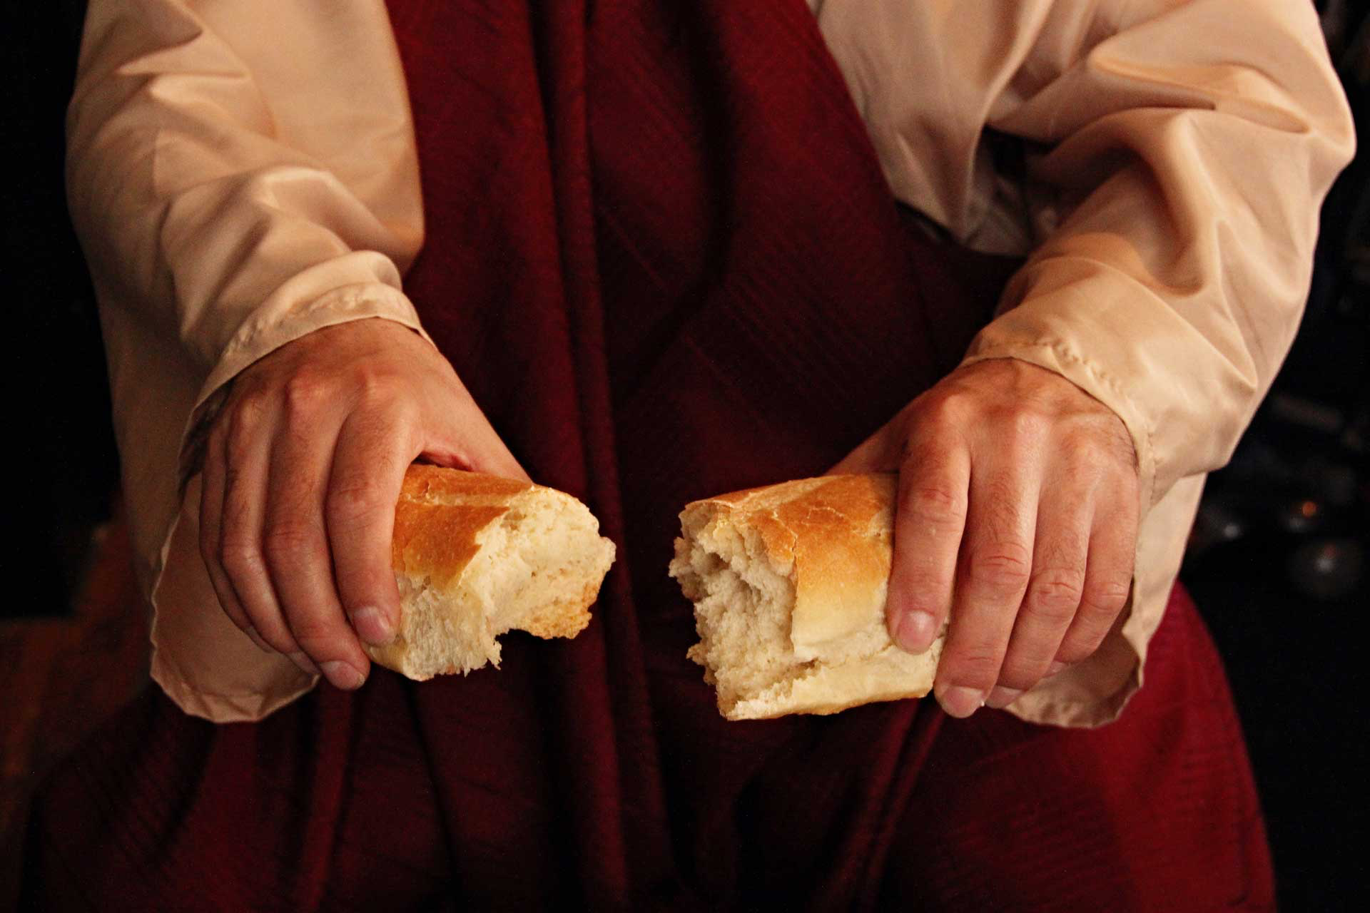
Do This Remembering The Cost

Slide 28
Romans 6:23
For the wages of sin is death, but the free gift of God is eternal life in Christ Jesus our Lord.

Slide 29
Romans 10:11-17
For the Scripture says, “Everyone who believes in him will not be put to shame.” ¹² For there is no distinction between Jew and Greek; for the same Lord is Lord of all, bestowing his riches on all who call on him……………….

Slide 30
^{………………13} For “everyone who calls on the name of the Lord will be saved.” ¹⁴ How then will they call on him in whom they have not believed? And how are they to believe in him of whom they have never heard? And how are they to hear without someone preaching?.........

Slide 31
^{………15} And how are they to preach unless they are sent? As it is written, “How beautiful are the feet of those who preach the good news!” ¹⁶ But they have not all obeyed the gospel. For Isaiah says, “Lord, who has believed what he has heard from us?” ¹⁷ So faith comes from hearing, and hearing through the word of Christ.

Slide 32
What Are We Saved From

