Slide 2
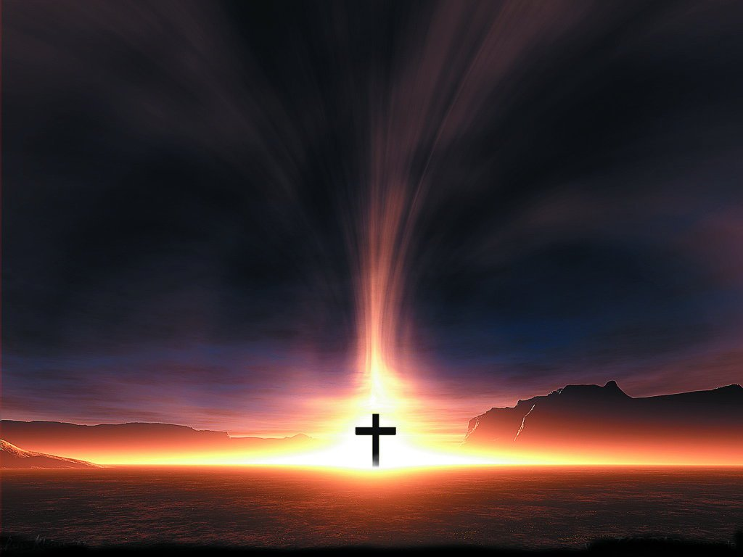
The Magnitude Of Sin And The Power Of The Cross

Slide 3
Galatians 6:14
But far be it from me to boast except in the cross of our Lord Jesus Christ, by which the world has been crucified to me, and I to the world.

Slide 4
1Corinthians 2:1-5 And I, when I came to you, brothers, did not come proclaiming to you the testimony of God with lofty speech or wisdom. ² For I decided to know nothing among you except Jesus Christ and him crucified. ³ And I was with you in weakness and in fear and much trembling, ⁴ and my speech and my message were not in plausible words of wisdom, but in demonstration of the Spirit and of power, ⁵ so that your faith might not rest in the wisdom of men but in the power of God.

Slide 5
Genesis 1:31
And God saw everything that he had made, and behold, it was very good. And there was evening and there was morning, the sixth day.

Slide 6
Genesis 3:17-18
And to Adam he said, “Because you have listened to the voice of your wife and have eaten of the tree of which I commanded you, ‘You shall not eat of it,’ cursed is the ground because of you; in pain you shall eat of it all the days of your life; ¹⁸ thorns and thistles it shall bring forth for you; and you shall eat the plants of the field.

Slide 7
Genesis 6:5-6
The Lord saw that the wickedness of man was great in the earth, and that every intention of the thoughts of his heart was only evil continually.
⁶And the Lord regretted that he had made man on the earth, and it grieved him to his heart.

Slide 8
Romans 8:22
For we know that the whole creation has been groaning together in the pains of childbirth until now.

Slide 9
Romans 3:23
“for all have sinned and fall short of the glory of God”

Slide 10
Proverbs 17:15
He who justifies the wicked and he who condemns the righteous are both alike an abomination to the Lord.

Slide 11
Isaiah 53:10
Yet it was the will of the Lord to crush him; he has put him to grief; when his soul makes an offering for guilt, he shall see his offspring; he shall prolong his days; the will of the Lord shall prosper in his hand. ¹¹Out of the anguish of his soul he shall see and be satisfied; by his knowledge shall the righteous one, my servant, make many to be accounted righteous, and he shall bear their iniquities.

Slide 12
Mark 14:36
And he said, “Abba, Father, all things are possible for you. Remove this cup from me. Yet not what I will, but what you will.”

Slide 13
John 3:13-14
No one has ascended into heaven except he who descended from heaven, the Son of Man. ¹⁴ And as Moses lifted up the serpent in the wilderness, so must the Son of Man be lifted up, ¹⁵ that whoever believes in him may have eternal life

Slide 14
John 12:23-24
And Jesus answered them, “The hour has come for the Son of Man to be glorified. ²⁴ Truly, truly, I say to you, unless a grain of wheat falls into the earth and dies, it remains alone; but if it dies, it bears much fruit.

Slide 15
Romans 3:23-26 for all have sinned and fall short of the glory of God, ²⁴ and are justified by his grace as a gift, through the redemption that is in Christ Jesus, ²⁵ whom God put forward as a propitiation by his blood, to be received by faith. This was to show God's righteousness, because in his divine forbearance he had passed over former sins. ²⁶ It was to show his righteousness at the present time, so that he might be just and the justifier of the one who has faith in Jesus.

Slide 16
2Peter 3:9
The Lord is not slow to fulfill his promise as some count slowness, but is patient toward you, not wishing that any should perish, but that all should reach repentance.

Slide 17
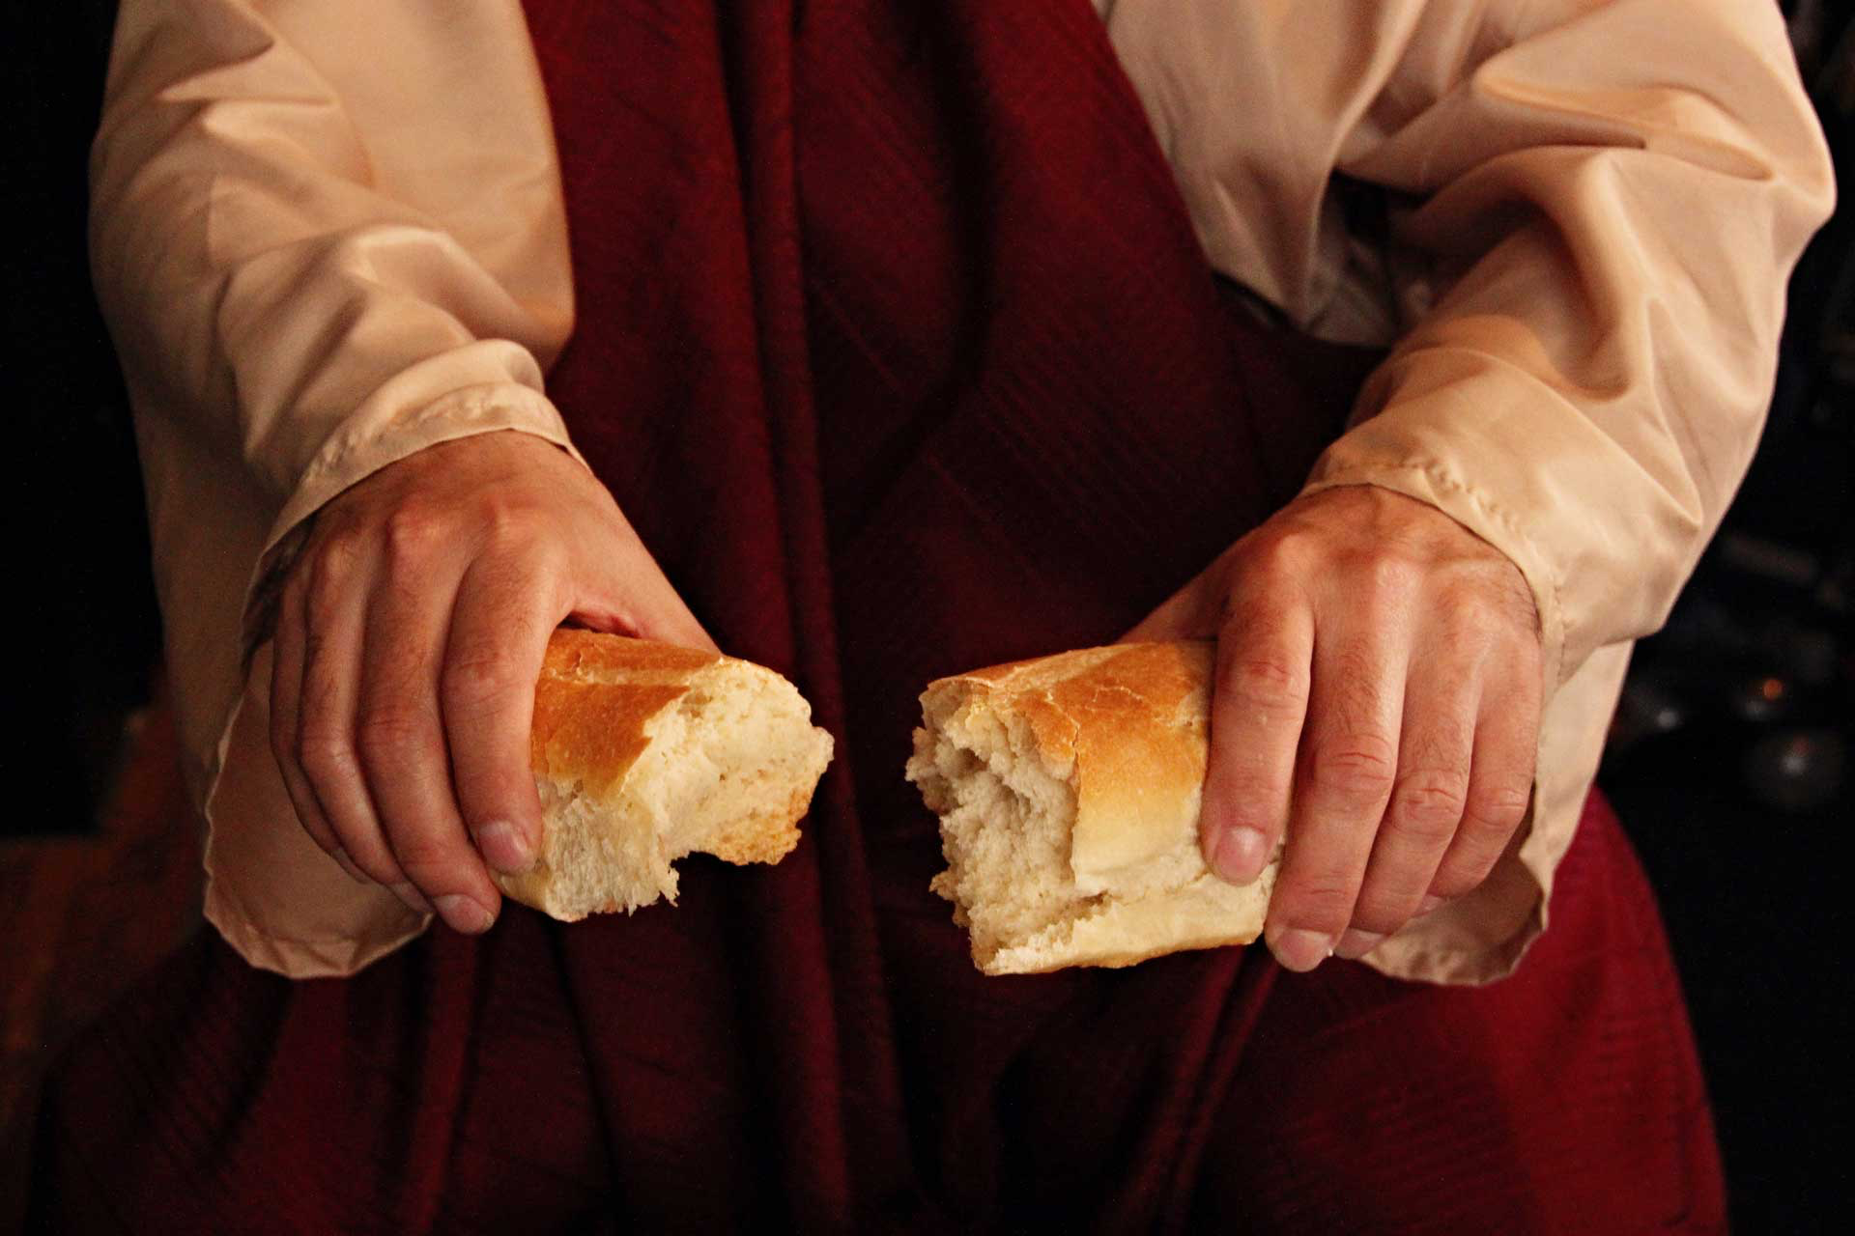
Celebrate that it
Pleased
the Lord to crush him

Slide 18
Isaiah 11:6-9
The wolf shall dwell with the lamb, and the leopard shall lie down with the young goat, and the calf and the lion and the fattened calf together; and a little child shall lead them. ⁷ The cow and the bear shall graze their young shall lie down together; and the lion shall eat straw like the ox………….

Slide 19
^{…………8} The nursing child shall play over the hole of the cobra, and the weaned child shall put his hand on the adder's den. ⁹ They shall not hurt or destroy in all my holy mountain; for the earth shall be full of the knowledge of the Lord as the waters cover the sea.

Slide 20
The Magnitude Of Sin And The Power Of The Cross

