Slide 2
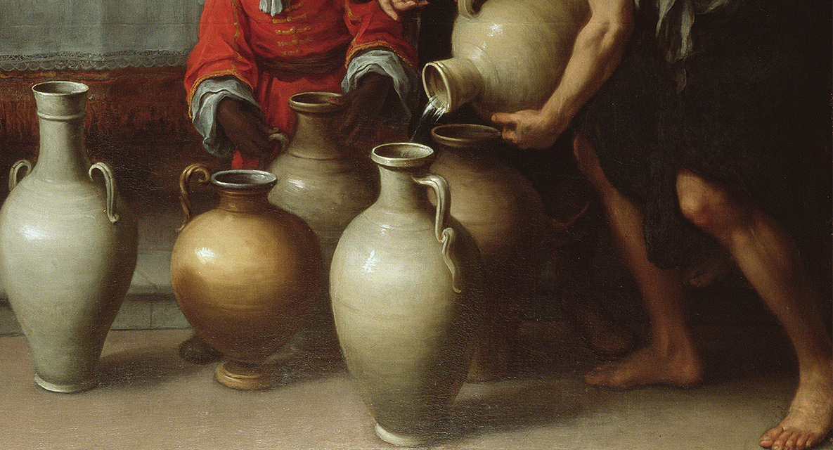
Changed
For God’s Purposes

Slide 3
John 2:1-2
On the third day there was a wedding at Cana in Galilee, and the mother of Jesus was there.² Jesus also was invited to the wedding with his disciples.

Slide 4
John 2:3
When the wine ran out, the mother of Jesus said to him, “They have no wine.” ⁴ And Jesus said to her, “Woman, what does this have to do with me? My hour has not yet come.”

Slide 5
John 5:30
“I can do nothing on my own. As I hear, I judge, and my judgment is just, because I seek not my own will but the will of him who sent me”.

Slide 6
John 8:28-29
So Jesus said to them, “When you have lifted up the Son of Man, then you will know that I am he, and that I do nothing on my own authority, but speak just as the Father taught me. ²⁹ And he who sent me is with me. He has not left me alone, for I always do the things that are pleasing to him.”

Slide 7
John 2:5
His mother said to the servants, “Do whatever he tells you.”

Slide 8
John 10:27 My sheep hear my voice, and I know them, and they follow me.
John 15:14 You are my friends if you do what I command you.

Slide 9
John 2:6-8
Now there were six stone water jars there for the Jewish rites of purification, each holding twenty or thirty gallons. ⁷ Jesus said to the servants, “Fill the jars with water.” And they filled them up to the brim. ⁸ And he said to them, “Now draw some out and take it to the master of the feast.” So they took it.

Slide 10
John 2:9-10 When the master of the feast tasted the water now become wine, and did not know where it came from (though the servants who had drawn the water knew), the master of the feast called the bridegroom ¹⁰ and said to him, “Everyone serves the good wine first, and when people have drunk freely, then the poor wine. But you have kept the good wine until now.”

Slide 11
John 2:11
This, the first of his signs, Jesus did at Cana in Galilee, and manifested his glory. And his disciples believed in him.

Slide 12
2Corinthians 5:17
Therefore, if anyone is in Christ, he is a new creation. The old has passed away; behold, the new has come.

Slide 13
Mark 2:22 And no one puts new wine into old wineskins. If he does, the wine will burst the skins—and the wine is destroyed, and so are the skins. But new wine is for fresh wineskins.”

Slide 14
John 15:1-2,6
“I am the true vine, and my Father is the vinedresser.² Every branch in me that does not bear fruit he takes away, and every branch that does bear fruit he prunes, that it may bear more fruit……….. ⁶ If anyone does not abide in me he is thrown away like a branch and withers; and the branches are gathered, thrown into the fire, and burned.

Slide 15
John 11:43-44
When he had said these things, he cried out with a loud voice, “Lazarus, come out.” ⁴⁴ The man who had died came out, his hands and feet bound with linen strips, and his face wrapped with a cloth. Jesus said to them, “Unbind him, and let him go.”

Slide 16
Acts 4:31
And when they had prayed, the place in which they were gathered together was shaken, and they were all filled with the Holy Spirit and continued to speak the word of God with boldness.

Slide 17
Acts 2:16-21 (Joel 2:28)
But this is what was uttered through the prophet Joel: “‘And in the last days it shall be, God declares, that I will pour out my Spirit on all flesh, and your sons and your daughters shall prophesy, and your young men shall see visions, and your old men shall dream dreams; ¹⁸ even on my male servants and female servants in those days I will pour out my Spirit, and they shall prophesy. …………

Slide 18
^{…………19} And I will show wonders in the heavens above and signs on the earth below, blood, and fire, and vapor of smoke; ²⁰ the sun shall be turned to darkness and the moon to blood, before the day of the Lord comes, the great and magnificent day. ²¹ And it shall come to pass that everyone who calls upon the name of the Lord shall be saved.’

Slide 19
Psalm 33:11
The counsel of the Lord stands forever, the plans of his heart to all generations

Slide 20
Hebrews 6:17
So when God desired to show more convincingly to the heirs of the promise the unchangeable character of his purpose, he guaranteed it with an oath.

Slide 21
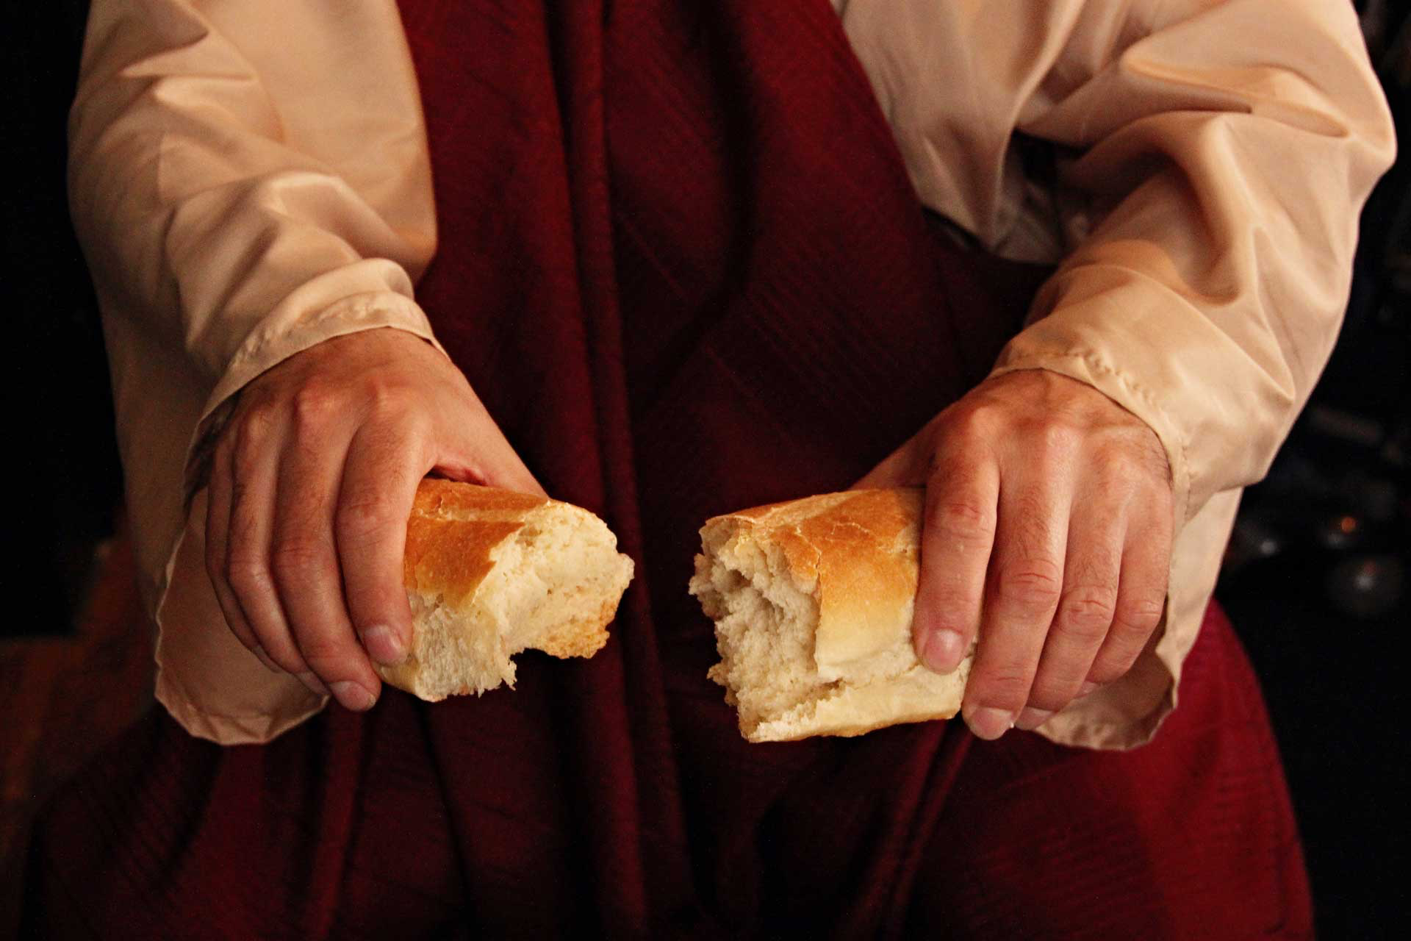
Remembering
The Great Exchange

Slide 22
Changed
For God’s Purposes

