Slide 2
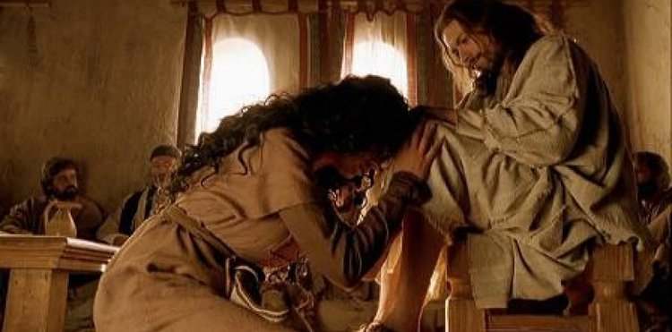
The
Unrestrained Fragrance
Of Worship
1 Peter 1:3
Blessed be the God and Father of our Lord Jesus Christ! According to his great mercy,
he has caused us to be born again to a living hope
through the resurrection of Jesus Christ from the dead.

Slide 3
John 11:45-53
Many of the Jews therefore, who had come with Mary and had seen what he did, believed in him, ⁴⁶ but some of them went to the Pharisees and told them what Jesus had done.⁴⁷ So the chief priests and the Pharisees gathered the council and said, “What are we to do? For this man performs many signs.

Slide 4
^{…………….48} If we let him go on like this, everyone will believe in him, and the Romans will come and take away both our place and our nation.” ⁴⁹ But one of them, Caiaphas, who was high priest that year, said to them, “You know nothing at all Nor do you understand that it is better for you that one man should die for the people, not that the whole nation should perish.” …………

Slide 5
^{……………51} He did not say this of his own accord, but being high priest that year he prophesied that Jesus would die for the nation, ⁵² and not for the nation only, but also to gather into one the children of God who are scattered abroad. ⁵³ So from that day on they made plans to put him to death.

Slide 6
Matthew 12:38 Then some of the scribes and Pharisees answered him, saying, “Teacher, we wish to see a sign from you.”
Matthew 16:1 And the Pharisees and Sadducees came, and to test him they asked him to show them a sign from heaven.

Slide 7
John 11:50-51
Nor do you understand that it is better for you that one man should die for the people, not that the whole nation should perish.” ⁵¹ He did not say this of his own accord, but being high priest that year he prophesied that Jesus would die for the nation.

Slide 8
Mark 15:31
So also the chief priests with the scribes mocked him to one another, saying, “He saved others; he cannot save himself

Slide 9
John 12:1-8
Six days before the Passover, Jesus therefore came to Bethany, where Lazarus was, whom Jesus had raised from the dead. ² So they gave a dinner for him there. Martha served, and Lazarus was one of those reclining with him at table. ³ Mary therefore took a pound of expensive ointment made from pure nard, and anointed the feet of Jesus and wiped his feet with her hair. The house was filled with the fragrance of the perfume…………

Slide 10
……… ⁴ But Judas Iscariot, one of his disciples (he who was about to betray him), said, ⁵ “Why was this ointment not sold for three hundred denarii and given to the poor?” ⁶ He said this, not because he cared about the poor, but because he was a thief, and having charge of the moneybag he used to help himself to what was put into it. ⁷ Jesus said, “Leave her alone, so that she may keep it for the day of my burial. ⁸ For the poor you always have with you, but you do not always have me.”

Slide 11
John 12 :7-8
Jesus said, “Leave her alone, so that she may keep it for the day of my burial. ⁸ For the poor you always have with you, but you do not always have me.”

Slide 12
John 1:14
And the Word became flesh and dwelt among us, and we have seen his glory, glory as of the only Son from the Father,
full of grace and truth.

Slide 13
John 6:21

Slide 14
1Corinthians 11:15
but if a woman has long hair, it is her glory? For her hair is given to her for a covering.

Slide 15
John 12:5
“Why was this ointment not sold for three hundred denarii and given to the poor?”

Slide 16
1Timothy 6:7-9
We brought nothing into the world, and we cannot take anything out of the world. ⁸ But if we have food and clothing, with these we will be content. ⁹But those who desire to be rich fall into temptation, into a snare, into many senseless and harmful desires that plunge people into ruin and destruction.

Slide 17
Matthew 6:24
“No one can serve two masters, for either he will hate the one and love the other, or he will be devoted to the one and despise the other. You cannot serve God and money.

Slide 18
John 12:7
Jesus said, “Leave her alone, so that she may keep it for the day of my burial.

Slide 19
1Corinthans 11:23-26
For I received from the Lord what I also delivered to you, that the Lord Jesus on the night when he was betrayed took bread, ²⁴ and when he had given thanks, he broke it, and said, “This is my body, which is for you. Do this in remembrance of me.” ²⁵ In the same way also he took the cup, after supper, saying, “This cup is the new covenant in my blood. Do this, as often as you drink it, in remembrance of me.” ²⁶ For as often as you eat this bread and drink the cup, you proclaim the Lord's death until he comes.

Slide 20
The
Unrestrained Fragrance
Of Worship
1 Peter 1:3
Blessed be the God and Father of our Lord Jesus Christ! According to his great mercy,
he has caused us to be born again to a living hope
through the resurrection of Jesus Christ from the dead.

