Slide 2
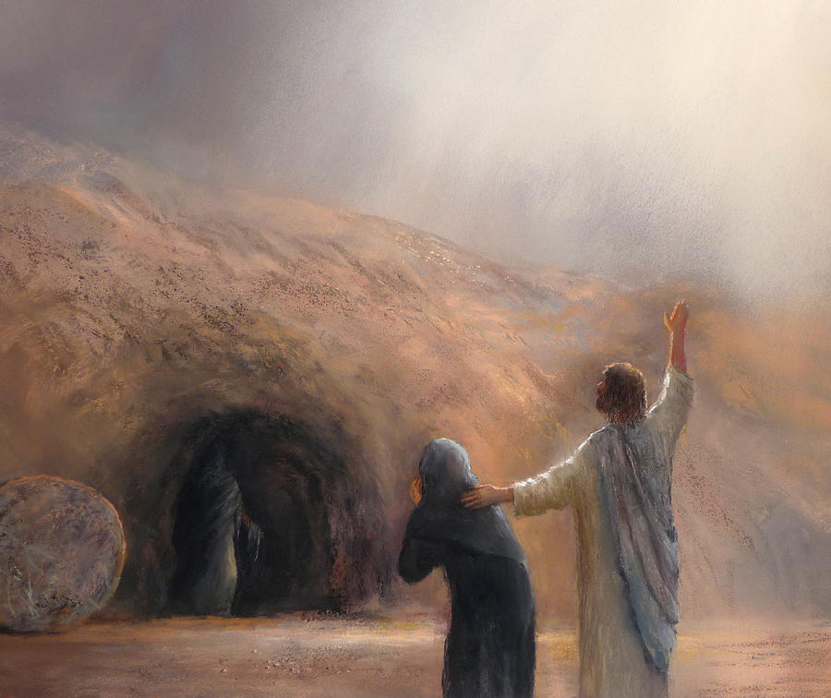
The Lazarus Miracle
1 Peter 1:3
Blessed be the God and Father of our Lord Jesus Christ! According to his great mercy,
he has caused us to be born again to a living hope
through the resurrection of Jesus Christ from the dead.

Slide 3
John 20:30-31
Now Jesus did many other signs in the presence of the disciples, which are not written in this book;³¹ but these are written so that you may believe that Jesus is the Christ, the Son of God, and that by believing you may have life in his name.

Slide 4
John 21:25
Now there are also many other things that Jesus did. Were every one of them to be written, I suppose that the world itself could not contain the books that would be written.

Slide 5
Chapter 1 Intro
Chapters 2-10 Miracles and controversies
Chapters 11-12 Final Miracle Raising Lazarus
Chapters 13-17 Final words and powerful teaching
Chapters 18-21 Betrayal and death – Resurrection and restoration.

Slide 6
John 11:4
But when Jesus heard it he said, “This illness does not lead to death. It is for the glory of God, so that the Son of God may be glorified through it.”

Slide 7
John 11:5-6
Now Jesus loved Martha and her sister and Lazarus. ⁶ So, when he heard that Lazarus was ill, he stayed two days longer in the place where he was.

Slide 8
John 11:7-10
Then after this he said to the disciples, “Let us go to Judea again.” ⁸ The disciples said to him, “Rabbi, the Jews were just now seeking to stone you, and are you going there again?” ⁹ Jesus answered, “Are there not twelve hours in the day? If anyone walks in the day, he does not stumble, because he sees the light of this world. ¹⁰ But if anyone walks in the night, he stumbles, because the light is not in him.”

Slide 9
John 11:11-15
After saying these things, he said to them, “Our friend Lazarus has fallen asleep, but I go to awaken him.” ¹² The disciples said to him, “Lord, if he has fallen asleep, he will recover.” ¹³ Now Jesus had spoken of his death, but they thought that he meant taking rest in sleep. ¹⁴ Then Jesus told them plainly, “Lazarus has died, ¹⁵ and for your sake I am glad that I was not there, so that you may believe. But let us go to him.”

Slide 10
John 11:16
So Thomas, called the Twin, said to his fellow disciples, “Let us also go, that we may die with him.”

Slide 11
John 11:17-22
Now when Jesus came, he found that Lazarus had already been in the tomb four days. ¹⁸ Bethany was near Jerusalem, about two miles off, ¹⁹ and many of the Jews had come to Martha and Mary to console them concerning their brother….

Slide 12
^{………….20} So when Martha heard that Jesus was coming, she went and met him, but Mary remained seated in the house. ²¹ Martha said to Jesus, “Lord, if you had been here, my brother would not have died. ²² But even now I know that whatever you ask from God, God will give you.”

Slide 13
John 11:23-27 Jesus said to her, “Your brother will rise again.” ²⁴ Martha said to him, “I know that he will rise again in the resurrection on the last day.” ²⁵ Jesus said to her, “I am the resurrection and the life. Whoever believes in me, though he die, yet shall he live, ……..

Slide 14
^{………..26} and everyone who lives and believes in me shall never die. Do you believe this?” ²⁷ She said to him, “Yes, Lord; I believe that you are the Christ, the Son of God, who is coming into the world.”

Slide 15
John 11:28-37 When she had said this, she went and called her sister Mary, saying in private, “The Teacher is here and is calling for you.” ²⁹ And when she heard it, she rose quickly and went to him. ³⁰ Now Jesus had not yet come into the village, but was still in the place where Martha had met him. ³¹ When the Jews who were with her in the house, consoling her, saw Mary rise quickly and go out, they followed her, supposing that she was going to the tomb to weep there…………..

Slide 16
^{………..32} Now when Mary came to where Jesus was and saw him, she fell at his feet, saying to him, “Lord, if you had been here, my brother would not have died.” ³³ When Jesus saw her weeping, and the Jews who had come with her also weeping, he was deeply moved in his spirit and greatly troubled. ³⁴ And he said, “Where have you laid him?” They said to him, “Lord, come and see.”……
1 Peter 1:3
Blessed be the God and Father of our Lord Jesus Christ! According to his great mercy,
he has caused us to be born again to a living hope
through the resurrection of Jesus Christ from the dead.

Slide 17
^{……….35} Jesus wept. ³⁶ So the Jews said, “See how he loved him!” ³⁷ But some of them said, “Could not he who opened the eyes of the blind man also have kept this man from dying?”

Slide 18
Hebrews 4:15
For we do not have a high priest who is unable to sympathize with our weaknesses, but one who in every respect has been tempted as we are, yet without sin.

Slide 19
John 11:38-44 Then Jesus, deeply moved again, came to the tomb. It was a cave, and a stone lay against it. ³⁹ Jesus said, “Take away the stone.” Martha, the sister of the dead man, said to him, “Lord, by this time there will be an odor, for he has been dead four days.” ……….

Slide 20
^{……….40} Jesus said to her, “Did I not tell you that if you believed you would see the glory of God?” ⁴¹ So they took away the stone. And Jesus lifted up his eyes and said, “Father, I thank you that you have heard me. ⁴² I knew that you always hear me, but I said this on account of the people standing around, that they may believe that you sent me.”………..

Slide 21
^{………43} When he had said these things, he cried out with a loud voice, “Lazarus, come out.” ⁴⁴ The man who had died came out, his hands and feet bound with linen strips, and his face wrapped with a cloth. Jesus said to them, “Unbind him, and let him go.”

Slide 22
1Corinthians 15:25-26
For he must reign until he has put all his enemies under his feet. ²⁶ The last enemy to be destroyed is death.

Slide 23
John 11:45-46 Many of the Jews therefore, who had come with Mary and had seen what he did, believed in him, ⁴⁶ but some of them went to the Pharisees and told them what Jesus had done.

Slide 24
Celebrate
Death Defeated

Slide 25
The Lazarus Miracle
1 Peter 1:3
Blessed be the God and Father of our Lord Jesus Christ! According to his great mercy,
he has caused us to be born again to a living hope
through the resurrection of Jesus Christ from the dead.

