Slide 2
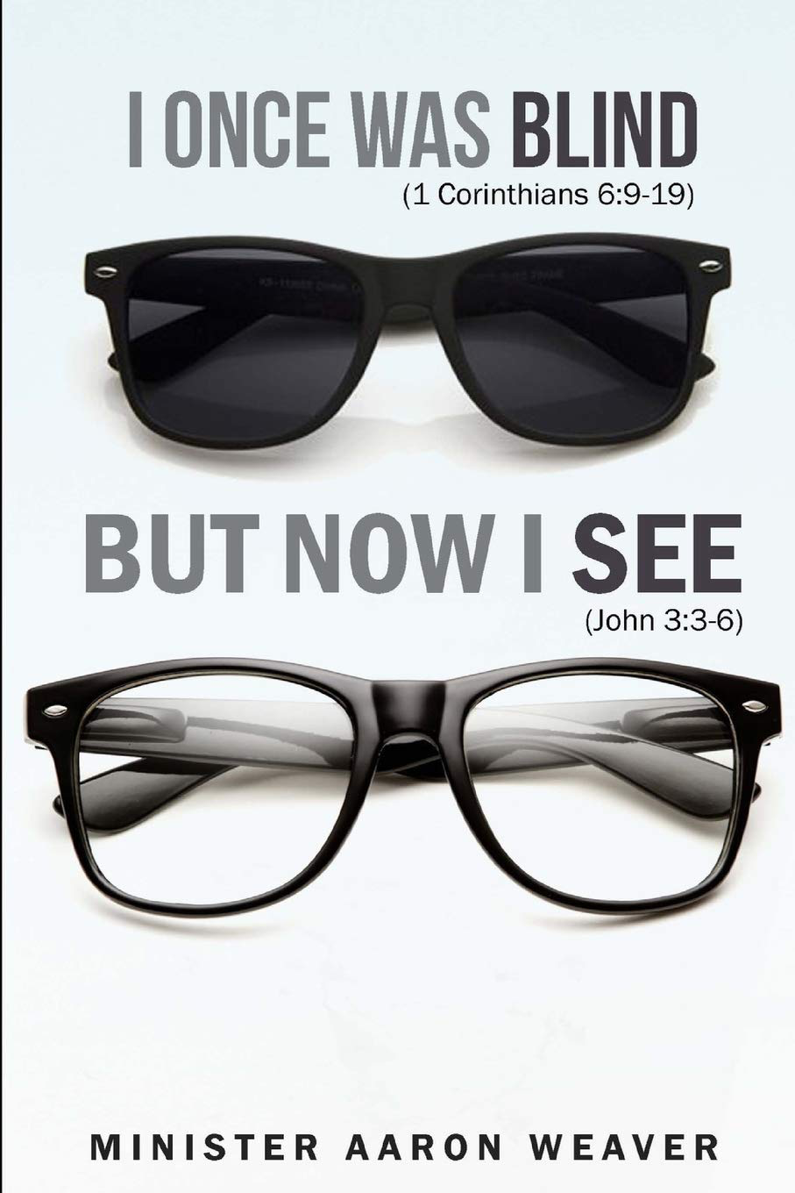
Living Word Church June 28, 2020

Slide 3
John 9:1-2
As he passed by, he saw a man blind from birth. ² And his disciples asked him, “Rabbi, who sinned, this man or his parents, that he was born blind?”

Slide 4
John 9:3-5
Jesus answered, “It was not that this man sinned, or his parents, but that the works of God might be displayed in him. ⁴ We must work the works of him who sent me while it is day; night is coming, when no one can work. ⁵ As long as I am in the world, I am the light of the world.”

Slide 5
Isaiah 55:8-9
For my thoughts are not your thoughts, neither are your ways my ways, declares the Lord. ⁹ For as the heavens are higher than the earth, so are my ways higher than your ways and my thoughts than your thoughts.

Slide 6
Romans 9:20
But who are you, O man, to answer back to God? Will what is molded say to its molder, “Why have you made me like this?”

Slide 7
1 Corinthians 2:16
“For who has understood the mind of the Lord so as to instruct him?” But we have the mind of Christ.

Slide 8
2Corinthians 12:7-10
So to keep me from becoming conceited because of the surpassing greatness of the revelations a thorn was given me in the flesh, a messenger of Satan to harass me, to keep me from becoming conceited.
⁸ Three times I pleaded with the Lord about this, that it should leave me………….

Slide 9
…… ⁹ But he said to me, “My grace is sufficient for you, for my power is made perfect in weakness.” Therefore I will boast all the more gladly of my weaknesses, so that the power of Christ may rest upon me. ¹⁰ For the sake of Christ, then, I am content with weaknesses, insults, hardships, persecutions, and calamities. For when I am weak, then I am strong.

Slide 10
John 9:4
We must work the works of him who sent me while it is day; night is coming, when no one can work.

Slide 11
Psalm 90:12
So teach us to number our days that we may get a heart of wisdom.

Slide 12
John 9:6-7
Having said these things, he spit on the ground and made mud with the saliva. Then he anointed the man's eyes with the mud ⁷ and said to him, “Go, wash in the pool of Siloam” (which means Sent). So he went and washed and came back seeing.

Slide 13
John 9:8-12
The neighbors and those who had seen him before as a beggar were saying, “Is this not the man who used to sit and beg?” ⁹ Some said, “It is he.” Others said, “No, but he is like him.” He kept saying, “I am the man.” ¹⁰ So they said to him, “Then how were your eyes opened?” ……….

Slide 14
^{…………11} He answered, “The man called Jesus made mud and anointed my eyes and said to me, ‘Go to Siloam and wash.’ So I went and washed and received my sight.” ¹² They said to him, “Where is he?” He said, “I do not know.”

Slide 15
John 9:18-23
The Jews did not believe that he had been blind and had received his sight, until they called the parents of the man who had received his sight ¹⁹ and asked them, “Is this your son, who you say was born blind? How then does he now see?” ²⁰ His parents answered, “We know that this is our son and that he was born blind. ………

Slide 16
^{………….21} But how he now sees we do not know, nor do we know who opened his eyes. Ask him; he is of age. He will speak for himself.” ²² (His parents said these things because they feared the Jews, for the Jews had already agreed that if anyone should confess Jesus to be Christ, he was to be put out of the synagogue.) ²³ Therefore his parents said, “He is of age; ask him.”

Slide 17
John 5:18 This was why the Jews were seeking all the more to kill him, because not only was he breaking the Sabbath, but he was even calling God his own Father, making himself equal with God. And in
John 8:59 So they picked up stones to throw at him, but Jesus hid himself and went out of the temple.
Matthew 24:9 “Then they will deliver you up to tribulation and put you to death, and you will be hated by all nations for my name's sake.

Slide 18
John 9:24-27
So for the second time they called the man who had been blind and said to him, “Give glory to God. We know that this man is a sinner.”
²⁵ He answered, “Whether he is a sinner I do not know. One thing I do know, that though I was blind, now I see.” ……..

Slide 19
^{……….. 26} They said to him, “What did he do to you? How did he open your eyes?” ²⁷ He answered them, “I have told you already, and you would not listen. Why do you want to hear it again? Do you also want to become his disciples?”

Slide 20
Revelation 12:10-11
And I heard a loud voice in heaven, saying, “Now the salvation and the power and the kingdom of our God and the authority of his Christ have come, for the accuser of our brothers has been thrown down, who accuses them day and night before our God. And they have conquered him by the blood of the Lamb and by the word of their testimony, for they loved not their lives even unto death.

Slide 21
John 9:28-34 And they reviled him, saying, “You are his disciple, but we are disciples of Moses. ²⁹ We know that God has spoken to Moses, but as for this man, we do not know where he comes from.”³⁰ The man answered, “Why, this is an amazing thing! You do not know where he comes from, and yet he opened my eyes. ……….

Slide 22
^{………..31} We know that God does not listen to sinners, but if anyone is a worshiper of God and does his will, God listens to him. ³² Never since the world began has it been heard that anyone opened the eyes of a man born blind. ³³ If this man were not from God, he could do nothing.” ³⁴ They answered him, “You were born in utter sin, and would you teach us?” And they cast him out.

Slide 23
John 9:35-41
Jesus heard that they had cast him out, and having found him he said, “Do you believe in the Son of Man?” ³⁶ He answered, “And who is he, sir, that I may believe in him?” ³⁷ Jesus said to him, “You have seen him, and it is he who is speaking to you.” ³⁸ He said, “Lord, I believe,” and he worshiped him………

Slide 24
^{…………..39} Jesus said, “For judgment I came into this world, that those who do not see may see, and those who see may become blind.” ⁴⁰ Some of the Pharisees near him heard these things, and said to him, “Are we also blind?” ⁴¹ Jesus said to them, “If you were blind, you would have no guilt; but now that you say, ‘We see,’ your guilt remains.

Slide 25
Mark 2:16-17
¹⁶ And the scribes of the Pharisees, when they saw that he was eating with sinners and tax collectors, said to his disciples, “Why does he eat with tax collectors and sinners?” ¹⁷ And when Jesus heard it, he said to them, “Those who are well have no need of a physician, but those who are sick. I came not to call the righteous, but sinners.”

Slide 26
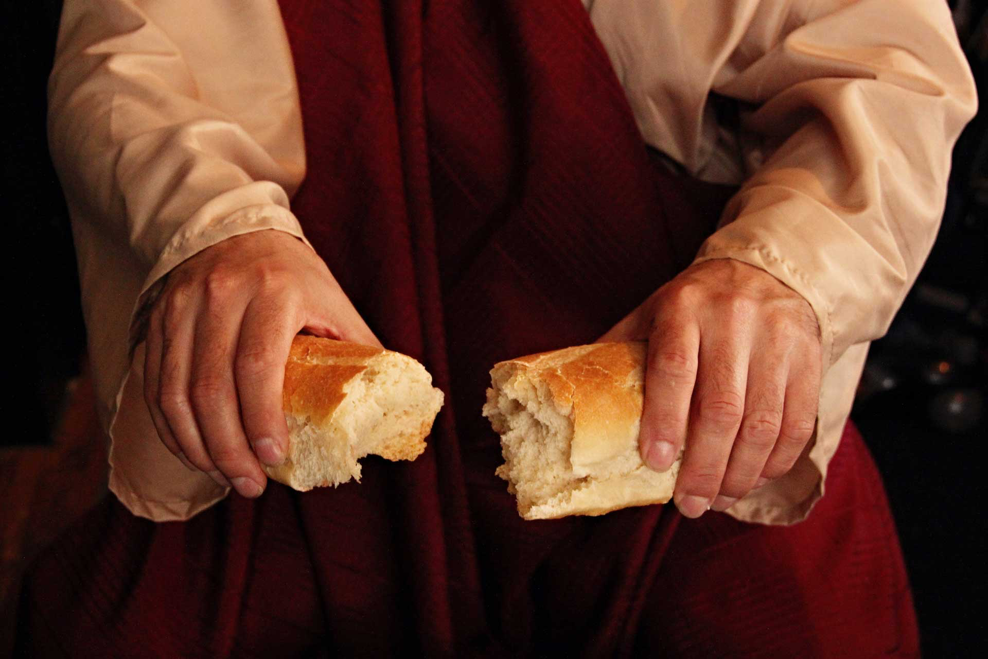
Remembering
The Act That Defeated Darkness

Slide 27
Living Word Church June 28, 2020

