Slide 2
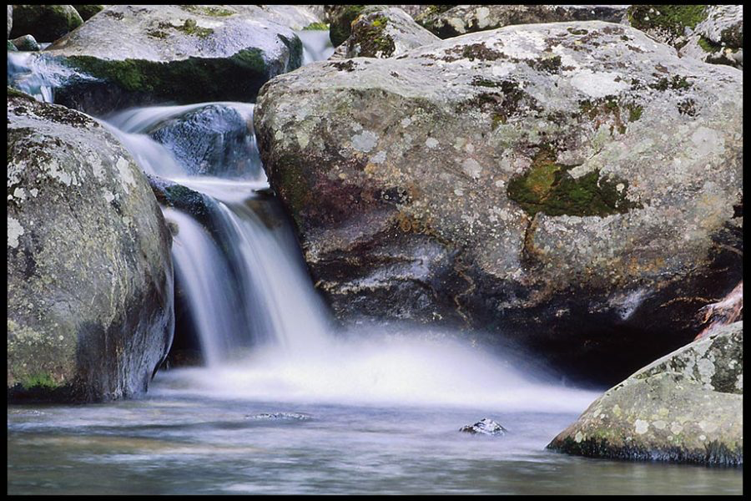
River Of Living Water
1 Peter 1:3
Blessed be the God and Father of our Lord Jesus Christ! According to his great mercy,
he has caused us to be born again to a living hope
through the resurrection of Jesus Christ from the dead.

Slide 3
John 7:37-39
On the last day of the feast, the great day, Jesus stood up and cried out, “If anyone thirsts, let him come to me and drink. ³⁸ Whoever believes in me, as the Scripture has said, ‘Out of his heart will flow rivers of living water.” ³⁹ Now this he said about the Spirit, whom those who believed in him were to receive, for as yet the Spirit had not been given, because Jesus was not yet glorified

Slide 4
Isaiah 12:2-3
“Behold, God is my salvation; I will trust, and will not be afraid; for the Lord God is my strength and my song, and he has become my salvation.” With joy you will draw water from the wells of salvation.

Slide 5
Jeremiah 2:13
for my people have committed two evils: they have forsaken me, the fountain of living waters, and hewed out cisterns for themselves, broken cisterns that can hold no water.

Slide 6
Revelation 7:17
For the Lamb in the midst of the throne will be their shepherd, and he will guide them to springs of living water, and God will wipe away every tear from their eyes.”

Slide 7
1 Peter 4:10-11
As each has received a gift, use it to serve one another, as good stewards of God's varied grace: ¹¹ whoever speaks, as one who speaks oracles of God; whoever serves, as one who serves by the strength that God supplies—in order that in everything God may be glorified through Jesus Christ. To him belong glory and dominion forever and ever. Amen

Slide 8
Isaiah 58:11
And the Lord will guide you continually and satisfy your desire in scorched places and make your bones strong; and you shall be like a watered garden, like a spring of water, whose waters do not fail.

Slide 9
Isaiah 55:1
“Come, everyone who thirsts, come to the waters; and he who has no money, come, buy and eat! Come, buy wine and milk without money and without price.

Slide 10
John 7:38
Whoever believes in me, as the Scripture has said, ‘Out of his heart will flow rivers of living water.”

Slide 11
2Kings 3:10-11
The king of Israel said, “Alas! The Lord has called these three kings to give them into the hand of Moab.” ¹¹ And Jehoshaphat said, “Is there no prophet of the Lord here, through whom we may inquire of the Lord?” Then one of the king of Israel's servants answered, “Elisha the son of Shaphat is here.

Slide 12
2Kings 3:16-17
“This is what the LORD says: ‘Dig ditches all over this dry stream bed. ¹⁷ Even though you will not see any rain or wind, this stream bed will be filled with water, and you, your livestock, and your pack animals will have plenty to drink.”

Slide 13
2Kings 3:22-24
And when they rose early in the morning and the sun shone on the water, the Moabites saw the water opposite them as red as blood. ²³ And they said, “This is blood; the kings have surely fought together and struck one another down. Now then, Moab, to the spoil!” ²⁴ But when they came to the camp of Israel, the Israelites rose and struck the Moabites, till they fled before them. And they went forward, striking the Moabites as they went.

Slide 14
John 7:38
“Whoever believes in me, as the Scripture has said, ‘Out of his heart will flow rivers of living water.”

Slide 15
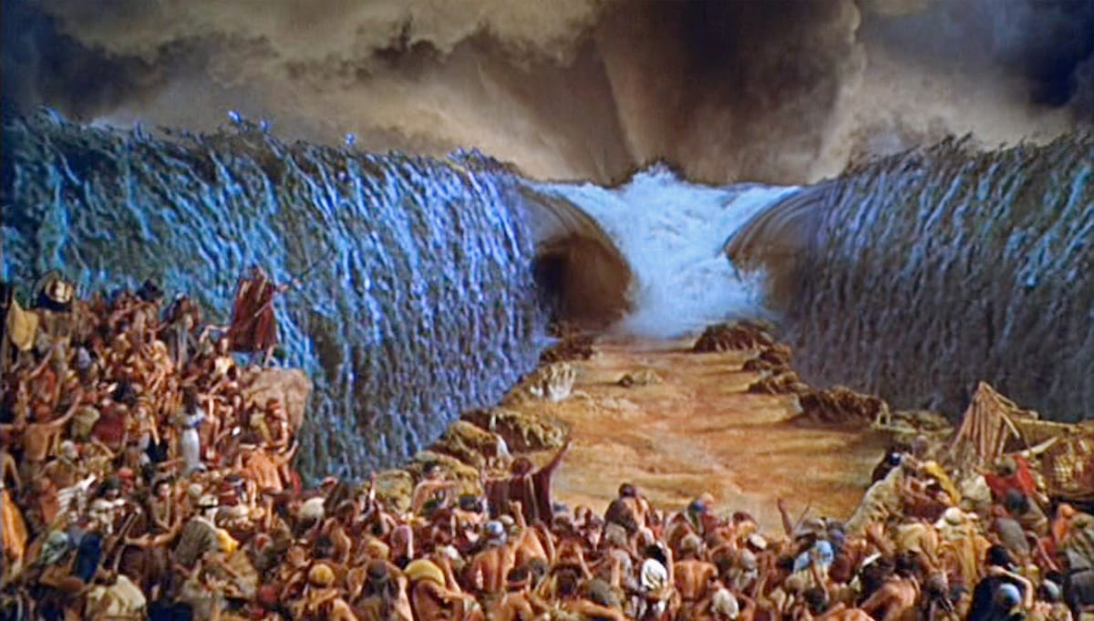
Communion
Remembering Salvation

Slide 16
River Of Living Water
1 Peter 1:3
Blessed be the God and Father of our Lord Jesus Christ! According to his great mercy,
he has caused us to be born again to a living hope
through the resurrection of Jesus Christ from the dead.

