Slide 2
Deception
Revelation 3:14-22
1 Peter 1:3
Blessed be the God and Father of our Lord Jesus Christ! According to his great mercy,
he has caused us to be born again to a living hope
through the resurrection of Jesus Christ from the dead.

Slide 3
Church Church Period Dates
Ephesus Apostolic Church AD30-100
Desired
Smyrna Persecuted Church AD 100-313
Myrrh
Pergamum State Church AD 313-590
Thoroughly Married
Thyatira Papal Church AD 600-1517 Perpetual Sacrifice

Slide 4
Church Church Period Dates
Sardis Reformation Church AD 1517-1648
Escaping
Philadelphia Missionary Church AD 1648-1900
Brotherly Love
Laodicea Apostasy Church AD 1900-NOW
People Ruling

Slide 5
Revelation 3:14-22 “And to the angel of the church in Laodicea write: ‘The words of the Amen, the faithful and true witness, the beginning of God's creation.¹⁵ “‘I know your works: you are neither cold nor hot. Would that you were either cold or hot! ¹⁶ So, because you are lukewarm, and neither hot nor cold, I will spit you out of my mouth……...

Slide 6
^{…….17} For you say, I am rich, I have prospered, and I need nothing, not realizing that you are wretched, pitiable, poor, blind, and naked. ¹⁸ I counsel you to buy from me gold refined by fire, so that you may be rich, and white garments so that you may clothe yourself and the shame of your nakedness may not be seen, and salve to anoint your eyes, so that you may see……………

Slide 7
^{…………19} Those whom I love, I reprove and discipline, so be zealous and repent. ²⁰ Behold, I stand at the door and knock. If anyone hears my voice and opens the door, I will come in to him and eat with him, and he with me. ²¹ The one who conquers, I will grant him to sit with me on my throne, as I also conquered and sat down with my Father on his throne. ²² He who has an ear, let him hear what the Spirit says to the churches.’”

Slide 8
Colossians 2:1
For I want you to know how great a struggle I have for you and for those at Laodicea and for all who have not seen me face to face,

Slide 9
Colossians 4:13,15-16 For I bear him witness that he has worked hard for you and for those in Laodicea and in Hierapolis……¹⁵ Give my greetings to the brothers at Laodicea, and to Nympha and the church in her house.¹⁶ And when this letter has been read among you, have it also read in the church of the Laodiceans; and see that you also read the letter from Laodicea

Slide 10
Revelation 3:15-16
“I know your works: you are neither cold nor hot. Would that you were either cold or hot! ¹⁶ So, because you are lukewarm, and neither hot nor cold, I will spit you out of my mouth”.

Slide 11
Revelation 3:17
For you say, I am rich, I have prospered, and I need nothing,
not realizing that you are wretched, pitiable, poor, blind, and naked.

Slide 12
Luke 18:18-19
And a ruler asked him, “Good Teacher, what must I do to inherit eternal life?” ¹⁹ And Jesus said to him, “Why do you call me good?
No one is good except God alone.

Slide 13
Matthew 5:3
Blessed are the poor in spirit, for theirs is the kingdom of heaven.

Slide 14
Matthew 15:7-10
You hypocrites! Well did Isaiah prophesy of you, when he said: ⁸ “‘This people honors me with their lips, but their heart is far from me; ⁹ in vain do they worship me, teaching as doctrines the commandments of men.’”

Slide 15
Matthew 7:21-23 “Not everyone who says to me, ‘Lord, Lord,’ will enter the kingdom of heaven, but the one who does the will of my Father who is in heaven. ²² On that day many will say to me, ‘Lord, Lord, did we not prophesy in your name, and cast out demons in your name, and do many mighty works in your name?’²³ And then will I declare to them, ‘I never knew you; depart from me, you workers of lawlessness.

Slide 16
2 Timothy 3:1-5 But understand this, that in the last days there will come times of difficulty. ² For people will be lovers of self, lovers of money, proud, arrogant, abusive, disobedient to their parents, ungrateful, unholy, ³ heartless, unappeasable, slanderous, without self-control, brutal, not loving good, ⁴ treacherous, reckless, swollen with conceit, lovers of pleasure rather than lovers of God, ⁵ having the appearance of godliness, but denying its power. Avoid such people.

Slide 17
Revelation 3:18
I counsel you to buy from me gold refined by fire, so that you may be rich, and white garments so that you may clothe yourself and the shame of your nakedness may not be seen, and salve to anoint your eyes, so that you may see.

Slide 18
Isaiah 61:10
I will greatly rejoice in the Lord; my soul shall exult in my God, for he has clothed me with the garments of salvation; he has covered me with the robe of righteousness,

Slide 19
Revelation 3:19
Those whom I love,
I reprove and discipline,
so be zealous and repent.

Slide 20
1 Corinthians 11:32 Nevertheless, when we are judged in this way by the Lord, we are being disciplined so that we will not be finally condemned with the world.

Slide 21
Ephesians 4:18
They are darkened in their understanding, alienated from the life of God because of the ignorance that is in them, due to their hardness of heart.

Slide 22
Ephesians 1:17-18 that the God of our Lord Jesus Christ, the Father of glory, may give you the Spirit of wisdom and of revelation in the knowledge of him, ¹⁸ having the eyes of your hearts enlightened, that you may know what is the hope to which he has called you, what are the riches of his glorious inheritance in the saints

Slide 23
Psalm 119:18
Open my eyes, that I may behold wondrous things out of your law.

Slide 24
Revelation 3:20-21
Behold, I stand at the door and knock. If anyone hears my voice and opens the door,
I will come in to him and eat with him, and he with me. ²¹ The one who conquers, I will grant him to sit with me on my throne, as I also conquered and sat down with my Father on his throne.

Slide 25
Revelation 3:20
“He who has an ear, let him hear what the Spirit says to the churches.”

Slide 26
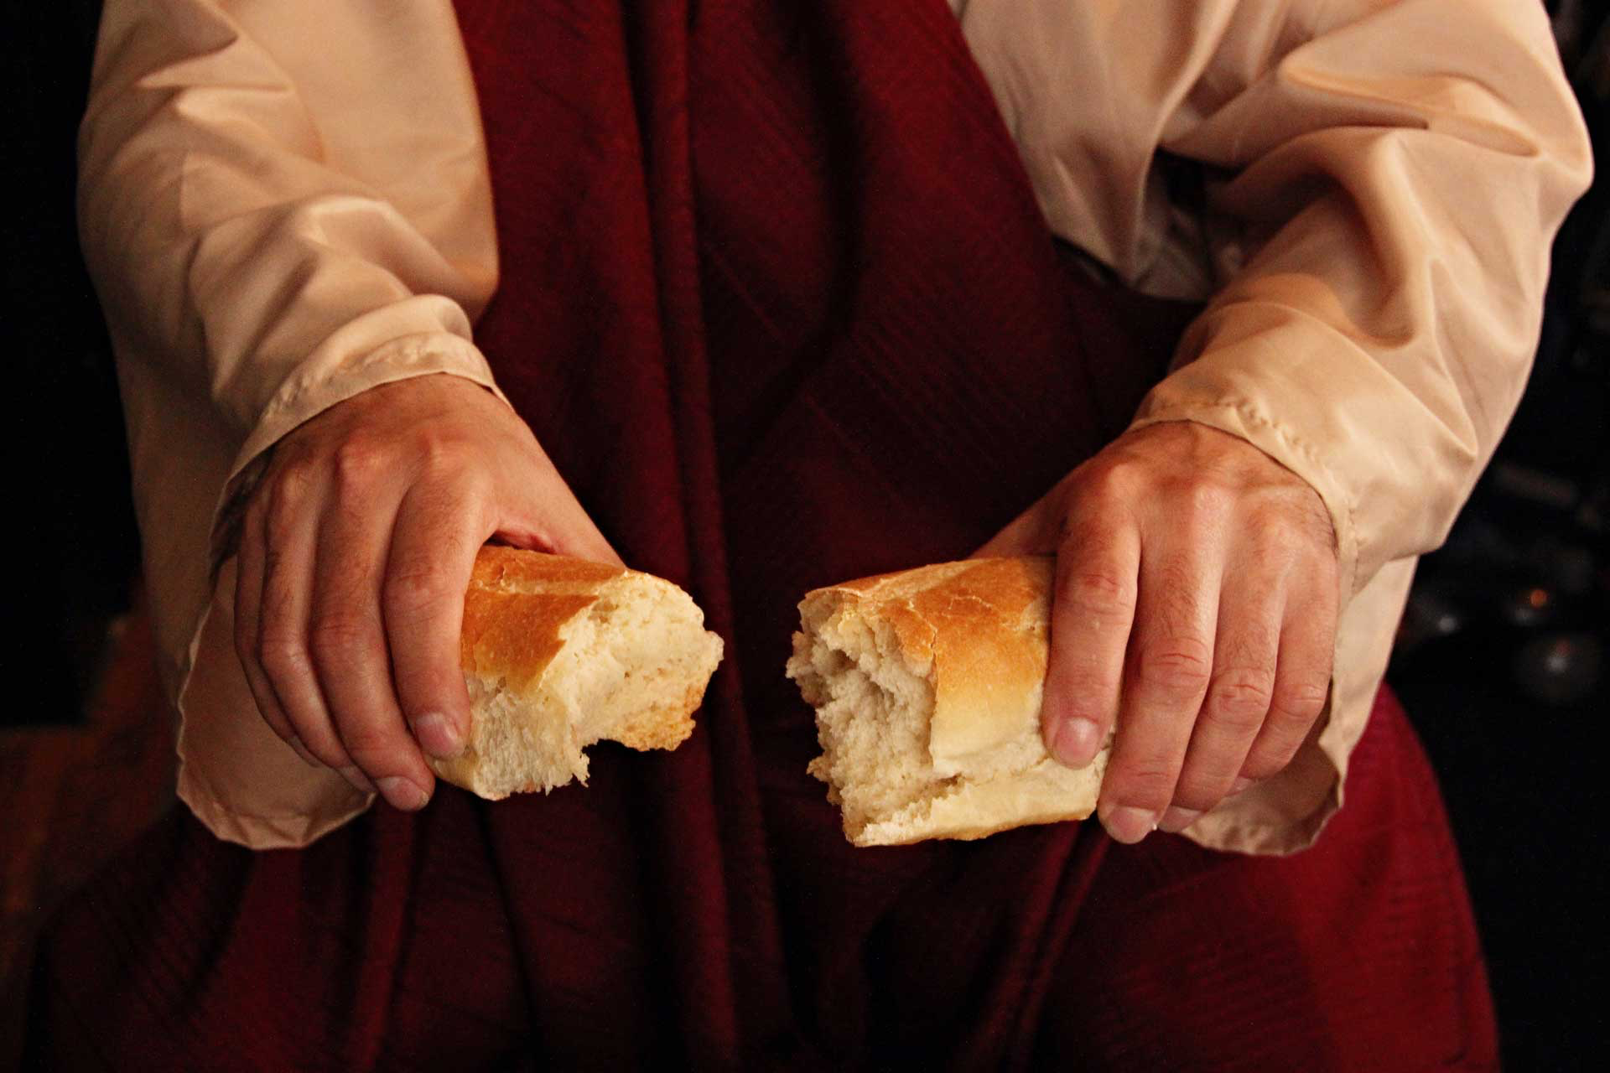
Celebrate
The Bread
Of Life

Slide 27
Deception
Revelation 3:14-22
1 Peter 1:3
Blessed be the God and Father of our Lord Jesus Christ! According to his great mercy,
he has caused us to be born again to a living hope
through the resurrection of Jesus Christ from the dead.

