Slide 2
“I have set before you an open door”
Jesus

Slide 3
Revelation 3:7
“And to the angel of the church in Philadelphia write: ‘The words of the holy one, the true one, who has the key of David, who opens and no one will shut, who shuts and no one opens.

Slide 4
Isaiah 22:20-23
In that day I will call my servant Eliakim the son of Hilkiah, ²¹ and I will clothe him with your robe, and will bind your sash on him, and will commit your authority to his hand. And he shall be a father to the inhabitants of Jerusalem and to the house of Judah……

Slide 5
…………….²² And I will place on his shoulder the key of the house of David. He shall open, and none shall shut; and he shall shut, and none shall open. ²³ And I will fasten him like a peg in a secure place, and he will become a throne of honor to his father's house.

Slide 6
Revelation 3:8
“‘I know your works. Behold, I have set before you an open door, which no one is able to shut. I know that you have but little power, and yet you have kept my word and have not denied my name.

Slide 7
1 Corinthians 16:8-9
But I will stay in Ephesus until Pentecost, ⁹ for a wide door for effective work has opened to me, and there are many adversaries

Slide 8
Colossians 4:3
At the same time, pray also for us, that God may open to us a door for the word, to declare the mystery of Christ, on account of which I am in prison

Slide 9
2 Corinthians 12:9-10
But he said to me, “My grace is sufficient for you, for my power is made perfect in weakness. ”Therefore I will boast all the more gladly of my weaknesses, so that the power of Christ may rest upon me. ¹⁰ For the sake of Christ, then, I am content with weaknesses, insults, hardships, persecutions, and calamities. For when I am weak, then I am strong.

Slide 10
Revelation 3:9-10
Behold, I will make those of the synagogue of Satan who say that they are Jews and are not, but lie—behold, I will make them come and bow down before your feet, and they will learn that I have loved you. ¹⁰ Because you have kept my word about patient endurance, I will keep you from the hour of trial that is coming on the whole world, to try those who dwell on the earth.

Slide 11
Romans 2:28
For no one is a Jew who
is merely one outwardly, nor is circumcision outward and physical.

Slide 12
Isaiah 45:14
Thus says the Lord: “The wealth of Egypt and the merchandise of Cush, and the Sabeans, men of stature, shall come over to you and be yours; they shall follow you; they shall come over in chains and bow down to you. They will plead with you, saying: ‘Surely God is in you, and there is no other, no god besides him.’”

Slide 13
Ephesians 2:6
And raised us up with him and seated us with him in the heavenly places in Christ Jesus,

Slide 14
Colossians 3:3
For you have died, and your life is hidden with Christ in God.

Slide 15
Revelation 3:11-12
I am coming soon. Hold fast what you have, so that no one may seize your crown.
¹² The one who conquers, I will make him a pillar in the temple of my God. Never shall he go out of it, and I will write on him the name of my God, and the name of the city of my God, the new Jerusalem, which comes down from my God out of heaven, and my own new name.

Slide 16
^{Revelation 3:13}
He who has an ear, Let him hear what the Spirit says to the churches.’

Slide 17
2 Timothy 2:12
if we endure, we will also reign with him; if we deny him, he also will deny us;

Slide 18
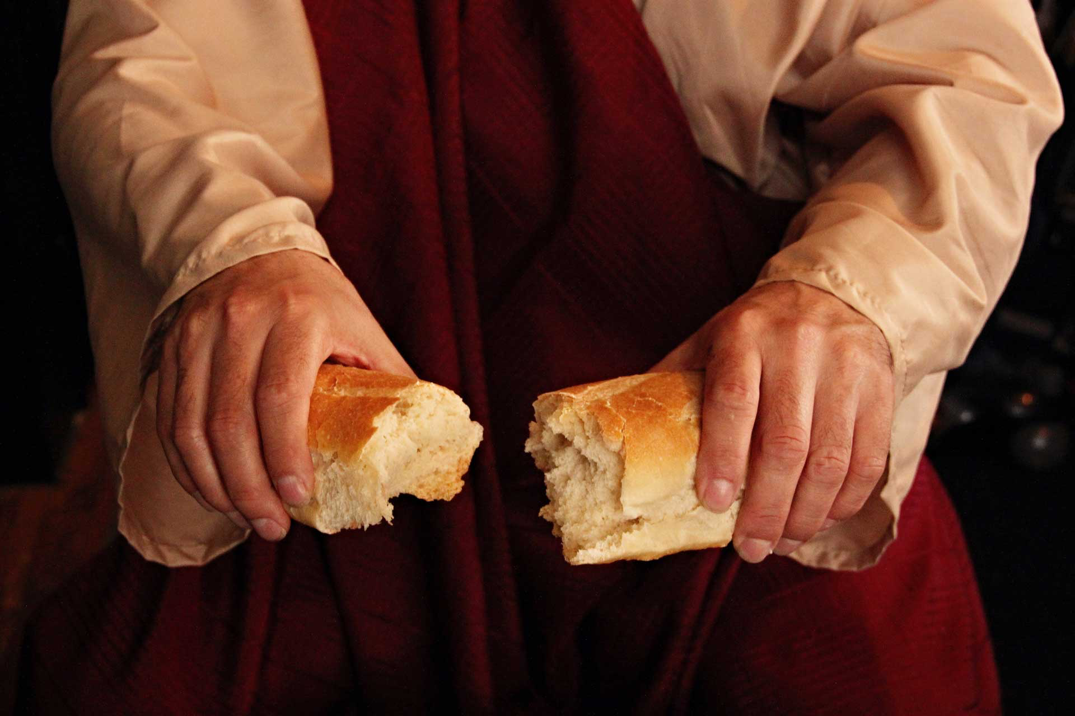
Remembering
The Act That Opened The Door Of Salvation

Slide 19
“I have set before you an open door”
Jesus

