Slide 2
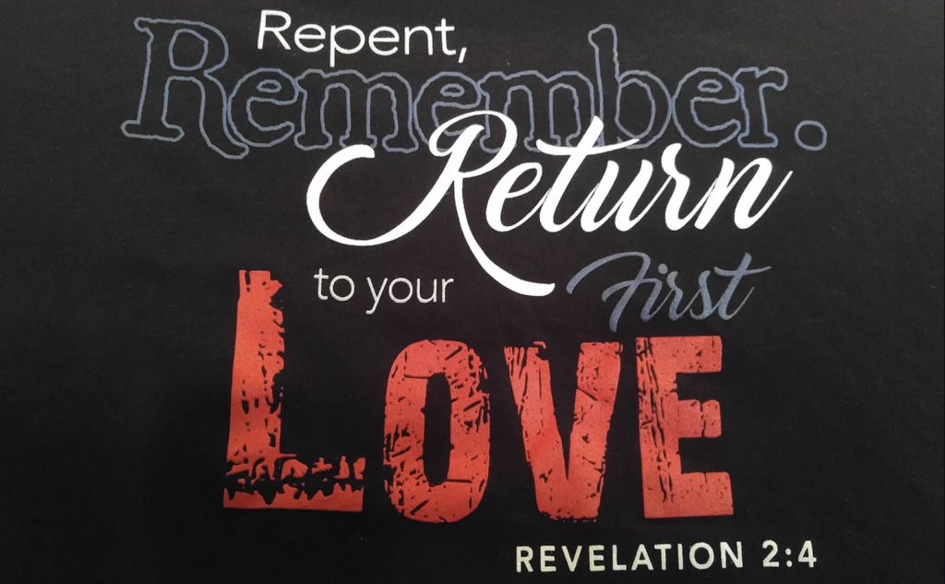
1 Peter 1:3
Blessed be the God and Father of our Lord Jesus Christ! According to his great mercy,
he has caused us to be born again to a living hope
through the resurrection of Jesus Christ from the dead.

Slide 3
Acts 18:19
And they came to Ephesus, and he left them there, but he himself went into the synagogue and reasoned with the Jews.

Slide 4
Acts 19:8-10 And he entered the synagogue and for three months spoke boldly, reasoning and persuading them about the kingdom of God. ⁹ But when some became stubborn and continued in unbelief, speaking evil of the Way before the congregation, he withdrew from them and took the disciples with him, reasoning daily in the hall of Tyrannus. ¹⁰ This continued for two years, so that all the residents of Asia heard the word of the Lord, both Jews and Greeks.

Slide 5
Acts 20:28-30
Pay careful attention to yourselves and to all the flock, in which the Holy Spirit has made you overseers, to care for the church of God, which he obtained with his own blood. ²⁹ I know that after my departure fierce wolves will come in among you, not sparing the flock; ³⁰ and from among your own selves will arise men speaking twisted things, to draw away the disciples after them. ……………..

Slide 6
…………. ³⁶ And when he had said these things, he knelt down and prayed with them all. ³⁷ And there was much weeping on the part of all; they embraced Paul and kissed him, ³⁸ being sorrowful most of all because of the word he had spoken, that they would not see his face again. And they accompanied him to the ship.

Slide 7
Revelation 2:1-7
“To the angel of the church in Ephesus write: ‘The words of him who holds the seven stars in his right hand, who walks among the seven golden lampstands.² “‘I know your works, your toil and your patient endurance, and how you cannot bear with those who are evil, but have tested those who call themselves apostles and are not, and found them to be false. …………………..

Slide 8
^{………….3} I know you are enduring patiently and bearing up for my name's sake, and you have not grown weary. ⁴ But I have this against you, that you have abandoned the love you had at first.
⁵ Remember therefore from where you have fallen; repent, and do the works you did at first. If not, I will come to you and remove your lampstand from its place, unless you repent………

Slide 9
^{………….6} Yet this you have: you hate the works of the Nicolaitans, which I also hate. ⁷ He who has an ear, let him hear what the Spirit says to the churches. To the one who conquers I will grant to eat of the tree of life, which is in the paradise of God.’
The Lord’s Table
“Bless The Lord, Oh My Soul”
The Song Of The Forgiven

Slide 10
Revelation 2:7
He who has an ear, let him hear what the Spirit says to the churches. To the one who conquers I will grant to eat of the tree of life, which is in the paradise of God

Slide 11
Matthew 15:8-9
This people honors me with their lips, but their heart is far from me; ⁹ in vain do they worship me, teaching as doctrines the commandments of men.’”

Slide 12
Psalm 43:4
Then I will go to the altar of God, to God my exceeding joy, and I will praise you with the lyre, O God, my God.

Slide 13
John 14:15
If you love me, you will keep my commandments.

Slide 14
Mark 12:29-31 Jesus answered, “The most important is, ‘Hear, O Israel: The Lord our God, the Lord is one.³⁰ And you shall love the Lord your God with all your heart and with all your soul and with all your mind and with all your strength.’ ³¹ The second is this: ‘You shall love your neighbor as yourself.’ There is no other commandment greater than these.”

Slide 15
Matthew 24:12
And because lawlessness will be increased, the love of many will grow cold.

Slide 16
Psalm 51:10-12
Create in me a clean heart, O God, and renew a right spirit within me.¹¹ Cast me not away from your presence, and take not your Holy Spirit from me.¹² Restore to me the joy of your salvation, and uphold me with a willing spirit.

Slide 17
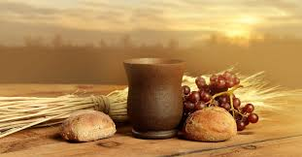
REMEMBER
REPENT
RETURN

Slide 18
1 Peter 1:3
Blessed be the God and Father of our Lord Jesus Christ! According to his great mercy,
he has caused us to be born again to a living hope
through the resurrection of Jesus Christ from the dead.

