Slide 2
From Grace
To Faith
Then Purpose

Slide 3
Ephesians 2:8-10
For by grace you have been saved through faith. And this is not your own doing; it is the gift of God, ⁹ not a result of works, so that no one may boast. ¹⁰ For we are his workmanship, created in Christ Jesus for good works, which God prepared beforehand, that we should walk in them.

Slide 4
Deuteronomy 9:5-6
Not because of your righteousness or the uprightness of your heart are you going in to possess their land, but because of the wickedness of these nations the Lord your God is driving them out from before you, and that he may confirm the word that the Lord swore to your fathers, to Abraham, to Isaac, and to Jacob.⁶ “Know, therefore, that the Lord your God is not giving you this good land to possess because of your righteousness, for you are a stubborn people.

Slide 5
John 1:16
For from his fullness we have all received, grace upon grace.

Slide 6
1 Corinthians 1:26-31 For consider your calling, brothers: not many of you were wise according to worldly standards, not many were powerful, not many were of noble birth. ²⁷ But God chose what is foolish in the world to shame the wise; God chose what is weak in the world to shame the strong; ²⁸ God chose what is low and despised in the world, even things that are not, to bring to nothing things that are, ²⁹ so that no human being might boast in the presence of God. ³⁰ And because of him you are in Christ Jesus, who became to us wisdom from God, righteousness and sanctification and redemption,

Slide 7
2 Corinthians 5:17
Therefore, if anyone is in Christ, he is a new creation. The old has passed away; behold, the new has come.

Slide 8
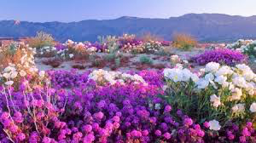
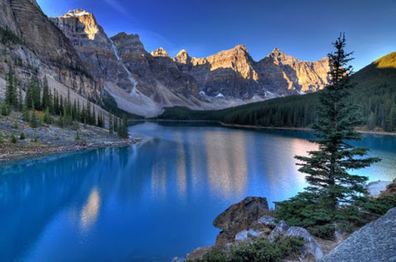
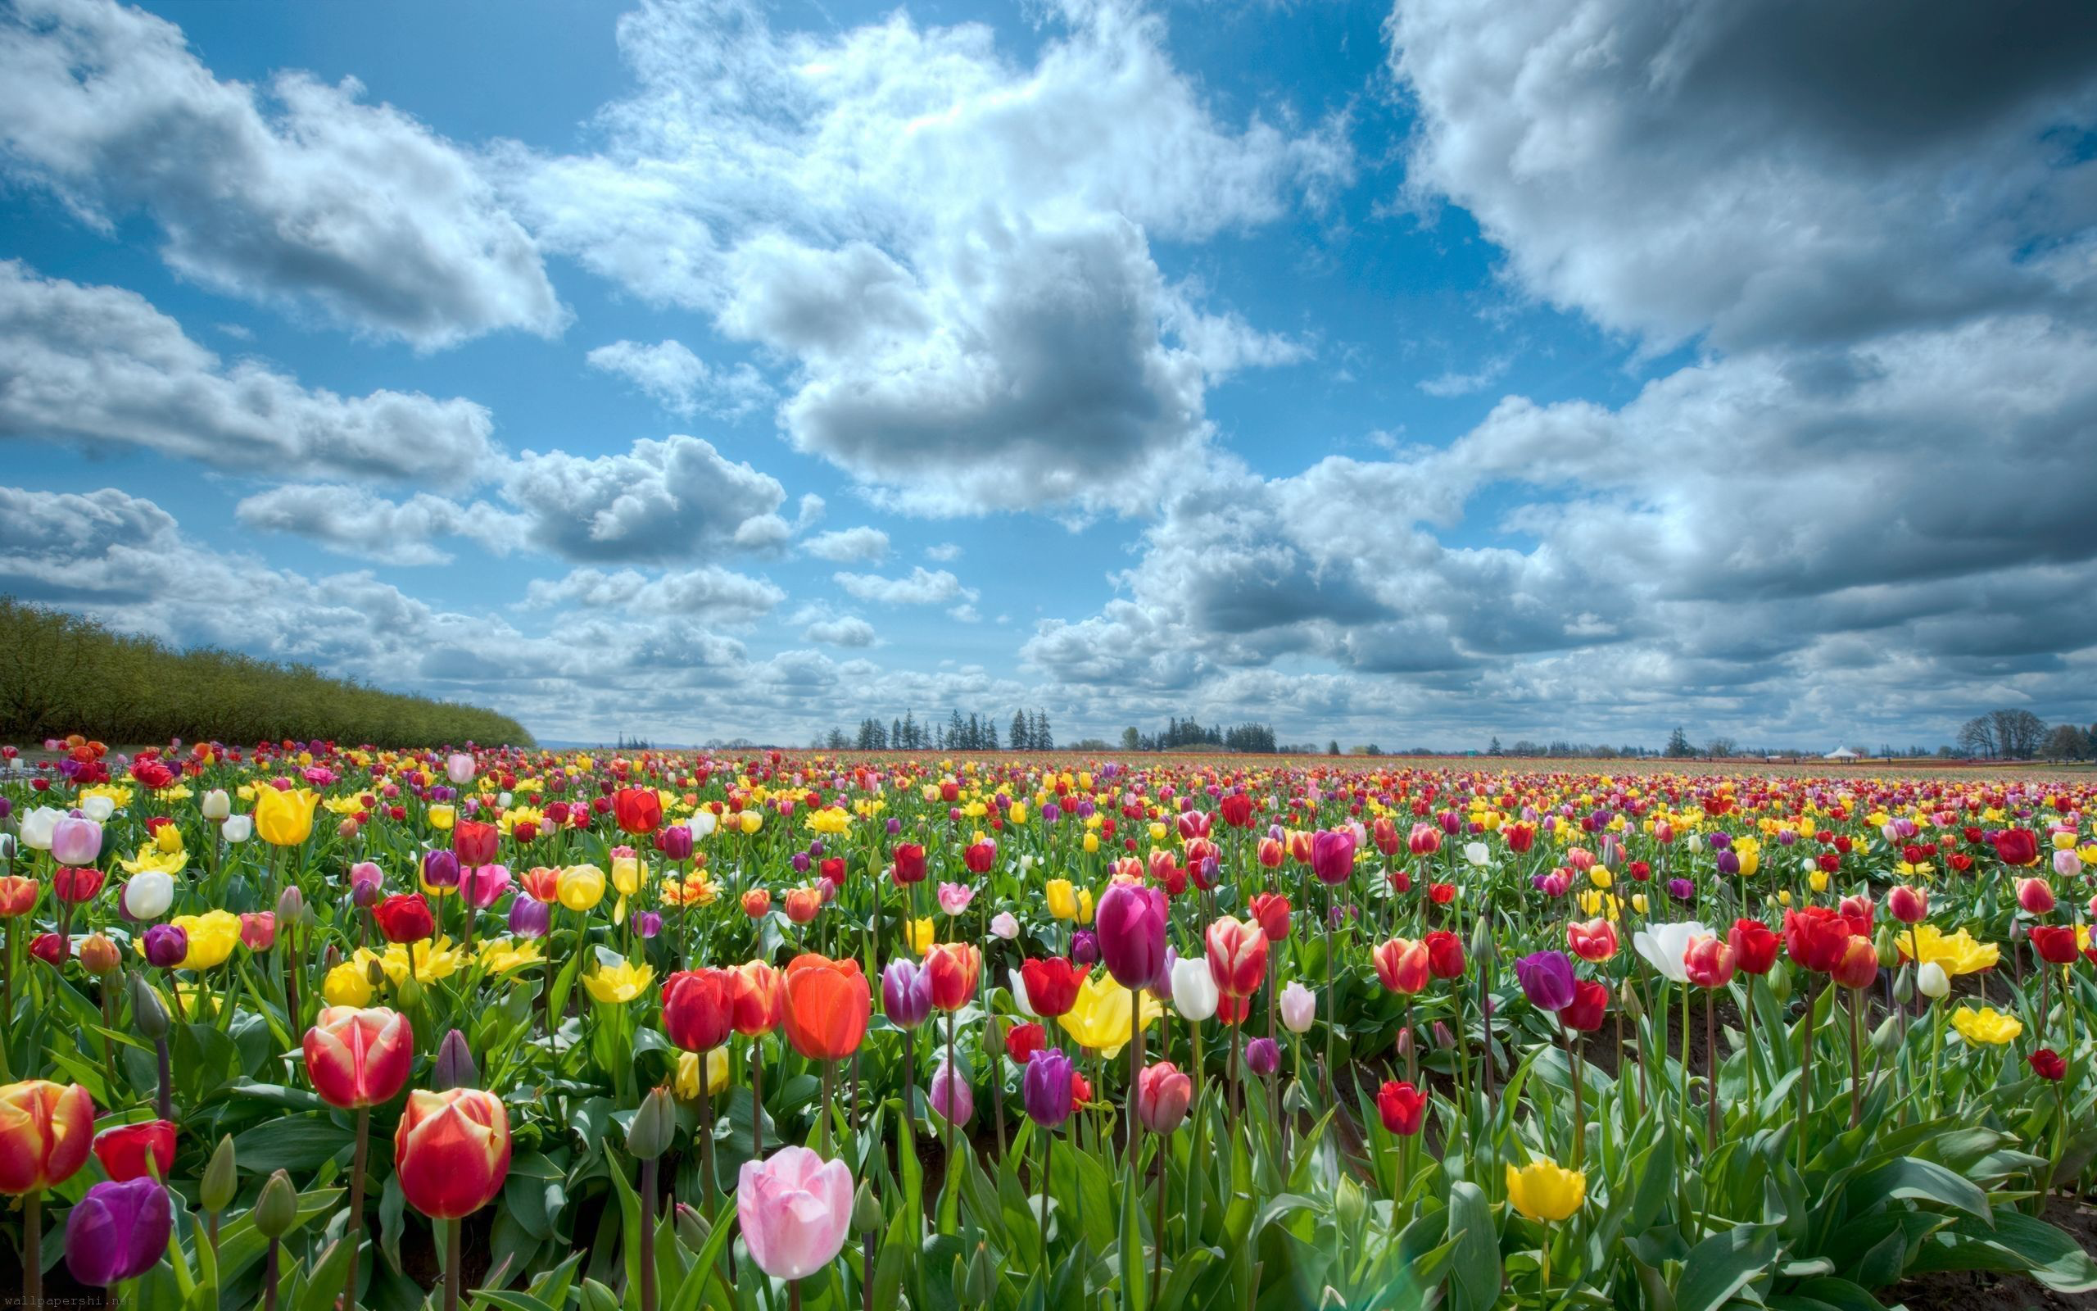
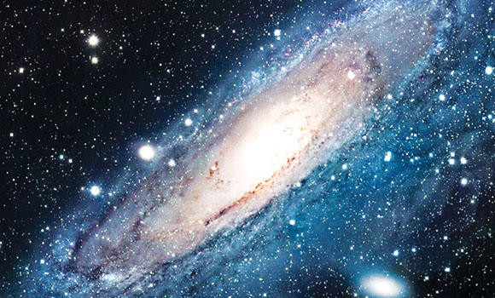
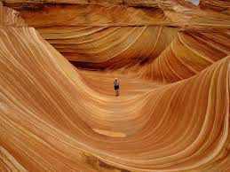
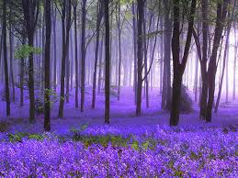
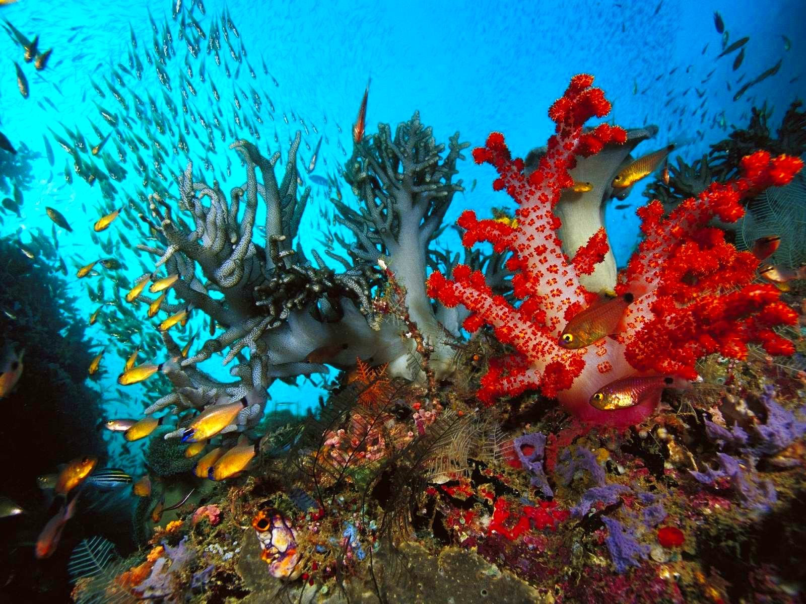
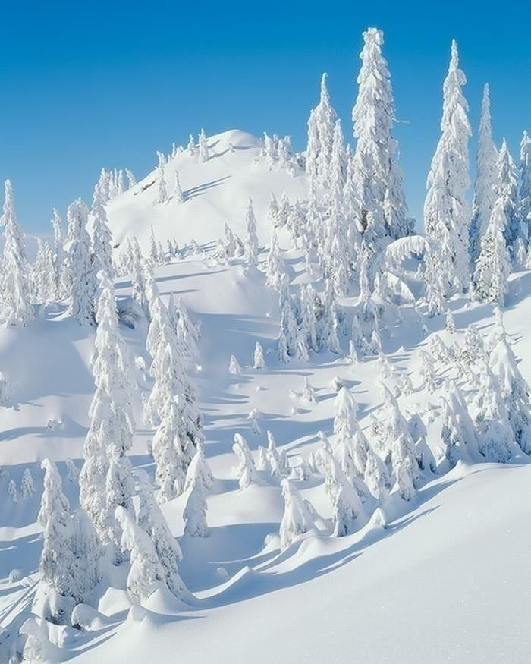

Slide 9
Isaiah 61:3
to grant to those who mourn in Zion— to give them a beautiful headdress instead of ashes, the oil of gladness instead of mourning, the garment of praise instead of a faint spirit; that they may be called oaks of righteousness, the planting of the Lord, that he may be glorified.

Slide 10
Psalm 139:14
I praise you, for I am fearfully and wonderfully made. Wonderful are your works; my soul knows it very well.

Slide 11
Romans 8:6
For to set the mind on the flesh is death, but to set the mind on the Spirit is life and peace.

Slide 12
Titus 3:8
The saying is trustworthy, and I want you to insist on these things, so that those who have believed in God may be careful to devote themselves to good works. These things are excellent and profitable for people.

Slide 13
John 3:29-31
The one who has the bride is the bridegroom. The friend of the bridegroom, who stands and hears him, rejoices greatly at the bridegroom's voice. Therefore this joy of mine is now complete. ³⁰ He must increase, but I must decrease.” ³¹ He who comes from above is above all. He who is of the earth belongs to the earth and speaks in an earthly way. He who comes from heaven is above all.

Slide 14
Role Modeling
Titus 2:7-8 Show yourself in all respects to be a model of good works, and in your teaching show integrity, dignity, ⁸ and sound speech that cannot be condemned, so that an opponent may be put to shame, having nothing evil to say about us.
Matthew 5:14-16 “You are the light of the world. A city set on a hill cannot be hidden.¹⁵ Nor do people light a lamp and put it under a basket, but on a stand, and it gives light to all in the house. ¹⁶ In the same way, let your light shine before others, so that they may see your good works and give glory to your Father who is in heaven.

Slide 15
Acts of Charity
Acts 20:35 In all things I have shown you that by working hard in this way we must help the weak and remember the words of the Lord Jesus, how he himself said, ‘It is more blessed to give than to receive.’”
Hebrews 13:16 Do not neglect to do good and to share what you have, for such sacrifices are pleasing to God.

Slide 16
Leaders of Hope
Romans 15:13 May the God of hope fill you with all joy and peace in believing, so that by the power of the Holy Spirit you may abound in hope.
1 Peter 3:15 but in your hearts honor Christ the Lord as holy, always being prepared to make a defense to anyone who asks you for a reason for the hope that is in you; yet do it with gentleness and respect,

Slide 17
Encouragers
1 Thessalonians 5:11 Therefore encourage one another and build one another up, just as you are doing.
1 Thessalonians 5:14 And we urge you, brothers, admonish the idle, encourage the fainthearted,
help the weak, be patient with them all.
Three Aspects Of Salvation

Slide 19
Share the Gospel
Mark 16:15-16 And he said to them, “Go into all the world and proclaim the gospel to the whole creation.
Acts 1:8 But you will receive power when the Holy Spirit has come upon you, and you will be my witnesses in Jerusalem and in all Judea and Samaria, and to the end of the earth.”

