Slide 2
GLORIOUS GOD BREATHED

Slide 3
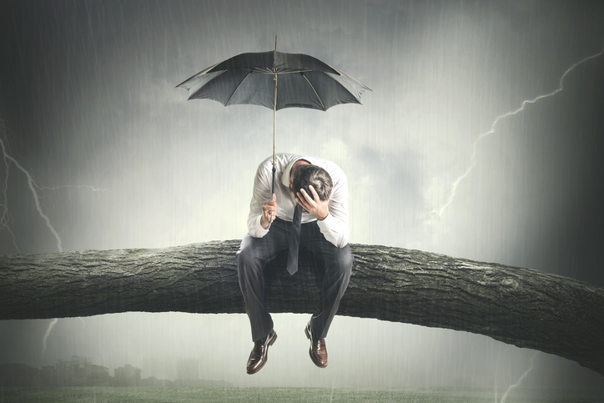
Wrong Expectations Can Be Destructive
1 Peter 1:3
Blessed be the God and Father of our Lord Jesus Christ! According to his great mercy,
he has caused us to be born again to a living hope
through the resurrection of Jesus Christ from the dead.

Slide 4
John 12:1-8
Six days before the Passover, Jesus therefore came to Bethany, where Lazarus was, whom Jesus had raised from the dead. ² So they gave a dinner for him there. Martha served, and Lazarus was one of those reclining with him at table. ³ Mary therefore took a pound of expensive ointment made from pure nard, and anointed the feet of Jesus and wiped his feet with her hair. The house was filled with the fragrance of the perfume……………………..

Slide 5
…⁴ But Judas Iscariot, one of his disciples (he who was about to betray him), said, ⁵ “Why was this ointment not sold for three hundred denarii and given to the poor?” ⁶ He said this, not because he cared about the poor, but because he was a thief, and having charge of the moneybag he used to help himself to what was put into it. ⁷ Jesus said, “Leave her alone, so that she may keep it for the day of my burial. ⁸ For the poor you always have with you, but you do not always have me.”

Slide 6
Luke 10:38-42
Now as they went on their way, Jesus entered a village. And a woman named Martha welcomed him into her house. ³⁹ And she had a sister called Mary, who sat at the Lord's feet and listened to his teaching.⁴⁰ But Martha was distracted with much serving. And she went up to him and said, “Lord, do you not care that my sister has left me to serve alone? Tell her then to help me.” ⁴¹ But the Lord answered her, “Martha, Martha, you are anxious and troubled about many things, ⁴² but one thing is necessary. Mary has chosen the good portion, which will not be taken away from her.”

Slide 7
John 12: 9-11
When the large crowd of the Jews learned that Jesus was there, they came, not only on account of him but also to see Lazarus, whom he had raised from the dead. ¹⁰ So the chief priests made plans to put Lazarus to death as well, ¹¹ because on account of him many of the Jews were going away and believing in Jesus.

Slide 8
John 11:50
Nor do you understand that it is better for you that one man should die for the people, not that the whole nation should perish.”

Slide 9
John 12:12-16
The next day the large crowd that had come to the feast heard that Jesus was coming to Jerusalem.¹³ So they took branches of palm trees and went out to meet him, crying out, “Hosanna! Blessed is he who comes in the name of the Lord, even the King of Israel!” …..
The Lord’s Table
“Bless The Lord, Oh My Soul”
The Song Of The Forgiven

Slide 10
^{……14} And Jesus found a young donkey and sat on it, just as it is written, ¹⁵ “Fear not, daughter of Zion; behold, your king is coming, sitting on a donkey's colt!” ¹⁶ His disciples did not understand these things at first, but when Jesus was glorified, then they remembered that these things had been written about him and had been done to him.

Slide 11
John 1:29 The next day he saw Jesus coming toward him, and said, “Behold, the Lamb of God, who takes away the sin of the world!

Slide 12
Psalm 118:25-26
Save us, we pray, O Lord! O Lord, we pray, give us success! ²⁶ Blessed is he who comes in the name of the Lord! We bless you from the house of the Lord.

Slide 13
John 12:17-19 The crowd that had been with him when he called Lazarus out of the tomb and raised him from the dead continued to bear witness. ¹⁸ The reason why the crowd went to meet him was that they heard he had done this sign. ¹⁹ So the Pharisees said to one another, “You see that you are gaining nothing. Look, the world has gone after him.”

Slide 14
John 12:20-24 Now among those who went up to worship at the feast were some Greeks. ²¹ So these came to Philip, who was from Bethsaida in Galilee, and asked him, “Sir, we wish to see Jesus.”
²² Philip went and told Andrew; Andrew and Philip went and told Jesus. ²³ And Jesus answered them, “The hour has come for the Son of Man to be glorified. ²⁴ Truly, truly, I say to you, unless a grain of wheat falls into the earth and dies, it remains alone; but if it dies, it bears much fruit.

Slide 15
John 7:30 So they were seeking to arrest him, but no one laid a hand on him, because his hour had not yet come.
John 8:20 These words he spoke in the treasury, as he taught in the temple; but no one arrested him, because his hour had not yet come.

Slide 16
Psalm 119:105 Your word is a lamp to my feet and a light to my path.
Joshua 1:8 This Book of the Law shall not depart from your mouth, but you shall meditate on it day and night, so that you may be careful to do according to all that is written in it. For then you will make your way prosperous, and then you will have good success.

Slide 17
Psalm 19:7 The law of the Lord is perfect, reviving the soul; the testimony of the Lord is sure, making wise the simple;
Hebrews 4:12 For the word of God is living and active, sharper than any two-edged sword, piercing to the division of soul and of spirit, of joints and of marrow, and discerning the thoughts and intentions of the heart. Breathed

Slide 18
GLORIOUS GOD BREATHED

Slide 19
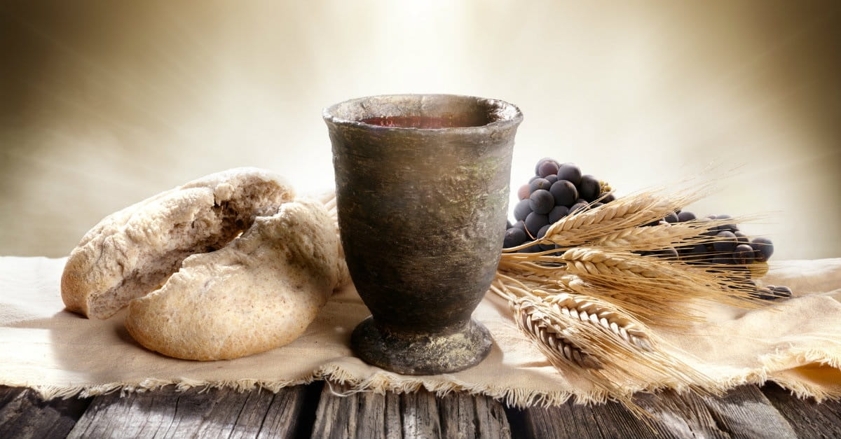
Do This In Remembrance Of Me

