Slide 2
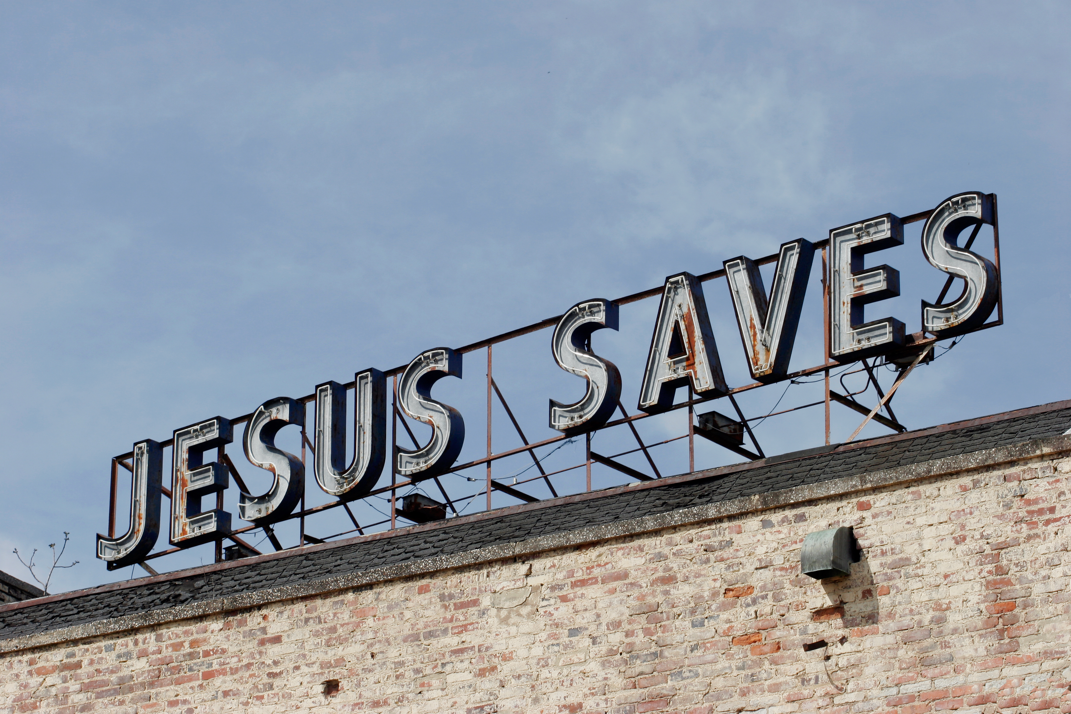
THREE ASPECTS OF SALVATION
1 Peter 1:3
Blessed be the God and Father of our Lord Jesus Christ! According to his great mercy,
he has caused us to be born again to a living hope
through the resurrection of Jesus Christ from the dead.
Three Aspects Of Salvation

Slide 3
1 Corinthians 1:18
For the word of the cross is folly to those who are perishing, but to us who are being saved it is the power of God.
Colossians 2:14
by canceling the record of debt that stood against us with its legal demands. This he set aside, nailing it to the cross.

Slide 4
Philippians 3:20-21
But our citizenship is in heaven, and from it we await a Savior, the Lord Jesus Christ,
²¹ who will transform our lowly body to be like his glorious body, by the power that enables him even to subject all things to himself.

Slide 5
Revelation 21:4
He will wipe away every tear from their eyes, and death shall be no more, neither shall there be mourning, nor crying, nor pain anymore, for the former things have passed away.”

Slide 6
1 Peter 2:24-25
He himself bore our sins in his body on the tree, that we might die to sin and live to righteousness. By his wounds you have been healed. ²⁵ For you were straying like sheep, but have now returned to the Shepherd and Overseer of your souls.

Slide 7
Galatians 2:20
I have been crucified with Christ. It is no longer I who live, but Christ who lives in me. And the life I now live in the flesh I live by faith in the Son of God, who loved me and gave himself for me.

Slide 8
Philippians 2:12
Therefore, my beloved, as you have always obeyed, so now, not only as in my presence but much more in my absence, work out your own salvation with fear and trembling,

Slide 9
2 Peter 1:3-4
His divine power has granted to us all things that pertain to life and godliness, through the knowledge of him who called us to his own glory and excellence ^{]4} by which he has granted to us his precious and very great promises, so that through them you may become partakers of the divine nature, having escaped from the corruption that is in the world because of sinful desire.
The Lord’s Table
“Bless The Lord, Oh My Soul”
The Song Of The Forgiven

Slide 10
2 Peter 1:5-7
For this very reason, make every effort to supplement your faith with virtue, and virtue with knowledge, ⁶ and knowledge with self-control, and self-control with steadfastness, and steadfastness with godliness, ⁷ and godliness with brotherly affection, and brotherly affection with love.

Slide 11
2 Peter 1:8-9
For if these qualities are yours and are increasing, they keep you from being ineffective or unfruitful in the knowledge of our Lord Jesus Christ. ⁹ For whoever lacks these qualities is so nearsighted that he is blind, having forgotten that he was
cleansed from his former sins.

Slide 12
Isaiah 1:18
“Come now, let us reason together, says the Lord: though your sins are like scarlet, they shall be as white as snow; though they are red like crimson, they shall become like wool.

Slide 13
2 Peter 1:10-11
Therefore, brothers, be all the more diligent to confirm your calling and election, for if you practice these qualities you will never fall. ¹¹ For in this way there will be richly provided for you an entrance into the eternal kingdom of our Lord and Savior Jesus Christ.

Slide 14
2 Peter 1:12-15
Therefore I intend always to remind you of these qualities, though you know them and are established in the truth that you have. ¹³ I think it right, as long as I am in this body, to stir you up by way of reminder.

Slide 15
John 15:1-11
“I am the true vine, and my Father is the vinedresser.² Every branch in me that does not bear fruit he takes away, and every branch that does bear fruit he prunes, that it may bear more fruit. ³ Already you are clean because of the word that I have spoken to you. ⁴ Abide in me, and I in you. As the branch cannot bear fruit by itself, unless it abides in the vine, neither can you, unless you abide in me. ⁵ I am the vine; you are the branches. Whoever abides in me and I in him, he it is that bears much fruit, for apart from me you can do nothing. ………………………

Slide 16
^{……6} If anyone does not abide in me he is thrown away like a branch and withers; and the branches are gathered, thrown into the fire, and burned. ⁷ If you abide in me, and my words abide in you, ask whatever you wish, and it will be done for you. ⁸ By this my Father is glorified, that you bear much fruit and so prove to be my disciples. ⁹ As the Father has loved me, so have I loved you. Abide in my love. ¹⁰ If you keep my commandments, you will abide in my love, just as I have kept my Father's commandments and abide in his love. ¹¹ These things I have spoken to you, that my joy may be in you, and that your joy may be full.

Slide 17
John 15:12-16 “This is my commandment, that you love one another as I have loved you. ¹³ Greater love has no one than this, that someone lay down his life for his friends. ¹⁴ You are my friends if you do what I command you. ¹⁵ No longer do I call you servants, for the servant does not know what his master is doing; but I have called you friends, for all that I have heard from my Father I have made known to you. ¹⁶ You did not choose me, but I chose you and appointed you that you should go and bear fruit and that your fruit should abide, so that whatever you ask the Father in my name, he may give it to you.

Slide 18
THREE ASPECTS OF SALVATION
1 Peter 1:3
Blessed be the God and Father of our Lord Jesus Christ! According to his great mercy,
he has caused us to be born again to a living hope
through the resurrection of Jesus Christ from the dead.
Three Aspects Of Salvation

