Slide 2
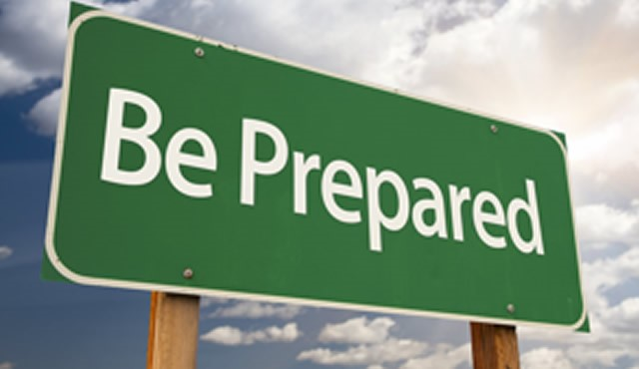
“

Slide 3
2 Corinthians 6:10
….as sorrowful, yet always rejoicing; as poor, yet making many rich; as having nothing, yet possessing everything.

Slide 4
1. Imagine what
waits for you.

Slide 5
1 Peter 1:3-4
Blessed be the God and Father of our Lord Jesus Christ! According to his great mercy, he has caused us to be born again to a living hope through the resurrection of Jesus Christ from the dead, ⁴ to an inheritance that is imperishable, undefiled, and unfading, kept in heaven for you,

Slide 6
1 Peter 1:6
In this you rejoice, though now for a little while, if necessary, you have been grieved by various trials,

Slide 7
1 Peter 5:10-11
And after you have suffered a little while, the God of all grace, who has called you to his eternal glory in Christ, will himself restore, confirm, strengthen, and establish you. ¹¹ To him be the dominion forever and ever. Amen.

Slide 8
2. Embrace the preciousness of refining.

Slide 9
1 Peter 1:6-7
In this you rejoice, though now for a little while, if necessary, you have been grieved by various trials,⁷ so that the tested genuineness of your faith—more precious than gold that perishes though it is tested by fire—may be found to result in praise and glory and honor at the revelation of Jesus Christ.

Slide 10
Matthew 7:13-14
“Enter by the narrow gate. For the gate is wide and the way is easy that leads to destruction, and those who enter by it are many. ¹⁴ For the gate is narrow and the way is hard that leads to life, and those who find it are few.”
Psalm 16:11
You make known to me the path of life; in your presence there is fullness of joy; at your right hand are pleasures forevermore.

Slide 11
3. Lean into one another all the more.

Slide 12
1 Peter 4:8
Above all, keep loving one another earnestly, since love covers a multitude of sins.

Slide 13
1 Peter 1:22
Having purified your souls by your obedience to the truth for a sincere brotherly love, love one another earnestly from a pure heart

Slide 14
1 Peter 3:8
Finally, all of you, have unity of mind, sympathy, brotherly love, a tender heart, and a humble mind.

Slide 15
.
2 Corinthians 12:9
But he said to me, “My grace is sufficient for you, for my power is made perfect in weakness. ”Therefore I will boast all the more gladly of my weaknesses, so that the power of Christ may rest upon me.

Slide 16
1 Peter 5:9
Resist him, firm in your faith, knowing that the same kinds of suffering are being experienced by your brotherhood throughout the world.

Slide 17
1 Peter 5:6-7
Humble yourselves, therefore, under the mighty hand of God so that at the proper time he may exalt you, ⁷ casting all your anxieties on him, because he cares for you.

Slide 18
1 Peter 2:21-24 For to this you have been called, because Christ also suffered for you, leaving you an example, so that you might follow in his steps. ²² He committed no sin, neither was deceit found in his mouth. ²³ When he was reviled, he did not revile in return; when he suffered, he did not threaten, but continued entrusting himself to him who judges justly. ²⁴ He himself bore our sins in his body on the tree, that we might die to sin and live to righteousness. By his wounds you have been healed.

Slide 19
Sacrificial Love Remembered

Slide 20
1 Corinthians 11:23-26 For I received from the Lord what I also delivered to you, that the Lord Jesus on the night when he was betrayed took bread, ²⁴ and when he had given thanks, he broke it, and said, “This is my body, which is for you. Do this in remembrance of me.” ²⁵ In the same way also he took the cup, after supper, saying, “This cup is the new covenant in my blood. Do this, as often as you drink it, in remembrance of me.” ²⁶ For as often as you eat this bread and drink the cup, you proclaim the Lord's death until he comes.

Slide 21
Imagine what waits for you
Embrace the preciousness of refining
Lean into one another all the more

Slide 22
John 16:33
“I have told you these things, so that in me you may have peace. In this world you will have trouble. But take heart! I have overcome the world.”

