Slide 2
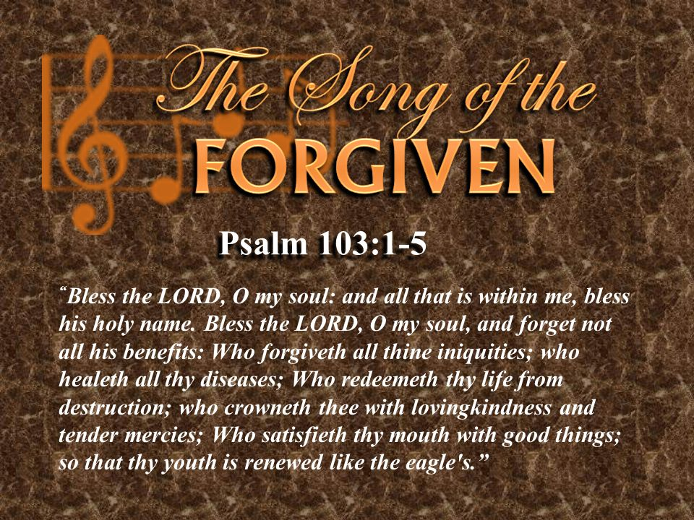
Bless The Lord, Oh My Soul
1 Peter 1:3
Blessed be the God and Father of our Lord Jesus Christ! According to his great mercy,
he has caused us to be born again to a living hope
through the resurrection of Jesus Christ from the dead.

Slide 3
Psalm 103
Bless the Lord, O my soul, and all that is within me, bless his holy name!² Bless the Lord, O my soul, and forget not all his benefits, ³ who forgives all your iniquity, who heals all your diseases, ⁴ who redeems your life from the pit, who crowns you with steadfast love and mercy, ⁵ who satisfies you with good so that your youth is renewed like the eagle’s ⁶ The Lord works righteousness and justice for all who are oppressed. ⁷ He made known his ways to Moses, his acts to the people of Israel. ⁸ The Lord is merciful and gracious, slow to anger and abounding in steadfast love. ⁹ He will not always chide, nor will he keep his anger forever. ¹⁰ He does not deal with us according to our sins, nor repay us according to our iniquities. ¹¹ For as high as the heavens are above the earth, so great is his steadfast love toward those who fear him;¹² as far as the east is from the west, so far does he remove our transgressions from us.¹³ As a father shows compassion to his children, so the Lord shows compassion to those who fear him…………..

Slide 4
^{…………..14} For he knows our frame; he remembers that we are dust.¹⁵ As for man, his days are like grass; he flourishes like a flower of the field; ¹⁶ for the wind passes over it, and it is gone, and its place knows it no more. ¹⁷ But the steadfast love of the Lord is from everlasting to everlasting on those who fear him, and his righteousness to children's children,¹⁸ to those who keep his covenant and remember to do his commandments ¹⁹ The Lord has established his throne in the heavens, and his kingdom rules over all.²⁰ Bless the Lord, O you his angels, you mighty ones who do his word, obeying the voice of his word! ²¹ Bless the Lord, all his hosts, his ministers, who do his will! ²² Bless the Lord, all his works, in all places of his dominion. Bless the Lord, O my soul!

Slide 5
Psalm 103:1-5
Bless the Lord, O my soul, and all that is within me, bless his holy name!² Bless the Lord, O my soul, and forget not all his benefits ³ who forgives all your iniquity, who heals all your diseases, ⁴ who redeems your life from the pit, who crowns you with steadfast love and mercy, ⁵ who satisfies you with good so that your youth is renewed like the eagle's.

Slide 6
Psalm 103: 6-10
The Lord works righteousness and justice for all who are oppressed. ⁷ He made known his ways to Moses, his acts to the people of Israel. ⁸ The Lord is merciful and gracious, slow to anger and abounding in steadfast love. ⁹ He will not always chide, nor will he keep his anger forever. ¹⁰ He does not deal with us according to our sins, nor repay us according to our iniquities.

Slide 7
Psalm 103: 11-13
For as high as the heavens are above the earth, so great is his steadfast love toward those who fear him;¹² as far as the east is from the west, so far does he remove our transgressions from us.¹³ As a father shows compassion to his children, so the Lord shows compassion to those who fear him.

Slide 8
Psalm 103:14-19
For he knows our frame; he remembers that we are dust.¹⁵ As for man, his days are like grass; he flourishes like a flower of the field; ¹⁶ for the wind passes over it, and it is gone, and its place knows it no more. ¹⁷ But the steadfast love of the Lord is from everlasting to everlasting on those who fear him, and his righteousness to children's children,¹⁸ to those who keep his covenant and remember to do his commandments. ¹⁹ The Lord has established his throne in the heavens, and his kingdom rules over all.

Slide 9
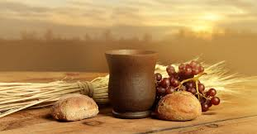
The Lord’s Table
“Bless The Lord, Oh My Soul”
The Song Of The Forgiven

Slide 10
Psalm 103:20-22
Bless the Lord, O you his angels, you
mighty ones who do his word, obeying the voice of his word! ²¹ Bless the Lord, all his hosts, his ministers, who do his will! ²² Bless the Lord, all his works, in all places of his dominion. Bless the Lord, O my soul!

