Slide 2
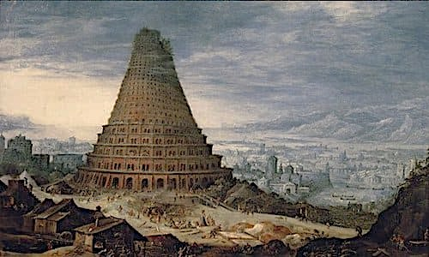
The Last Days Return To Babel
1 Peter 1:3
Blessed be the God and Father of our Lord Jesus Christ! According to his great mercy,
he has caused us to be born again to a living hope
through the resurrection of Jesus Christ from the dead.

Slide 3
Genesis 1:28
And God blessed them. And God said to them, “Be fruitful and multiply and fill the earth and subdue it, and have dominion over the fish of the sea and over the birds of the heavens and over every living thing that moves on the earth.”

Slide 4
Genesis 9:1
And God blessed Noah and his sons and said to them, “Be fruitful and multiply and fill the earth.

Slide 5
Genesis 11: 1-9 Now the whole earth had one language and the same words. ² And as people migrated from the east, they found a plain in the land of Shinar and settled there. ³ And they said to one another, “Come, let us make bricks, and burn them thoroughly.” And they had brick for stone, and bitumen for mortar. ⁴ Then they said, “Come, let us build ourselves a city and a tower with its top in the heavens, and let us make a name for ourselves, lest we be dispersed over the face of the whole earth.” ⁵ And the Lord came down to see the city and the tower, which the children of man had built……...

Slide 6
^{………..6} And the Lord said, “Behold, they are one people, and they have all one language, and this is only the beginning of what they will do. And nothing that they propose to do will now be impossible for them. ⁷ Come,
let us go down there and confuse their language, so that they may not understand one another’s speech” ⁸ So the Lord dispersed them from there over the face of all the earth, and they left off building the city. ⁹ Therefore its name was called Babel, because there the Lord confused
the language of all the earth. And from there the Lord dispersed them over the face of all the earth.
Jesus spoke to them, saying:

Slide 7
Genesis 11:6
And the Lord said, “Behold, they are one people, and they have all one language, and this is only the beginning of what they will do. And nothing that they propose to do will now be impossible for them.

Slide 8
Revelation 13:7-9
Also it was allowed to make war on the saints and to conquer them. And authority was given it over every tribe and people and language and nation, ⁸ and all who dwell on earth will worship it, everyone whose name has not been written before the foundation of the world in the book of life of the Lamb who was slain. ⁹ If anyone has an ear, let him hear.

Slide 9
Revelation 16:14 For they are demonic spirits, performing signs, who go abroad to the kings of the whole world, to assemble them for battle on the great day of God the Almighty.
Revelation 19:19 And I saw the beast and the kings of the earth with their armies gathered to make war against him who was sitting on the horse and against his army.

Slide 10
Genesis 11:4
Then they said, “Come, let us build ourselves a city and a tower with its top in the heavens, and let us make a name for ourselves, lest we be dispersed over the face of the whole earth.”
Psalm 16:11
You make known to me the path of life; in your presence there is fullness of joy; at your right hand are pleasures forevermore.

Slide 11
2 Timothy 3:1-4
But understand this, that in the last days there will come times of difficulty. ² For people will be lovers of self, lovers of money, proud, arrogant, abusive, disobedient to their parents, ungrateful, unholy, ³ heartless, unappeasable, slanderous, without self-control, brutal, not loving good, ⁴ treacherous, reckless, swollen with conceit, lovers of pleasure rather than lovers of God

Slide 12
Revelation 16:9 They were scorched by the fierce heat, and they cursed the name of God who had power over these plagues. They did not repent and give him glory.
Revelation 16:11 and cursed the God of heaven for their pain and sores. They did not repent of their deeds.

Slide 13
Revelation 16:21
And great hailstones, about one hundred pounds each, fell from heaven on people; and they cursed God for the plague of the hail, because the plague was so severe.

Slide 14
Genesis 11:4
Then they said, “Come, let us build ourselves a city and a tower with its top in the heavens, and let us make a name for ourselves, lest we be dispersed over the face of the whole earth.”

Slide 15
James 4:6
But he gives more grace. Therefore it says, “God opposes the proud but gives grace to the humble.”

Slide 16
Mark 16:14-15
Afterward he appeared to the eleven themselves as they were reclining at table, and he rebuked them for their unbelief and hardness of heart, because they had not believed those who saw him after he had risen.
¹⁵ And he said to them, “Go into all the world and proclaim the gospel to the whole creation”.

Slide 17
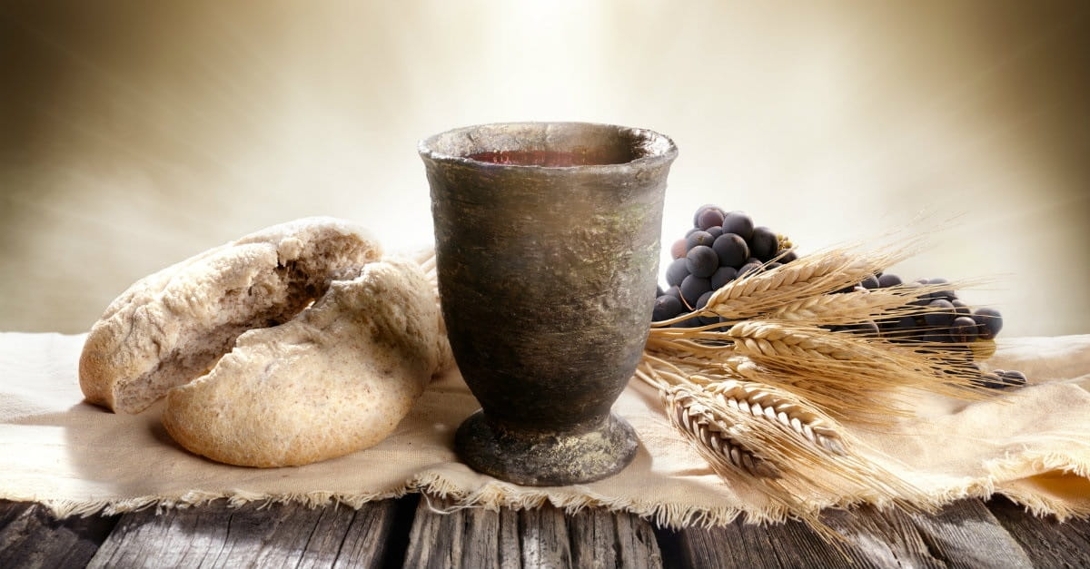
Communion

Slide 18
John 20:19-23 On the evening of that day, the first day of the week, the doors being locked where the disciples were for fear of the Jews, Jesus came and stood among them and said to them, “Peace be with you.” ²⁰ When he had said this, he showed them his hands and his side. Then the disciples were glad when they saw the Lord…………

Slide 19
^{……21} Jesus said to them again, “Peace be with you. As the Father has sent me, even so I am sending you.” ²² And when he had said this, he breathed on them and said to them, “Receive the Holy Spirit. ²³ If you forgive the sins of any, they are forgiven them; if you withhold forgiveness from any, it is withheld.

Slide 20
Communion

Slide 21
Psalm 44:11
In God we make our boast all day long, and we will praise your name forever.

