Slide 2
Salvation
1 Peter 1:3
Blessed be the God and Father of our Lord Jesus Christ! According to his great mercy,
he has caused us to be born again to a living hope
through the resurrection of Jesus Christ from the dead.

Slide 3
John 3:16
For God so loved the world, that he gave his only Son, that whoever believes in him should not perish but have eternal life.

Slide 4
Romans 10:9
because, if you confess with your mouth that Jesus is Lord and believe in your heart that God raised him from the dead, you will be saved.

Slide 5
Romans 5:15
But the free gift is not like the trespass. For if many died through one man's trespass, much more have the grace of God and the free gift by the grace of that one man Jesus Christ abounded for many.

Slide 6
Romans 6:23
For the wages of sin is death, but the free gift of God is eternal life in Christ Jesus our Lord.
Jesus spoke to them, saying:

Slide 7
Ephesians 2:1-5 And you were dead in the trespasses and sins ² in which you once walked, following the course of this world, following the prince of the power of the air, the spirit that is now at work in the sons of disobedience ³ among whom we all once lived in the passions of our flesh, carrying out the desires of the body and the mind, and were by nature children of wrath, like the rest of mankind. ⁴ But God, being rich in mercy, because of the great love with which he loved us, ⁵ even when we were dead in our trespasses, made us alive together with Christ—by grace you have been saved

Slide 8
Colossians 2:13
And you, who were dead in your trespasses and the uncircumcision of your flesh, God made alive together with him, having forgiven us all our trespasses,

Slide 9
John 4:10
Jesus answered her, “If you knew the gift of God, and who it is that is saying to you, ‘Give me a drink,’ you would have asked him, and he would have given you living water.”

Slide 10
Matthew 25:14-28 “For it will be like a man going on a journey, who called his servants and entrusted to them his property. ¹⁵ To one he gave five talents, to another two, to another one, to each according to his ability. Then he went away. ¹⁶ He who had received the five talents went at once and traded with them, and he made five talents more.¹⁷ So also he who had the two talents made two talents more. ¹⁸ But he who had received the one talent went and dug in the ground and hid his master's money. ¹⁹ Now after a long time the master of those servants came and settled accounts with them…….
Psalm 16:11
You make known to me the path of life; in your presence there is fullness of joy; at your right hand are pleasures forevermore.

Slide 11
^{……......20} And he who had received the five talents came forward, bringing five talents more, saying, ‘Master, you delivered to me five talents; here, I have made five talents more.’ ²¹ His master said to him, ‘Well done, good and faithful servant. You have been faithful over a little; I will set you over much. Enter into the joy of your master.’ ²² And he also who had the two talents came forward, saying, ‘Master, you delivered to me two talents; here, I have made two talents more.’ ²³ His master said to him, ‘Well done, good and faithful servant. You have been faithful over a little; I will set you over much. Enter into the joy of your master.’ ……….

Slide 12
^{…………24} He also who had received the one talent came forward, saying, ‘Master, I knew you to be a hard man, reaping where you did not sow, and gathering where you scattered no seed, ²⁵ so I was afraid, and I went and hid your talent in the ground. Here, you have what is yours.’ ²⁶ But his master answered him, ‘You wicked and slothful servant! You knew that I reap where I have not sown and gather where I scattered no seed? ²⁷ Then you ought to have invested my money with the bankers, and at my coming I should have received what was my own with interest.²⁸ So take the talent from him and give it to him who has the ten talents.

Slide 13
John 10:10
The thief comes only to steal and kill and destroy. I came that they may have life and have it abundantly.

Slide 14
2 Corinthians 5:17
Therefore, if anyone is in Christ, he is a new creation. The old has passed away; behold, the new has come

Slide 15
Ephesians 2:8-9
For by grace you have been saved through faith. And this is not your own doing; it is the gift of God, ⁹ not a result of works, so that no one may boast.
Philippians 2:12-13
Therefore, my beloved, as you have always obeyed, so now, not only as in my presence but much more in my absence, work out your own salvation with fear and trembling, ¹³ for it is God who works in you, both to will and to work for his good pleasure.

Slide 16
1 Corinthians 6:19-20
Or do you not know that your body is a temple of the Holy Spirit within you, whom you have from God? You are not your own, ²⁰ for you were bought with a price. So glorify God in your body.

Slide 17
1 Peter 1:17-19
And if you call on him as Father who judges impartially according to each one's deeds, conduct yourselves with fear throughout the time of your exile, ¹⁸ knowing that you were ransomed from the futile ways inherited from your forefathers, not with perishable things such as silver or gold, ¹⁹ but with the precious blood of Christ, like that of a lamb without blemish or spot.

Slide 18
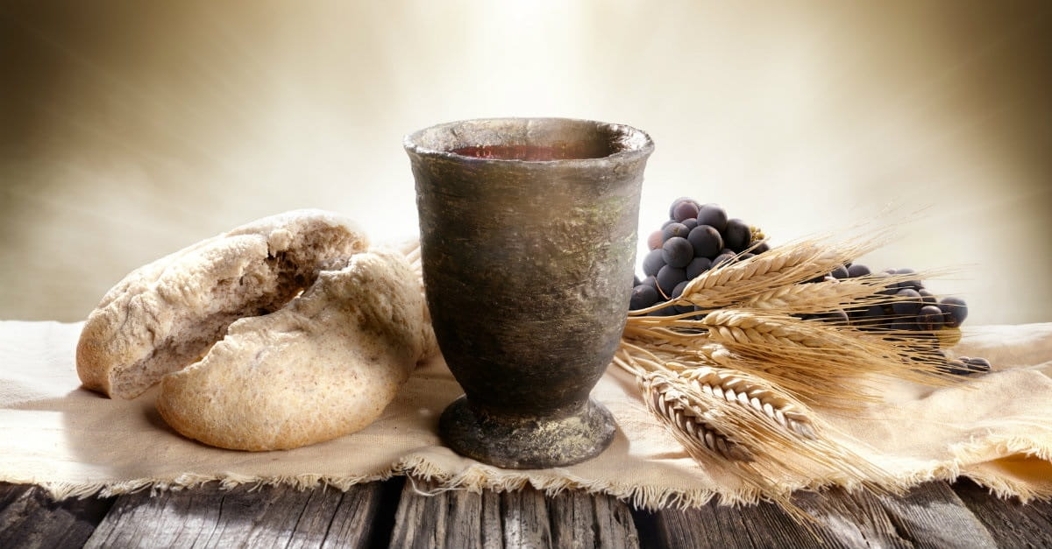
Communion

Slide 19
Luke 9:62
Jesus said to him, “No one who puts his hand to the plow and looks back is fit for the kingdom of God.”

Slide 20
James 2:18
But someone will say, “You have faith and I have works.” Show me your faith apart from your works, and I will show you my faith by my works.

Slide 21
That’s why on one hand Jesus says,
John 6:44 No one can come to me unless the Father who sent me draws him. And I will raise him up on the last day.
And on the other hand he says,
John 14:15 “If you love me, you will keep my commandments.
He ties both together when he says,
John 10:27 My sheep hear my voice, and I know them, and they follow me.

Slide 22
Matthew 13:24-26
He put another parable before them, saying, “The kingdom of heaven may be compared to a man who sowed good seed in his field, ²⁵ but while his men were sleeping, his enemy came and sowed weeds among the wheat and went away. ²⁶ So when the plants came up and bore grain, then the weeds appeared also.

Slide 23
Matthew 25:34-36
Then the King will say to those on his right, ‘Come, you who are blessed by my Father, inherit the kingdom prepared for you from the foundation of the world. ³⁵ For I was hungry and you gave me food, I was thirsty and you gave me drink, I was a stranger and you welcomed me,³⁶ I was naked and you clothed me, I was sick and you visited me, I was in prison and you came to me.’

Slide 24
Galatians 5:6
For in Christ Jesus neither circumcision nor uncircumcision counts for anything, but only faith working through love.

Slide 25
Matthew 7:21
“Not everyone who says to me, ‘Lord, Lord,’ will enter the kingdom of heaven, but the one who does the will of my Father who is in heaven.”

Slide 26
2 Peter 1:10
Therefore, brothers, be all the more diligent to confirm your calling and election, for if you practice these qualities you will never fall.

Slide 27
Salvation

