Slide 2
1 Peter 1:3
Blessed be the God and Father of our Lord Jesus Christ! According to his great mercy,
he has caused us to be born again to a living hope
through the resurrection of Jesus Christ from the dead.
MATTHEW 24 & 25

Slide 3
Matthew 24:3-6
As he sat on the Mount of Olives, the disciples came to him privately, saying, “Tell us, when will these things be, and what will be the sign of your coming and of the end of the age?” ⁴ And Jesus answered them, “See that no one leads you astray. ⁵ For many will come in my name, saying, ‘I am the Christ,’ and they will lead many astray. ⁶ And you will hear of wars and rumors of wars. See that you are not alarmed, for this must take place, but the end is not yet.

Slide 4
Matthew 24:7-12
For nation will rise against nation, and kingdom against kingdom, and there will be famines and earthquakes in various places. ⁸ All these are but the beginning of the birth pains.⁹ “Then they will deliver you up to tribulation and put you to death, and you will be hated by all nations for my name's sake. ¹⁰ And then many will fall away and betray one another and hate one another. ¹¹ And many false prophets will arise and lead many astray. ¹² And because lawlessness will be increased, the love of many will grow cold.

Slide 5
Matthew 24:13-14
But the one who endures to the end will be saved. ¹⁴ And this gospel of the kingdom will be proclaimed throughout the whole world as a testimony to all nations, and then the end will come.

Slide 6
Matthew 24:21
For then there will be great tribulation, such as has not been from the beginning of the world until now, no, and never will be.
Jesus spoke to them, saying:

Slide 7
Matthew 24:32-34
“From the fig tree learn its lesson: as soon as its branch becomes tender and puts out its leaves, you know that summer is near. ³³ So also, when you see all these things, you know that he is near, at the very gates. ³⁴ Truly, I say to you, this generation will not pass away until all these things take place.

Slide 8
Matthew 24:36-39
“But concerning that day and hour no one knows, not even the angels of heaven, nor the Son, but the Father only. ³⁷ For as were the days of Noah, so will be the coming of the Son of Man.³⁸ For as in those days before the flood they were eating and drinking, marrying and giving in marriage, until the day when Noah entered the ark,³⁹ and they were unaware until the flood came and swept them all away, so will be the coming of the Son of Man.

Slide 9
Matthew 24:42-44
Therefore, stay awake, for you do not know on what day your Lord is coming. ⁴³ But know this, that if the master of the house had known in what part of the night the thief was coming, he would have stayed awake and would not have let his house be broken into.⁴⁴ Therefore you also must be ready, for the Son of Man is coming at an hour you do not expect.⁴⁴ Therefore you also must be ready, for the Son of Man is coming at an hour you do not expect.

Slide 10
Matthew 24:45-51
“Who then is the faithful and wise servant, whom his master has set over his household, to give them their food at the proper time? ⁴⁶ Blessed is that servant whom his master will find so doing when he comes.⁴⁷ Truly, I say to you, he will set him over all his possessions. ⁴⁸ But if that wicked servant says to himself, ‘My master is delayed,’ ⁴⁹ and begins to beat his fellow servants and eats and drinks with drunkards, ⁵⁰ the master of that servant will come on a day when he does not expect him and at an hour he does not know ⁵¹ and will cut him in pieces and put him with the hypocrites. In that place there will be weeping and gnashing of teeth.
Psalm 16:11
You make known to me the path of life; in your presence there is fullness of joy; at your right hand are pleasures forevermore.

Slide 11
Matthew 25:1-13 “Then the kingdom of heaven will be like ten virgins who took their lamps and went to meet the bridegroom. ² Five of them were foolish, and five were wise. ³ For when the foolish took their lamps, they took no oil with them, ⁴ but the wise took flasks of oil with their lamps. ⁵ As the bridegroom was delayed, they all became drowsy and slept. ⁶ But at midnight there was a cry, ‘Here is the bridegroom! Come out to meet him.’ ⁷ Then all those virgins rose and trimmed their lamps. ⁸ And the foolish said to the wise, ‘Give us some of your oil, for our lamps are going out.’ ⁹ But the wise answered, saying, ‘Since there will not be enough for us and for you, go rather to the dealers and buy for yourselves.’ ¹⁰ And while they were going to buy, the bridegroom came, and those who were ready went in with him to the marriage feast, and the door was shut. ¹¹ Afterward the other virgins came also, saying, ‘Lord, lord, open to us.’ ¹² But he answered, ‘Truly, I say to you, I do not know you.’ ¹³ Watch therefore, for you know neither the day nor the hour.

Slide 12
Matthew 25:14-15
“For it will be like a man going on a journey, who called his servants and entrusted to them his property. ¹⁵ To one he gave five talents, to another two, to another one, to each according to his ability. Then he went away”…

Slide 13
Matthew 25:23-25, 30
His master said to him, ‘Well done, good and faithful servant. You have been faithful over a little; I will set you over much. Enter into the joy of your master.’ ²⁴ He also who had received the one talent came forward, saying, ‘Master, I knew you to be a hard man, reaping where you did not sow, and gathering where you scattered no seed, ²⁵ so I was afraid, and I went and hid your talent in the ground. Here, you have what is yours.’ …… ³⁰ And cast the worthless servant into the outer darkness. In that place there will be weeping and gnashing of teeth.’……..

Slide 14
Matthew 25:31- 36, 45 “When the Son of Man comes in his glory, and all the angels with him, then he will sit on his glorious throne.³² Before him will be gathered all the nations, and he will separate people one from another as a shepherd separates the sheep from the goats. ³³ And he will place the sheep on his right, but the goats on the left. ³⁴ Then the King will say to those on his right, ‘Come, you who are blessed by my Father, inherit the kingdom prepared for you from the foundation of the world. ³⁵ For I was hungry and you gave me food, I was thirsty and you gave me drink, I was a stranger and you welcomed me, ³⁶ I was naked and you clothed me, I was sick and you visited me, I was in prison and you came to me.’…….. ⁴⁵ Then he will answer them, saying, ‘Truly, I say to you, as you did not do it to one of the least of these, you did not do it to me.’

Slide 15
Mark 14:32-42
And they went to a place called Gethsemane. And he said to his disciples, “Sit here while I pray.” ³³ And he took with him Peter and James and John, and began to be greatly distressed and troubled. ³⁴ And he said to them, “My soul is very sorrowful, even to death. Remain here and watch.”…..

Slide 16
^{…….35} And going a little farther, he fell on the ground and prayed that, if it were possible, the hour might pass from him. ³⁶ And he said, “Abba, Father, all things are possible for you. Remove this cup from me. Yet not what I will, but what you will.” ³⁷ And he came and found them sleeping, and he said to Peter, “Simon, are you asleep? Could you not watch one hour? ³⁸ Watch and pray that you may not enter into temptation. The spirit indeed is willing, but the flesh is weak.” ………..

Slide 17
^{……….39} And again he went away and prayed, saying the same words. ⁴⁰ And again he came and found them sleeping, for their eyes were very heavy, and they did not know what to answer him. ⁴¹ And he came the third time and said to them, “Are you still sleeping and taking your rest? It is enough; the hour has come. The Son of Man is betrayed into the hands of sinners. ⁴² Rise, let us be going; see, my betrayer is at hand.”

Slide 18
Luke 22:33
Peter said to him,
“Lord, I am ready to go with you both to prison and to death.”

Slide 19
Matthew 26:41
Watch and pray that you may not enter into temptation.
The spirit indeed is willing,
but the flesh is weak

Slide 20
Luke 18:8
Nevertheless, when the Son of Man comes, will he find faith on earth?”

Slide 21
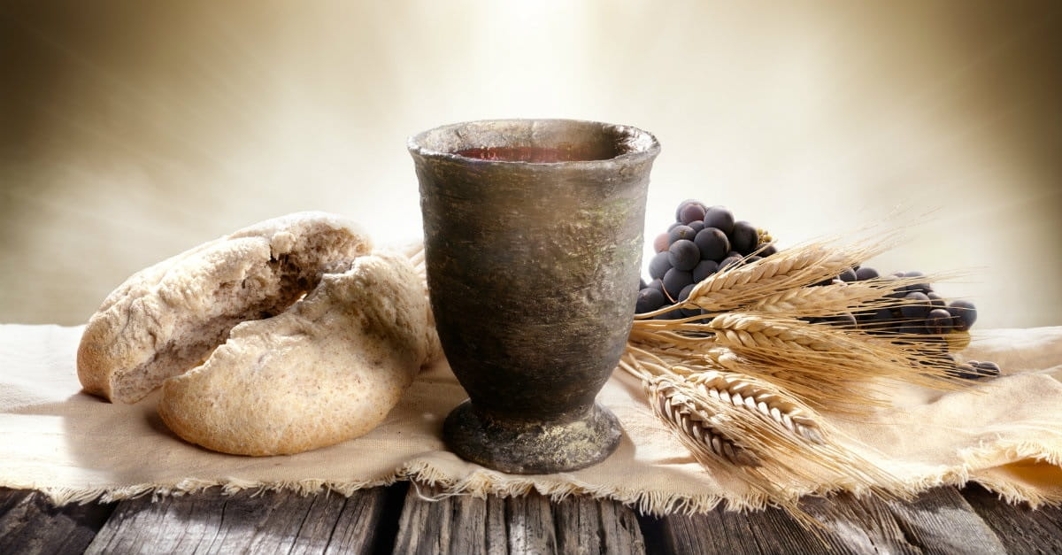
Communion

