Slide 2
1 Peter 1:3
Blessed be the God and Father of our Lord Jesus Christ! According to his great mercy,
he has caused us to be born again to a living hope
through the resurrection of Jesus Christ from the dead.

Slide 3
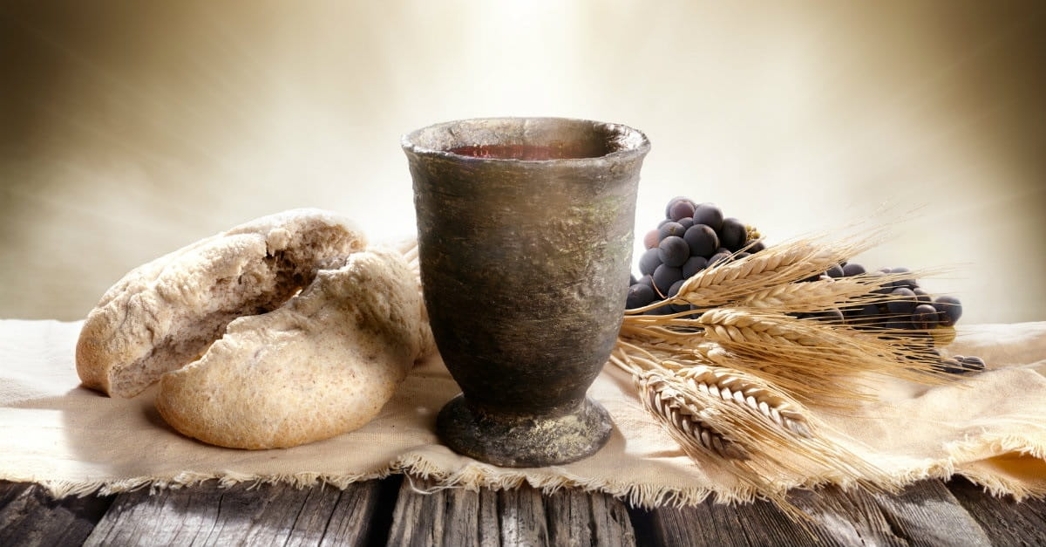
Communion

Slide 5
Matthew 2:1-12
Now after Jesus was born in Bethlehem of Judea in the days of Herod the king, behold, wise men from the east came to Jerusalem,² saying, “Where is he who has been born king of the Jews? For we saw his star when it rose and have come to worship him.” ³ When Herod the king heard this, he was troubled, and all Jerusalem with him;⁴ and assembling all the chief priests and scribes of the people, he inquired of them where the Christ was to be born. ……….

Slide 6
^{………5} They told him, “In Bethlehem of Judea, for so it is written by the prophet: ⁶ “‘And you, O Bethlehem, in the land of Judah, are by no means least among the rulers of Judah; for from you shall come a ruler who will shepherd my people Israel.’” ⁷ Then Herod summoned the wise men secretly and ascertained from them what time the star had appeared. ⁸ And he sent them to Bethlehem, saying, “Go and search diligently for the child, and when you have found him, bring me word, that I too may come and worship him.” ……….

Slide 7
^{………….9} After listening to the king, they went on their way. And behold, the star that they had seen when it rose went before them until it came to rest over the place where the child was. ¹⁰ When they saw the star, they rejoiced exceedingly with great joy. ¹¹ And going into the house, they saw the child with Mary his mother, and they fell down and worshiped him. Then, opening their treasures, they offered him gifts, gold and frankincense and myrrh. ¹² And being warned in a dream not to return to Herod, they departed to their own country by another way.
Jesus spoke to them, saying:

Slide 8
Matthew 2:1 Now after Jesus was born in Bethlehem of Judea in the days of Herod the king, behold, wise men from the east came to Jerusalem .

Slide 9
Matthew 2:2
saying, “Where is he who has been born king of the Jews? For we saw his star when it rose and have come to worship him.”

Slide 10
Matthew 2:3-6
When Herod the king heard this, he was troubled, and all Jerusalem with him;⁴ and assembling all the chief priests and scribes of the people, he inquired of them where the Christ was to be born. ⁵ They told him, “In Bethlehem of Judea, for so it is written by the prophet: ⁶ “‘And you, O Bethlehem, in the land of Judah, are by no means least among the rulers of Judah; for from you shall come a ruler who will shepherd my people Israel.’”

Slide 11
Matthew 2:7-8
Then Herod summoned the wise men secretly and ascertained from them what time the star had appeared. ⁸ And he sent them to Bethlehem, saying, “Go and search diligently for the child, and when you have found him, bring me word, that I too may come and worship him.”

Slide 12
Matthew 2:9-10
After listening to the king, they went on their way. And behold, the star that they had seen when it rose went before them until it came to rest over the place where the child was. ¹⁰ When they saw the star, they rejoiced exceedingly with great joy.

Slide 13
Matthew 2:11
And going into the house, they saw the child with Mary his mother, and they fell down and worshiped him. Then, opening their treasures, they offered him gifts, gold and frankincense and myrrh.

Slide 14
Matthew 2:12
And being warned in a dream not to return to Herod, they departed to their own country by another way.

