Slide 2
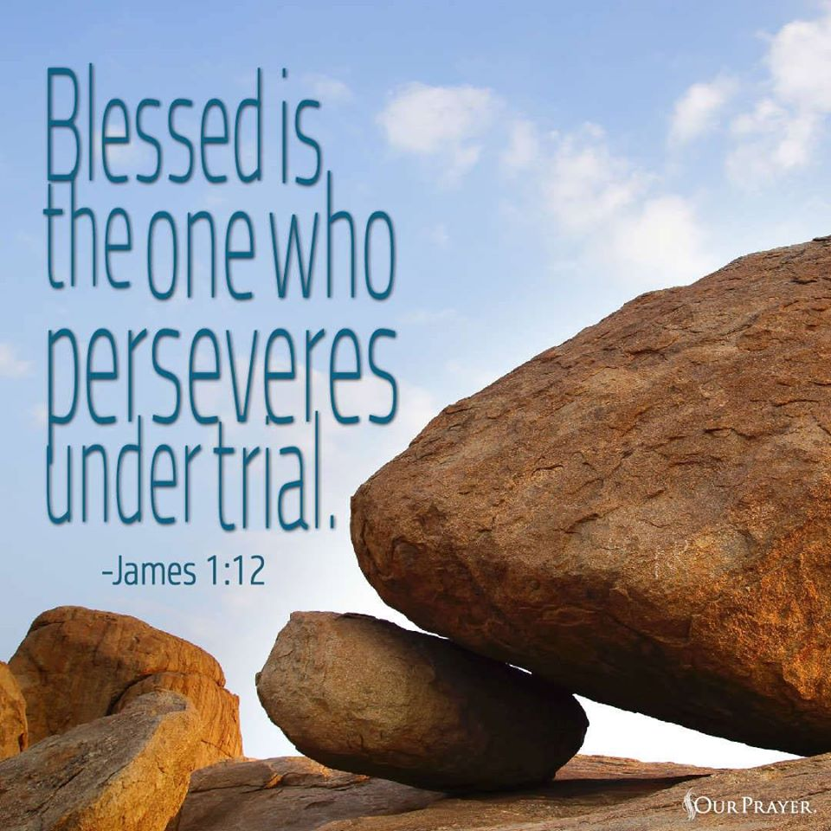
1 Peter 1:3
Blessed be the God and Father of our Lord Jesus Christ! According to his great mercy,
he has caused us to be born again to a living hope
through the resurrection of Jesus Christ from the dead.

Slide 3
1 Peter 4:1-2
Since therefore Christ suffered in the flesh, arm yourselves with the same way of thinking, for whoever has suffered in the flesh has ceased from sin, ² so as to live for the rest of the time in the flesh no longer for human passions but for the will of God.

Slide 4
1 Peter 4:12-14
Beloved, do not be surprised at the fiery trial when it comes upon you to test you, as though something strange were happening to you.¹³ But rejoice insofar as you share Christ's sufferings, that you may also rejoice and be glad when his glory is revealed. ¹⁴ If you are insulted for the name of Christ, you are blessed, because the Spirit of glory and of God rests upon you.

Slide 5
Matthew 5:11-12
“Blessed are you when others revile you and persecute you and utter all kinds of evil against you falsely on my account. ¹² Rejoice and be glad, for your reward is great in heaven, for so they persecuted the prophets who were before you”

Slide 6
1 Peter 4:15-19
But let none of you suffer as a murderer or a thief or an evildoer or as a meddler. ¹⁶ Yet if anyone suffers as a Christian, let him not be ashamed, but let him glorify God in that name. ¹⁷ For it is time for judgment to begin at the household of God; and if it begins with us, what will be the outcome for those who do not obey the gospel of God? ¹⁸ And “If the righteous is scarcely saved, what will become of the ungodly and the sinner?” ¹⁹ Therefore let those who suffer according to God's will entrust their souls to a faithful Creator while doing good.
Jesus spoke to them, saying:

Slide 7
Hebrews 5:7-9
In the days of his flesh, Jesus offered up prayers and supplications, with loud cries and tears, to him who was able to save him from death, and he was heard because of his reverence. ⁸ Although he was a son, he learned obedience through what he suffered. ⁹ And being made perfect, he became the source of eternal salvation to all who obey him.

Slide 8
Mark 8:31-33
And he began to teach them that the Son of Man must suffer many things and be rejected by the elders and the chief priests and the scribes and be killed, and after three days rise again. ³² And he said this plainly. And Peter took him aside and began to rebuke him. ³³ But turning and seeing his disciples, he rebuked Peter and said, “Get behind me, Satan! For you are not setting your mind on the things of God, but on the things of man.”

Slide 9
Matthew 10:21-22 Brother will deliver brother over to death, and the father his child, and children will rise against parents and have them put to death, ²² and you will be hated by all for my name's sake. But the one who endures to the end will be saved.

Slide 10
Matthew 24:9-14
“Then they will deliver you up to tribulation and put you to death, and you will be hated by all nations for my name's sake. ¹⁰ And then many will fall away and betray one another and hate one another. ¹¹ And many false prophets will arise and lead many astray. ¹² And because lawlessness will be increased, the love of many will grow cold. ¹³ But the one who endures to the end will be saved. ¹⁴ And this gospel of the kingdom will be proclaimed throughout the whole world as a testimony to all nations, and then the end will come.
Psalm 16:11
You make known to me the path of life; in your presence there is fullness of joy; at your right hand are pleasures forevermore.

Slide 11
Luke 21:16-17
You will be delivered up even by parents and brothers and relatives and friends, and some of you they will put to death. ¹⁷ You will be hated by all for my name's sake.

Slide 12
Matthew 13:20-21
“As for what was sown on rocky ground, this is the one who hears the word and immediately receives it with joy, ²¹ yet he has no root in himself, but endures for a while, and when tribulation or persecution arises on account of the word, immediately he falls away.

Slide 13
John 16:1-3
“I have said all these things to you to keep you from falling away. ² They will put you out of the synagogues. Indeed, the hour is coming when whoever kills you will think he is offering service to God. ³ And they will do these things because they have not known the Father, nor me”

Slide 14
John 15:18-27
“If the world hates you, know that it has hated me before it hated you. ¹⁹ If you were of the world, the world would love you as its own; but because you are not of the world, but I chose you out of the world, therefore the world hates you. ²⁰ Remember the word that I said to you: ‘A servant is not greater than his master.’ If they persecuted me, they will also persecute you. If they kept my word, they will also keep yours. ²¹ But all these things they will do to you on account of my name, because they do not know him who sent me. ²² If I had not come and spoken to them, they would not have been guilty of sin, but now they have no excuse for their sin.

Slide 15
²³ Whoever hates me hates my Father also. ²⁴ If I had not done among them the works that no one else did, they would not be guilty of sin, but now they have seen and hated both me and my Father. ²⁵ But the word that is written in their Law must be fulfilled: ‘They hated me without a cause.’²⁶ “But when the Helper comes, whom I will send to you from the Father, the Spirit of truth, who proceeds from the Father, he will bear witness about me. ²⁷ And you also will bear witness, because you have been with me from the beginning.

Slide 16
2 Corinthians 4:14-17
knowing that he who raised the Lord Jesus will raise us also with Jesus and bring us with you into his presence. ¹⁵ For it is all for your sake, so that as grace extends to more and more people it may increase thanksgiving, to the glory of God.¹⁶ So we do not lose heart. Though our outer self is wasting away, our inner self is being renewed day by day. ¹⁷ For this light momentary affliction is preparing for us an eternal weight of glory beyond all comparison.

Slide 17
1 Corinthians 15:19
If in Christ we have hope in this life only, we are of all people most to be pitied.

Slide 18
Romans 5:3-5
Not only that, but we rejoice in our sufferings, knowing that suffering produces endurance,
⁴ and endurance produces character, and character produces hope, ⁵ and hope does not put us to shame, because God's love has been poured into our hearts through the Holy Spirit who has been given to us.

Slide 19
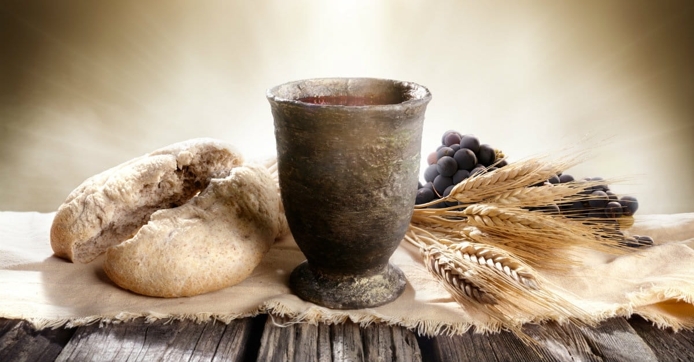
Communion

Slide 20
2 Corinthians 4:7-10
For God, who said, “Let light shine out of darkness,” has shone in our hearts to give the light of the knowledge of the glory of God in the face of Jesus Christ. ⁷But we have this treasure in jars of clay, to show that the surpassing power belongs to God and not to us. ⁸ We are afflicted in every way, but not crushed; perplexed, but not driven to despair;⁹ persecuted, but not forsaken; struck down, but not destroyed; ¹⁰ always carrying in the body the death of Jesus, so that the life of Jesus may also be manifested in our bodies.

Slide 21
https://youtu.be/3QCkBL2DfVg

Slide 22
Romans 15:13
May the God of hope fill you with all joy and peace in believing, so that by the power of the Holy Spirit you may abound in hope.

Slide 23
1 Peter 1:3
Blessed be the God and Father of our Lord Jesus Christ! According to his great mercy,
he has caused us to be born again to a living hope
through the resurrection of Jesus Christ from the dead.

