Slide 2
1 Peter 1:3
Blessed be the God and Father of our Lord Jesus Christ! According to his great mercy,
he has caused us to be born again to a living hope
through the resurrection of Jesus Christ from the dead.

Slide 3
Galatians 5:16-18 So I say, walk by the Spirit, and you will not gratify the desires of the flesh. ¹⁷ For the flesh desires what is contrary to the Spirit, and the Spirit what is contrary to the flesh. They are in conflict with each other, so that you are not to do whatever you want. ¹⁸ But if you are led by the Spirit, you are not under the law.

Slide 4
Galatians 5:19-21 The acts of the flesh are obvious: sexual immorality, impurity and debauchery; ²⁰ idolatry and witchcraft; hatred, discord, jealousy, fits of rage, selfish ambition, dissensions, factions²¹ and envy; drunkenness, orgies, and the like. I warn you, as I did before, that those who live like this will not inherit the kingdom of God.

Slide 5
Galatians 5:22-25 But the fruit of the Spirit is love, joy, peace, forbearance, kindness, goodness, faithfulness, ²³gentleness and self-control. Against such things there is no law. ²⁴ Those who belong to Christ Jesus have crucified the flesh with its passions and desires. ²⁵ Since we live by the Spirit, let us keep in step with the Spirit.
Jesus spoke to them, saying:

Slide 6
Colossians 2:20-23
If with Christ you died to the elemental spirits of the world, why, as if you were still alive in the world, do you submit to regulations ²¹ “Do not handle, Do not taste, Do not touch” ²² (referring to things that all perish as they are used) according to human precepts and teachings? ²³ These have indeed an appearance of wisdom in promoting self-made religion and asceticism and severity to the body, but they are of no value in stopping the indulgence of the flesh.

Slide 7
Luke 15:1
Not many days later, the younger son gathered all he had and took a journey into a far country, and there he squandered his property in reckless living.
Psalm 16:11
You make known to me the path of life; in your presence there is fullness of joy; at your right hand are pleasures forevermore.

Slide 8
Galatians 5:16
So I say, walk by the Spirit, and you will not gratify the desires of the flesh.

Slide 9
Galatians 5:19-21 The acts of the flesh are obvious: sexual immorality, impurity and debauchery; ²⁰ idolatry and witchcraft; hatred, discord, jealousy, fits of rage, selfish ambition, dissensions, factions²¹ and envy; drunkenness, orgies, and the like. I warn you, as I did before, that those who live like this will not inherit the kingdom of God.

Slide 10
Galatians 5:21
“I warn you, as I warned you before, that those who do such things will not inherit the kingdom of God”.

Slide 11
Galatians 5:22–23
But the fruit of the Spirit is love, joy, peace, forbearance, kindness, goodness, faithfulness, ²³gentleness and self-control. Against such things there is no law.

Slide 12
Romans 5:5
…….God's love has been poured into our hearts through the Holy Spirit who has been given to us

Slide 13
Romans 12:1
I appeal to you therefore, brothers, by the mercies of God, to present your bodies as a living sacrifice, holy and acceptable to God, which is your spiritual worship.

Slide 14
2 Corinthians 3:18
And we all, with unveiled face, beholding the glory of the Lord,
are being transformed into the same image from one degree of glory to another. For this comes from the Lord who is the Spirit.

Slide 15
John 16:14
He will glorify me, for he will take what is mine and declare it to you.

Slide 16
John 14:26
But the Helper, the Holy Spirit, whom the Father will send in my name, he will teach you all things and bring to your remembrance all that I have said to you.

Slide 17
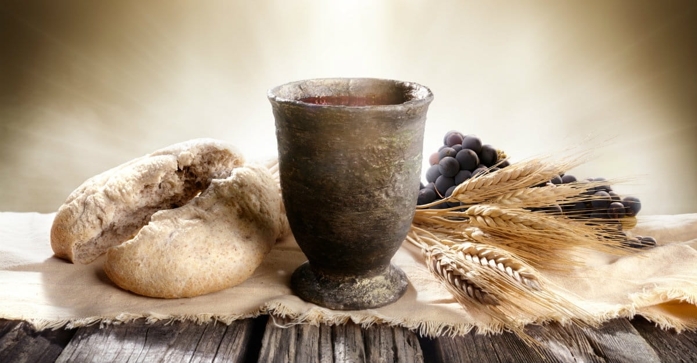
Communion

Slide 18
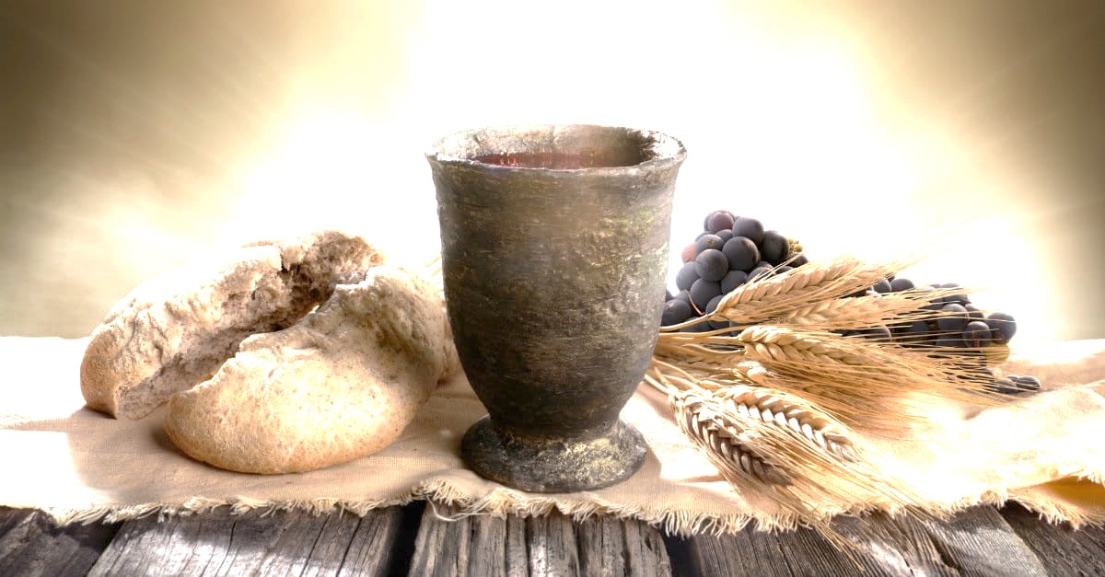
Do this in remembrance of Me

