Slide 2
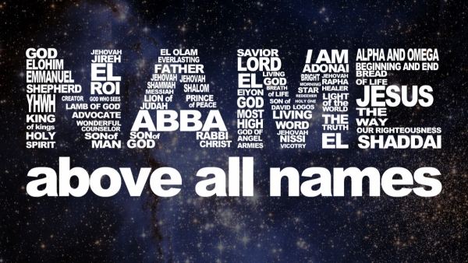
1 Peter 1:3
Blessed be the God and Father of our Lord Jesus Christ! According to his great mercy,
he has caused us to be born again to a living hope
through the resurrection of Jesus Christ from the dead.

Slide 3
Psalm 100 Make a joyful noise to the Lord, all the earth! ² Serve the Lord with gladness! Come into his presence with singing! ³ Know that the Lord, he is God! It is he who made us, and we are his, we are his people, and the sheep of his pasture. ⁴ Enter his gates with thanksgiving, and his courts with praise! Give thanks to him; bless his name. ⁵ For the Lord is good his steadfast love endures forever, and his faithfulness to all generations.

Slide 4
EL, ELOAH [el, el-oh-ah]: God "mighty, strong, prominent"
ELOHIM [el-oh-heem]: God “Creator, Mighty and Strong”
EL SHADDAI [el-shah-dahy] “God Almighty,” “The Mighty One of Jacob,” speaks to God’s ultimate power over all.
ADONIA [ˌædɒˈnaɪ; ah-daw-nahy]: “Lord” used in place of YHWH, which was thought by the Jews to be too sacred to be uttered by sinful men.

Slide 5
Psalm 95:1-7 Oh come, let us sing to the Lord; let us make a joyful noise to the rock of our salvation! ² Let us come into his presence with thanksgiving; let us make a joyful noise to him with songs of praise! ³ For the Lord is a great God, and a great King above all gods. ⁴ In his hand are the depths of the earth; the heights of the mountains are his also. ⁵ The sea is his, for he made it, and his hands formed the dry land. ⁶ Oh come, let us worship and bow down; let us kneel before the Lord, our Maker! ⁷ For he is our God, and we are the people of his pasture and the sheep of his hand.
Jesus spoke to them, saying:

Slide 6
YHWH / YAHWEH / JEHOVAH [yah-way / ji-hoh-veh]: “LORD” strictly speaking, the only proper name for God. Translated in English Bibles “LORD” (all capitals) to distinguish it from Adonai, “Lord.”
YAHWEH-JIREH [yah-way-ji-reh]: "The Lord Will Provide" the name memorialized by Abraham when God provided the ram to be sacrificed in place of Isaac.
YAHWEH-RAPHA [yah-way-raw-faw]: "The Lord Who Heals"
YAHWEH-NISSI [yah-way-nee-see]: "The Lord Our Banner"

Slide 7
Psalm 79:13
But we your people, the sheep of your pasture, will give thanks to you forever; from generation to generation we will recount your praise.
Psalm 16:11
You make known to me the path of life; in your presence there is fullness of joy; at your right hand are pleasures forevermore.

Slide 8
YAHWEH-M'KADDESH [yah-way-meh-kad-esh]: "The Lord Who Sanctifies, Makes Holy.
YAHWEH-SHALOM [yah-way-shah-lohm]: "The Lord Our Peace"
YAHWEH-ELOHIM [yah-way-el-oh-him]: "LORD God" a combination of God’s unique name YHWH and the generic “Lord,” signifying that He is the Lord of Lords.
YAHWEH-TSIDKENU [yah-way-tzid-kay-noo]: "The Lord Our Righteousness”

Slide 9
Psalm 96:1-4 Oh sing to the Lord a new song; sing to the Lord, all the earth!
² Sing to the Lord, bless his name; tell of his salvation from day to day.
³ Declare his glory among the nations, his marvelous works among all the peoples! ⁴ For great is the Lord, and greatly to be praised; he is to be feared above all gods.

Slide 10
YAHWEH-ROHI [yah-way-roh-hee]: "The Lord Our Shepherd"
YAHWEH-SHAMMAH [yah-way-sham-mahw]: "The Lord Is There”
YAHWEH-SABAOTH [yah-way-sah-bah-ohth]: "The Lord of Hosts" both of angels and of men. He is Lord of the host of heaven and of the inhabitants of the earth, of Jews and Gentiles, of rich and poor, master and slave. The name is expressive of the majesty, power, and authority of God and shows that He is able to accomplish what He determines to do.

Slide 11
Psalm 136:1-3
Give thanks to the Lord, for he is good, for his steadfast love endures forever. ² Give thanks to the God of gods, for his steadfast love endures forever. ³ Give thanks to the Lord of lords, for his steadfast love endures forever;

Slide 12
EL ELYON [el-el-yohn]: “Most High" derived from the Hebrew root for “go up” or “ascend,” so the implication is of that which is the very highest. El Elyon denotes exaltation and speaks of absolute right to lordship.
EL ROI [el-roh-ee]: "God of Seeing All"
EL-OLAM [el-oh-lahm]: "Everlasting God" God’s nature is without beginning or end, free from all constraints of time, and He contains within Himself the very cause of time itself. “From everlasting to everlasting.”
EL-GIBHOR [el-ghee-bohr]: “Mighty God” the name describing the Messiah, Christ Jesus.

Slide 13
Philippians 2:9-11 Therefore God has highly exalted him and bestowed on him the name that is above every name, ¹⁰ so that at the name of Jesus every knee should bow, in heaven and on earth and under the earth, ¹¹ and every tongue confess that Jesus Christ is Lord, to the glory of God the Father.

Slide 14
Isaiah 45:23-24
I have sworn by my own name; I have spoken the truth, and I will never go back on my word: Every knee will bend to me, and every tongue will declare allegiance to me.”
²⁴The people will declare, “The Lord is the source of all my righteousness and strength.” And all who were angry with him will come to him and be ashamed.

Slide 15
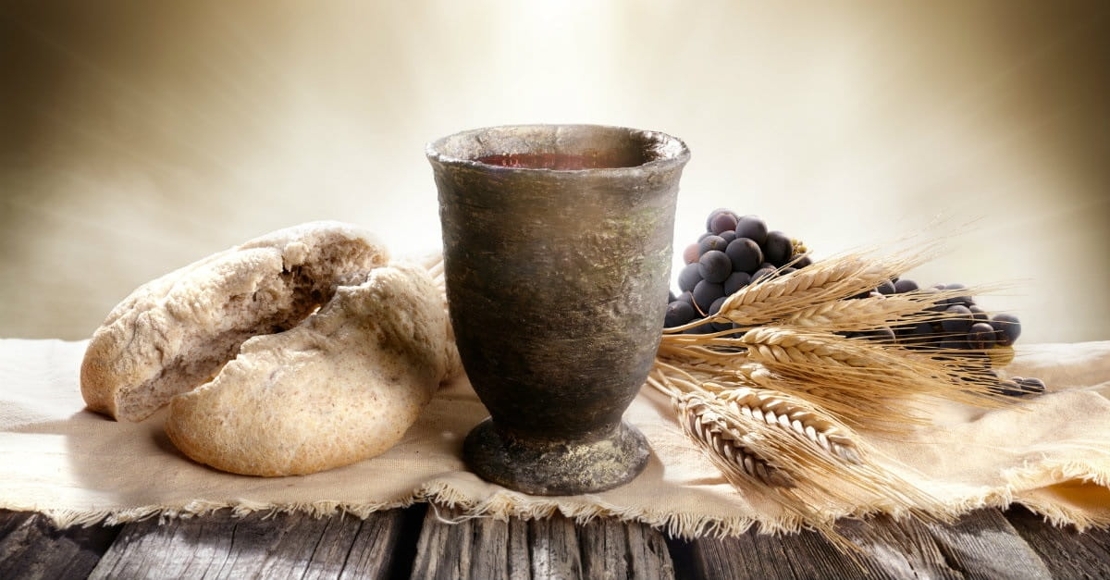
Communion

Slide 16
John 19:19-20
Pilate also wrote an inscription and put it on the cross. It read, “Jesus of Nazareth, the King of the Jews.”²⁰ Many of the Jews read this inscription, for the place where Jesus was crucified was near the city, and it was written in Aramaic, in Latin, and in Greek.

Slide 17
Colossians 2:13-14
And you, who were dead in your trespasses and the uncircumcision of your flesh, God made alive together with him, having forgiven us all our trespasses, ¹⁴ by canceling the record of debt that stood against us with its legal demands. This he set aside, nailing it to the cross.

Slide 18
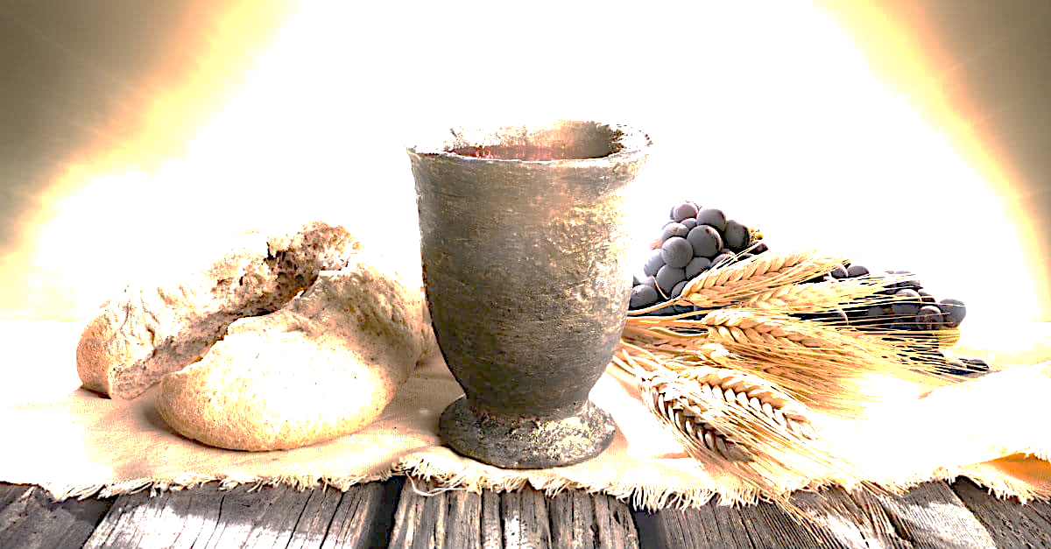
The Lord Jesus on the night when he was betrayed took bread, ²⁴ and when he had given thanks, he broke it, and said, “This is my body, which is for you. Do this in remembrance of me.” ²⁵ In the same way also he took the cup, after supper, saying, “This cup is the new covenant in my blood. Do this, as often as you drink it, in remembrance of me.” ²⁶ For as often as you eat this bread and drink the cup, you proclaim the Lord's death until he comes.
1Corinthians 11:23-26

Slide 19
Revelation 19:16
On his robe and on his thigh he has a name written, King of kings and Lord of lords.

