Slide 2
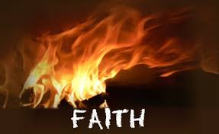
FIRE RESISTANT
1 Peter 1:3
Blessed be the God and Father of our Lord Jesus Christ! According to his great mercy,
he has caused us to be born again to a living hope
through the resurrection of Jesus Christ from the dead.

Slide 3
Revelation 21:7-8 The one who conquers will have this heritage, and I will be his God and he will be my son. ⁸ But as for the cowardly, the faithless, the detestable, as for murderers, the sexually immoral, sorcerers, idolaters, and all liars, their portion will be in the lake that burns with fire and sulfur, which is the second death.”

Slide 4
Psalm 78:13-16
He divided the sea and let them pass through it, and made the waters stand like a heap. ¹⁴ In the daytime he led them with a cloud, and all the night with a fiery light. ¹⁵ He split rocks in the wilderness and gave them drink abundantly as from the deep. ¹⁶ He made streams come out of the rock and caused waters to flow down like rivers.

Slide 5
Psalm 78:17-21
Yet they sinned still more against him, rebelling against the Most High in the desert.¹⁸ They tested God in their heart by demanding the food they craved.¹⁹ They spoke against God, saying, “Can God spread a table in the wilderness? ²⁰ He struck the rock so that water gushed out and streams overflowed. Can he also give bread or provide meat for his people?” ²¹ Therefore, when the Lord heard, he was full of wrath; a fire was kindled against Jacob; his anger rose against Israel.

Slide 6
Psalm 78:22
because they did not believe in God and did not trust his saving power.
Jesus spoke to them, saying:

Slide 7
Hebrews 4:2
For good news came to us just as to them, but the message they heard did not benefit them, because they were not united by faith with those who listened.

Slide 8
John 17:23
I in them and you in me, that they may become perfectly one, so that the world may know that you sent me and loved them even as you loved me.

Slide 9
Psalm 34:19
Many are the afflictions of the righteous, but the Lord delivers him out of them all.

Slide 10
Psalm 78:21
Therefore, when the Lord heard, he was full of wrath; a fire was kindled against Jacob; his anger rose against Israel.
Psalm 16:11
You make known to me the path of life; in your presence there is fullness of joy; at your right hand are pleasures forevermore.

Slide 11
Revelation 21:8
But as for the cowardly, the faithless, the detestable, as for murderers, the sexually immoral, sorcerers, idolaters, and all liars, their portion will be in the lake that burns with fire and sulfur, which is the second death.”

Slide 12
Malachi 3:6
For I the Lord do not change; therefore you,
O children of Jacob, are not consumed.

Slide 13
Mark 4:40
He said to them,
“Why are you so afraid? Have you still no faith?”

Slide 14
2 Corinthians 5:7
for we walk by faith, not by sight.

Slide 15
Hebrews 3:18-19
And to whom did he swear that they would not enter his rest, but to those who were disobedient? ¹⁹ So we see that they were unable to enter because of unbelief.

Slide 16
Hebrews 11:6
And without faith it is impossible to please him, for whoever would draw near to God must believe that he exists and that he rewards those who seek him.

Slide 17
Romans 14:23
But whoever has doubts is condemned if he eats, because the eating is not from faith. For whatever does not proceed from faith is sin.

Slide 18
1 Corinthians 6:9-10
Or do you not know that the unrighteous will not inherit the kingdom of God? Do not be deceived: neither the sexually immoral, nor idolaters, nor adulterers, nor men who practice homosexuality, ¹⁰ nor thieves, nor the greedy, nor drunkards, nor revilers, nor swindlers will inherit the kingdom of God.

Slide 19
Galatians 5:19-21
Now the works of the flesh are evident: sexual immorality, impurity, sensuality, ²⁰ idolatry, sorcery, enmity, strife, jealousy, fits of anger, rivalries, dissensions, divisions, ²¹ envy, drunkenness, orgies, and things like these. I warn you, as I warned you before, that those who do such things will not inherit the kingdom of God.

Slide 20
Titus 1:15-16
To the pure, all things are pure, but to the defiled and unbelieving, nothing is pure; but both their minds and their consciences are defiled. ¹⁶ They profess to know God, but they deny him by their works. They are detestable, disobedient, unfit for any good work.

Slide 21
Hebrews 10:39
But we are not of those who shrink back and are destroyed, but of those who have faith and preserve their souls.

Slide 22
Acts 16:31
And they said, “Believe in the Lord Jesus, and you will be saved, you and your household.”

Slide 23
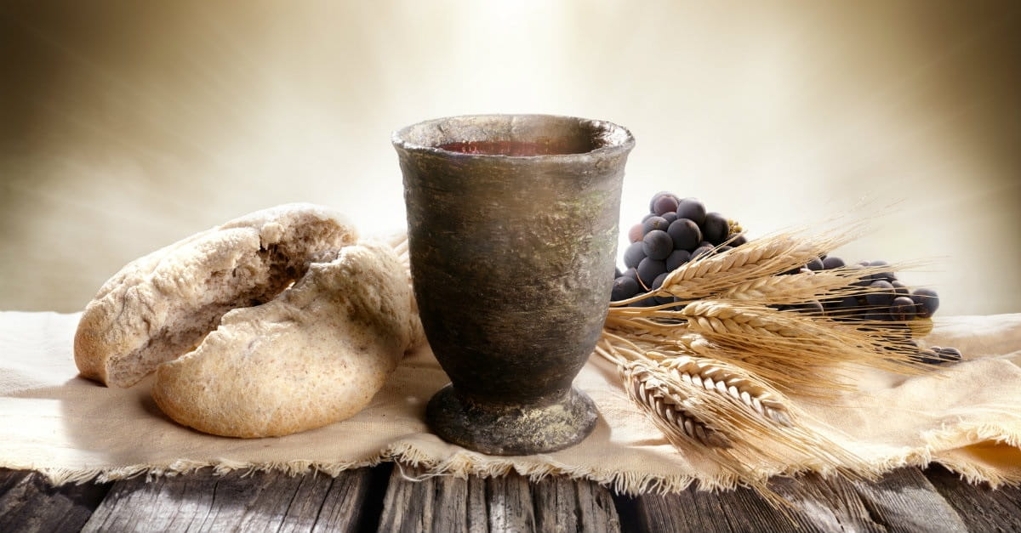
Communion

Slide 24
1 Corinthians 11:23-26 For I received from the Lord what I also delivered to you, that the Lord Jesus on the night when he was betrayed took bread,²⁴ and when he had given thanks, he broke it, and said, “This is my body, which is for you. Do this in remembrance of me.”
²⁵ In the same way also he took the cup, after supper, saying, “This cup is the new covenant in my blood. Do this, as often as you drink it, in remembrance of me.” ²⁶ For as often as you eat this bread and drink the cup, you proclaim the Lord's death until he comes.

Slide 25
Jeremiah 31:34 And no longer shall each one teach his neighbor and each his brother, saying, ‘Know the Lord,’ for they shall all know me, from the least of them to the greatest, declares the Lord. For I will forgive their iniquity, and I will remember their sin no more.”

Slide 26
Hebrews 9:28
so Christ, having been offered once to bear the sins of many, will appear a second time, not to deal with sin but to save those who are eagerly waiting for him.

Slide 27
Luke 18:8
I tell you, he will give justice to them speedily. Nevertheless, when the Son of Man comes, will he find faith on earth?”

